Slide 1
Lesson 44 Georgia Plays Basketball
WWW.PPT818.COM

Slide 2
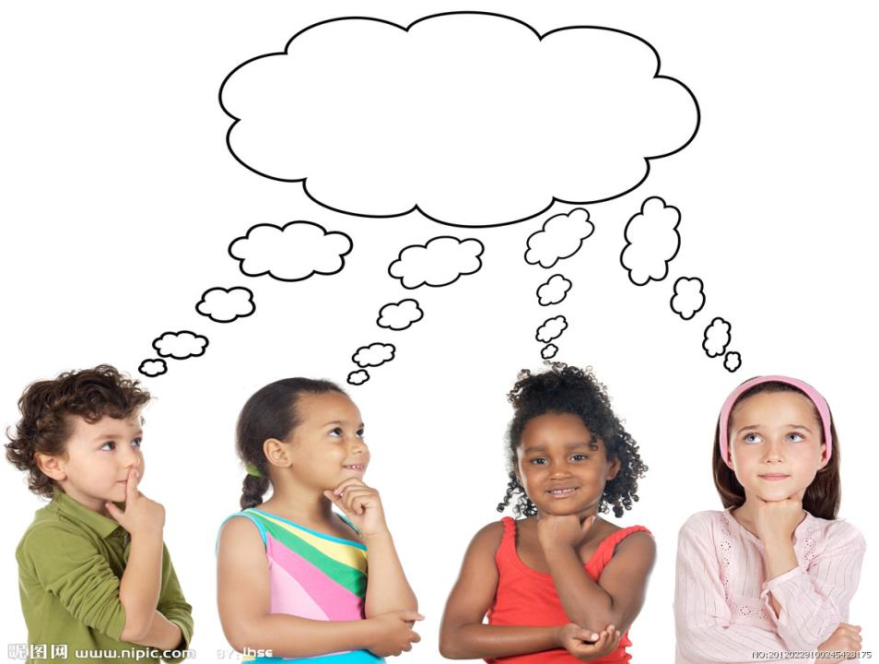
THINK ABOUT IT

Slide 3
Do you have basketball teams in your school?
What makes you unique in your class?

Slide 4
Hello everyone! My name is Georgia. I am
in Grade 8.
What makes me unique? Let’s see. My
family comes from Greece. I was born there.
Nobody else in my school comes from Greece!
That makes me unique.

Slide 5
I’ve been in Canada for seven and a half
years. My grandparents, aunts, uncles and
cousins still live in Greece. My sister is a basketball
player in Canada. But she sometimes returns to
Greece to play for the Greek National Basketball
Team.

Slide 6
Playing basketball is my main talent, too.
When I was in Grade 6, I played for the junior
high basketball team. I was the youngest player.
We did very well last year. We lost only two
games.
Once, we played against a team from
another city. The game was almost over, and the
score was fifty-one to fifty –one.

Slide 7
A player on my team passed me the ball. I
was too far from the basket. Could I put the ball
into the basket? I tried and the ball went in!
The final score was fifty-four to fifty-one. We
won! We felt proud of ourselves.

Slide 8
My dream is to play basketball in the
Olympics. I'd like to go to university, too. My
parents want me to study medicine, but I want to
continue taking P.E. What sport would I study?
Basketball, of course!

Slide 9
Read the lesson and complete the passage. The
first letter is given.
Georgia is a student in Grade 8. She is unique in
her school because she was b__________in Greece.
N___________else in her class in from Greece.
Georgia has a big family. Her grandparents,
aunts, uncles and cousins are living in Greece.
orn
obody

Slide 10
Her sister is a basketball player in Canada. But
she sometimes r ___________to Greece to play
for the Greek National Basketball Team.
Georgia is good at basketball, too. Her parents
want her to study m ___________, but she
wants to c ____________taking P.E. Her dream
is to be a basketball player.
eturns
edicine
ontinue

Slide 11
1. Nobody else in my school comes from Greece!
我们学校没有其他人来自希腊了。
nobody else = no other people. 没有其他人
Nobody else knows the secret.
没有别人知道这个秘密了。
else 表示“另外，其他”，常放在不定代词，
疑问代词或疑问副词之后

Slide 12
Did you see anybody else?
你见到其他人了吗？
Ask somebody else to help you.
请别人帮帮你吧。
Do you have anything else to do ?
你还有别的事要做吗？
Who else wants to sing the English song?
还有谁想唱这首英文歌吗？
不定代词 + else
不定代词 + else
不定代词 + else
疑问代词 + else

Slide 13
2. I’ve been in Canada for seven and a half years.
我在加拿大待了七年半了。
类似说法：
one and a half years 一年半
a year and a half 一年半
two and a half hours 两个半小时
two hours and a half 两个半小时

Slide 14
作不及物动词
回；返回
3.
return
作及物动词
归还；放回；送回
He has returned to Paris from London.
他已经从伦敦回到巴黎。
She returned home to get her umbrella.
她回家取雨伞。
She returned the bird to its cage.
她把鸟放回笼子里。
不及物动词
不及物动词
及物动词

Slide 15
Please return me my five dollars/return my five
dollars to me.
请把我的5美元还给我。
及物动词
及物动词
注意：
1. return （归还）= give back
return （返回，回来）= come/get back
2. return 后边不能加back

Slide 16
4. Once, we played against a team from another
city.
有一次，我们和来自另一个城市的队伍比赛。
此处是副词，曾经；一度
play against和……比赛
She was once my teacher. 她曾经是我的老师。
At the end of the season the two top teams play
against each other.
赛季末，有两个最强队之间进行比赛。
Which team did they play against this time?
这次他们的对手是谁？

Slide 17
Your school team will play against us this
afternoon.
你们校队今天下午和我们比赛。
play for
为……比赛，为……效力
My brother plays for the national football team.
我弟弟为国家足球队效力。

Slide 18
5.
⑴ almost作副词，相当于nearly, 表示“几乎，
差不多”
It’s almost time to go . 差不多是该走的时候了。
Dinner is almost ready. 饭差不多好啦！
⑵ be over意思是 “结束；完结”。
Their relationship is over.
他们的关系已经结束了。
By the time we arrived, the meeting was over.
我们到达时，会议已结束了。

Slide 19
⑶ score 作名词，表示“（比赛中）得分，分数”
The final score was 4 to 3.
最后的比分是4比3。
score 还可以作动词，表示“得分”。
She scored 120 in the IQ test.
她在智商测试中得了120分。

Slide 20
6.
go to university/college 上大学
不表示具体的大学，前面不用冠词。
I work hard in school and I hope to go to college
someday.
我在学校很努力，我希望有一天去上大学。

Slide 21
go to school 上学
go to prison 坐牢
go to hospital 去医院看病
leave school 放学；辍学；毕业
be in hospital 住院
不表示具体的大学，前面不用冠词。但当这些名词表示具体的事物时，前面要加冠词。
I went to the hospital to see a friend this morning.
今天上午我去医院看了一个朋友。

Slide 22
7.
+ to do sth.
强调继续做另一件事情
（已经完成一件工作）
continue 动词
继续，持续
+ doing sth.
强调继续做同一件事（还没完成）

Slide 23
After a rest, he continues his reading.
稍事休息后，他继续看书。
After he finished reading a novel, he continued
to play games with his friends.
他读完小说后跟朋友们继续玩游戏。
刚才就在看书，现在继续看书，只干了一件事情
刚才在读小说，然后去玩游戏干了两件事情

Slide 24
Listen to the passage and tick the correct answers.
Name | Where’s he/she from? | What’s his/her father’s job?
Tom
Natalie
Hong Lei
√
√
The U.S.
A teacher.
Canada.
A doctor.
√
Russia.
A businessman.
India.
√
A police officer.
√
China.
A tailor.
Singapore.
√
A bank clerk.

Slide 25
Name | What’s his/her mother’s job? | What’s his/her dream job?
Tom
Natalie
Hong Lei
√
A teacher
A teacher
√
A doctor
A doctor
A writer.
A writer.
√
√
A doctor.
A shop assistant.
√
√
A bank clerk.
A basketball player.
A writer.
A teacher.

Slide 26
Fill in the blanks with the correct forms of the given words.
Last year he ____________(return) to China to
play for the Chinese team.
2. Once, she _____________(win) a game for her
city. She was very proud of herself.
returned
won

Slide 27
3. Her dream is ______________(play) ping- pong
in the Olympics.
4. Jack wants to _______________(continue)
studying Chinese when he returns to Canada.
to play/playing
continue

Slide 28
Work in groups. What makes you unique? Think
about the other members and share your ideas.
Example:
I think Da Zhi is special. He can play the guitar
very well. Lin Tao always helps others. She is
really kind. She is unique.

Slide 29
Bye-bye

