Slide 1
Unit 7 What’s the highest mountain in the world?
Section A 1a — 2d
WWW.PPT818.COM

Slide 2
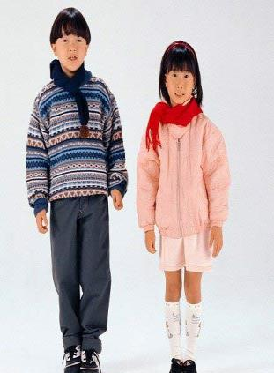
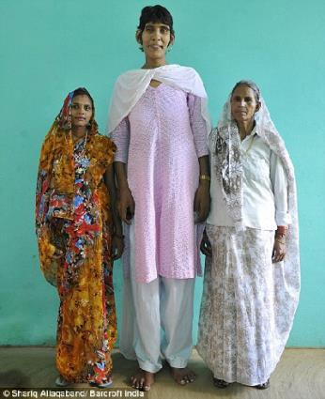
Who is taller than others?
taller
the tallest

Slide 3
1. 一般情况:+er(比较级)+est(最高级)
quiet—quieter—the quietest bright—brighter—the brightest
2. 词末为-e（不发音）+ r —+st
fine—finer—the finest nice—nicer—the nicest
3.重读闭音节，末尾只有一个辅音字母的：双写辅音字母+er—双写辅音字母+est
hot—hotter—the hottest wet—wetter—the wettest
4.三个或三个以上音节的形容词只能加more和most
5.. 特殊变化
good—better—best many/much—more—the most
比较级主要运用与两者比较，最高级运用于三者包括三者以上的比较。
A …+er…than …B ,
A …+est…of the three, A …+est… than others

Slide 4
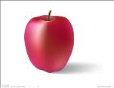
one two three four five six seven eight nine ten
eleven twelve thirteen fourteen fifteen sixteen，seventeen eighteen nineteen

Slide 5
Can you read them?
8,448 5,654 4,321 9,543
23,345 34,666 43,233 67,321

Slide 6
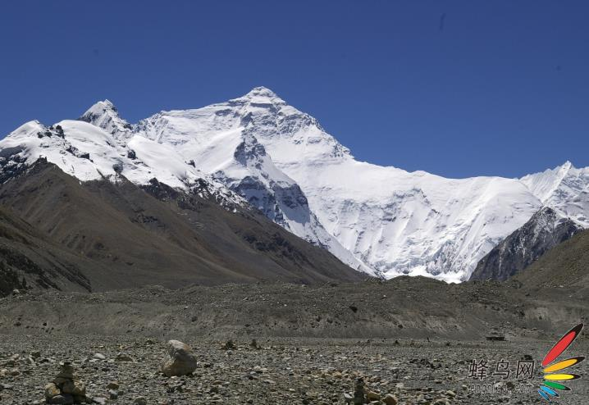
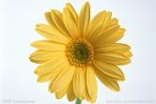
Qomolangma.
It’s 8,844.43 meters high!

Slide 7
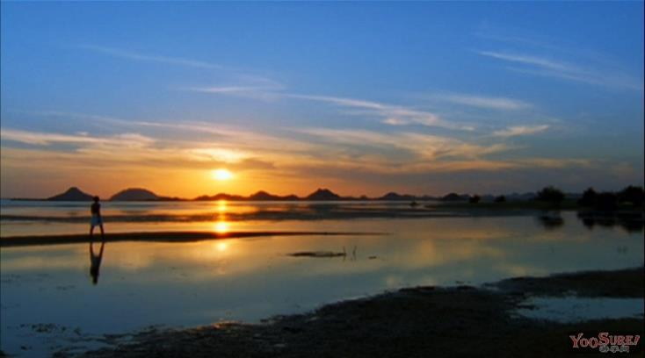
The Nile
It’s 6,671 kilometers long.

Slide 8
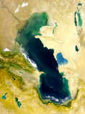
Caspian Sea
It’s 1,025 meters deep.

Slide 9
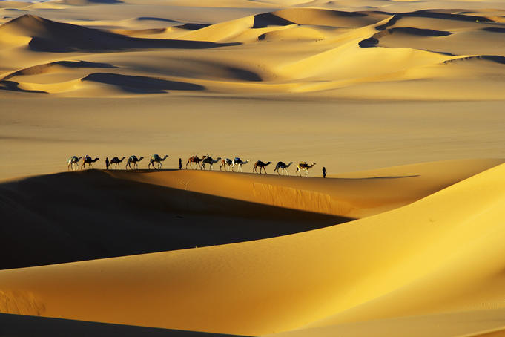
The Sahara
It’s 9,600,000 square kilometers in size.

Slide 10
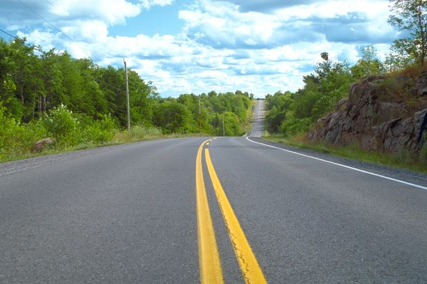
2,300 meters

Slide 11
square kilometer=km² square meter=m²
度量单位使用规律
（1）数词+meters/kilometers+high/deep/long/wide
（2）XX 平方米= XX square meter
How+high/deep/long/wide… +be+主语？

Slide 12
1a
Match the facts you know .
Qomolangma | About 9,600,000 square kilometers in size
The Sahara | 1,025 meters deep
The Caspian Sea | 6,671 kilometers long
The Nile | 8,844.43 meters high

Slide 13
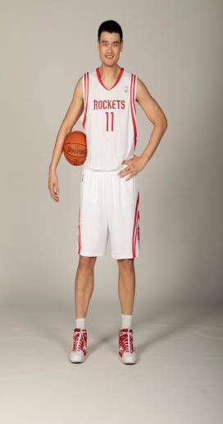
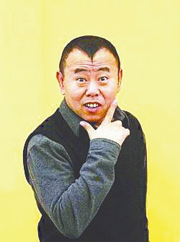
Yao is much taller than Pan.
a bit, a little, much, many, a lot, lots, any, even + 比较级

Slide 14
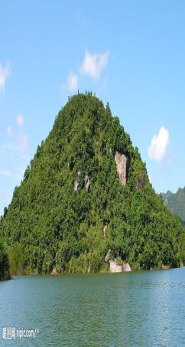
A is as high as mountain B
A is as high as mountain B.

Slide 15
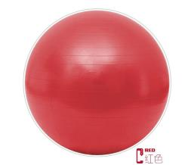
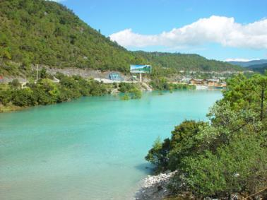
This ball is as big as that one.
This river is …

Slide 16
Quick check
(1) My brother is _____ more outgoing than me.
A. many B. little C. much
(2)The experiment was____ easier than we had expected.
A. more B. much more C. much (3)If there were no examinations, we should have ___ at school.
A. the happiest time B. a more happier time C. a much happier time
(4 )Traveling by train is excited than a rushed trip by air.
A. much B. a little C. far more
(5 )这部电影和那部电影一样有趣。（as…as）
(6 ) 这件红大衣和那件蓝色大衣一样长。(as…as)
（答案：C, C, C,C This film is as interesting as that one. The red coat is as long as the blue one.)

Slide 17
language points
1.feel free to do sth.
是指你想做什么就做什么,别介意我的看法,有“放松点,别紧张”的意思.
Feel free to ask me anything about this book. 关于这本书有什么问题尽管问，放松点。
2.the main reason was to protect China.
主要的原因是为了保护中国。
protect 表“保护”的意思。To protect China 是不定式表目的，做目的状语。为了保护中国。
3.as you can see 正如你所见
As you can see, every one is studying hard. 正如你所见，每个人都在努力学习。
4.as far as I know 据我所知。
as far as
用于本义，意为“与……一样远”“一直到……”。
We walked as far as the river. 我们一直走到河边。
用于引申义，意为“就……而言”“从……来看”“尽……所能”“只要”。
As far as I know, that is highly unlikely. 就我所知，那是极不可能的。
5.man-made作形容词用，就是“人造的”（非自然的）意思。
man-made flowers 人造花

Slide 18
A report
Place | Facts | Country | Feeling
The Yangtze River | 6，300 kilometers long | China | Much longer than the river in my hometown.
…

Slide 19
Summary
What’s the highest mountain in the world?
How high is it? | It’s .
China is than the US.
China is the oldest countries in the world. China is almost as the US.

Slide 20
Homework
1.Write a passage about your report.
2.Make a survey about other places around the world. Introduce the places.

