Slide 1
There is a park near my home.
WWW.PPT818.COM

Slide 2
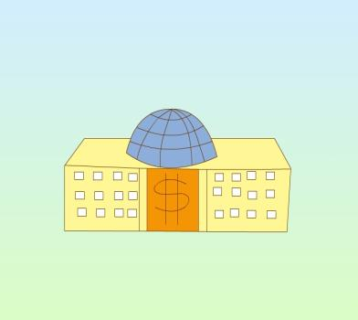
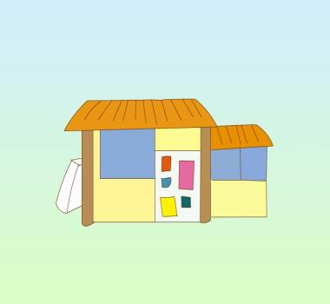
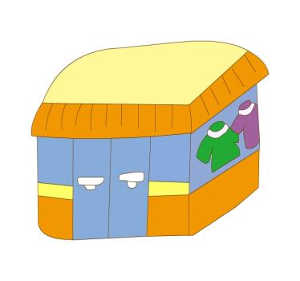
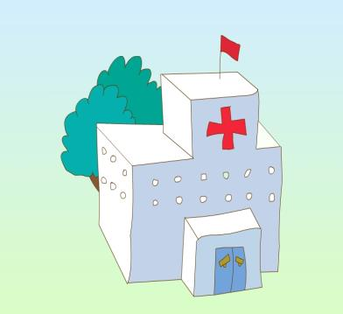
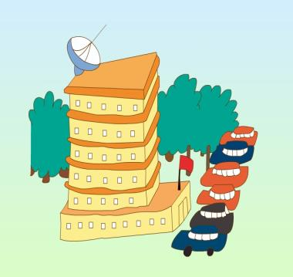
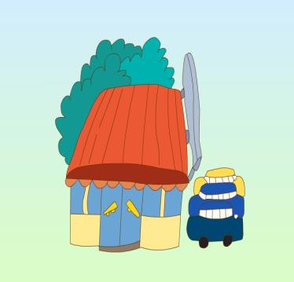
(bank)
(bookshop)
(clothes shop)
(hospital)
(hotel)
(supermarket)

Slide 3
Just write
1. 河流
2. 在...附近
3. 在...旁边
4. 在...中间
5.健康的食品
6.蔬菜
（river）
（near）
（beside）
（between）
（healthy food）
（vegetable）

Slide 4
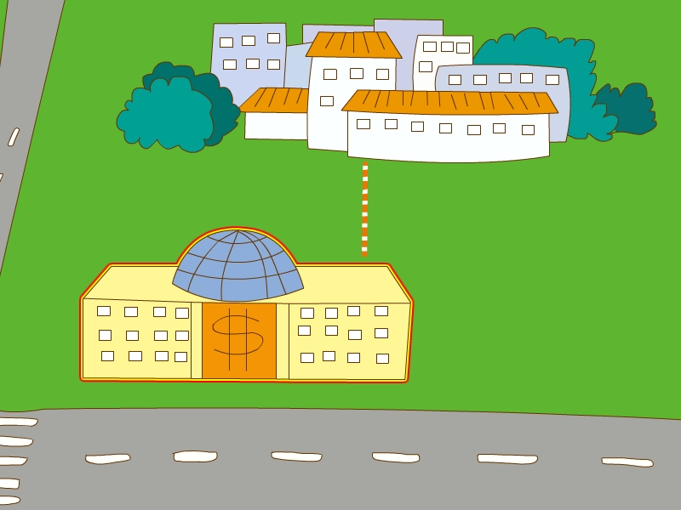
bank /in front of
My home
Bank

Slide 5
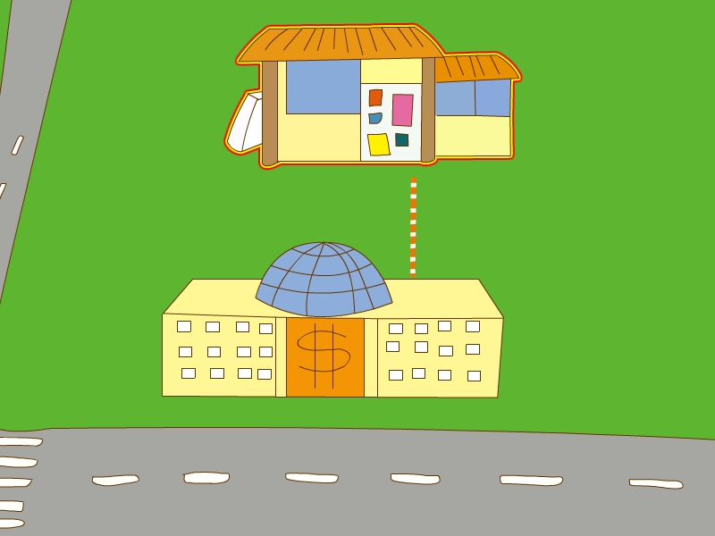
bookshop/behind
Bookshop
Bank

Slide 6
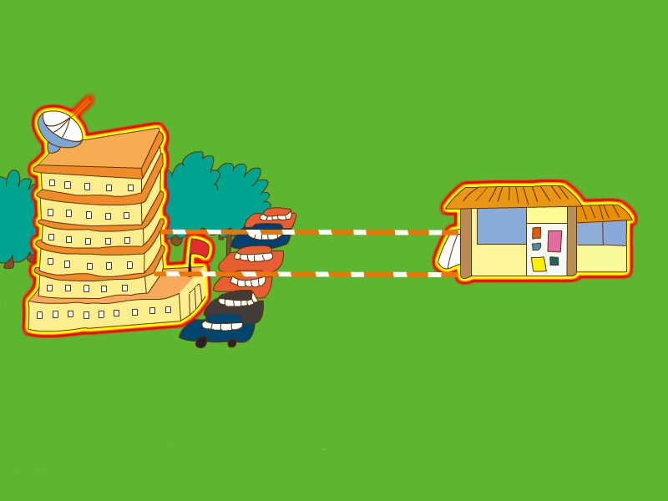
hotel/beside
hotel
Bookshop

Slide 7
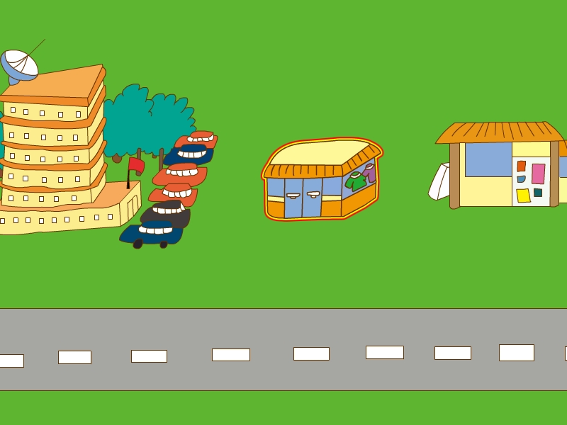
clothes shop/between
Hotel
Book shop
clothes shop

Slide 8
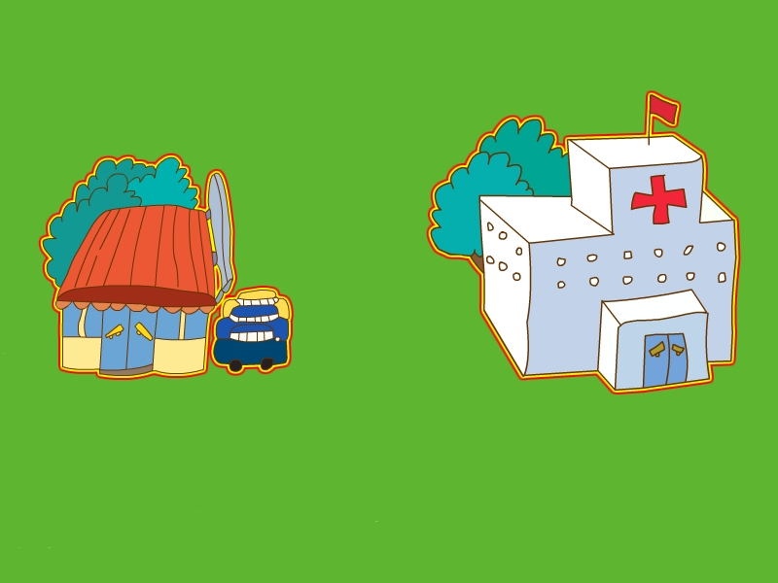
hospital/near
Supermarket
Hospital

Slide 9
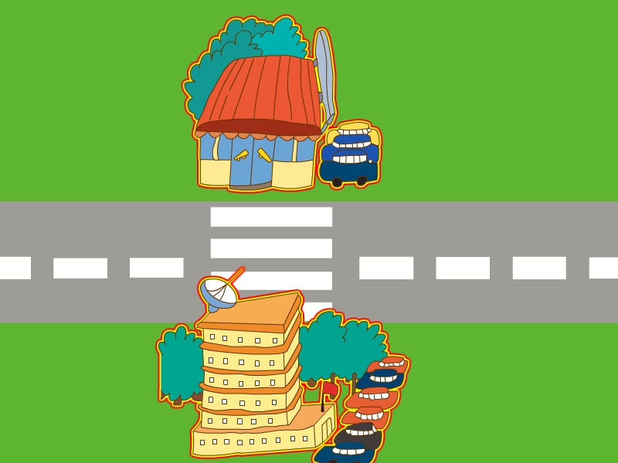
supermarket/across the road
Supermarket
Hotel

Slide 10
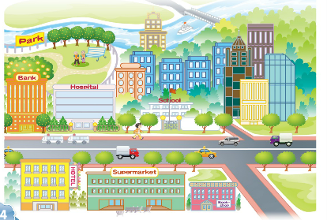
Sunsan's Community

Slide 11
Read the text
and answer the questions.
1.Whose community is this?
2.Are there many tall buildings in her community?
3.Does Susan live in one of the buildings?
4.Is there a park near Susan's home?
5.What is there behind the park?

Slide 12
6.What are there in the park?
7.Where is the bank?
8.Where is the hospital?
9.Where is the supermarket?
10.What's in the centre of the community?
11.How's Susan's community?

Slide 13
1.Whose community is this?
It's Susan's.
2.Are there many tall buildings in her community?
Yes, there are.
3.Does Susan live in one of the buildings?
Yes, she does.
4.Is there a park near Susan's home?
Yes, there is.
5.What is there behind the park?
There is a river behind the park.

Slide 14

6.What are there in the park?
There are a lot of trees and flowers in the park.
7.Where is the bank?
On the main street.
8.Where is the hospital?
Beside the bank is a hospital.
9.Where is the supermarket?
Across the road, there is a big supermarket between a hotel and bookshop.
10.What's in the centre of the community?
There is a school.
11.How's Susan's community?
It's a busy, clean and nice place!

Slide 15
小组合作 work in groups
Learn the text.

Slide 16

小组展示 Let's show!

Slide 17
A.Read and choose.
1.There is a park near my home.
2.There is a bank in front of home.
3. I live in one of the buildings.
4. There are a lot of trees and flowers in the park.
5. Beside the bank is a hospital.
A.我住在其中的一栋楼里。
B.银行旁边是医院。
C.我家附近有个公园。
D.公园里有许多树和花。
E.我家前面有个银行。
(C)
(E)
(A)
(D)
(B)

Slide 18
B. Think and fill in the blanks.
across from of on behind
1. Look at this picture （ ）my community.
2. There is a river（ ）the park.
3. （ ）the street, there is a big supermarket.
4. My family often buy healthy food （ ） that shop.
5. I can see everything（ ）my way to school.
of
behind
Across
from
on

Slide 19
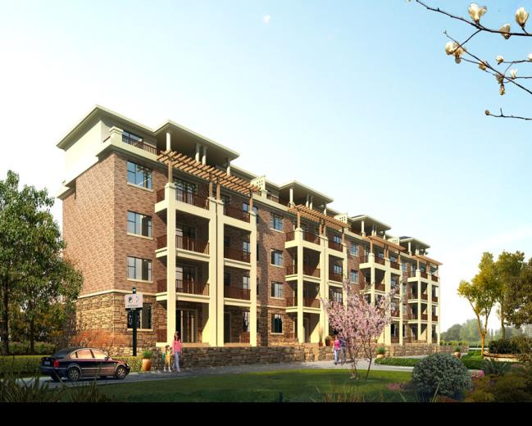
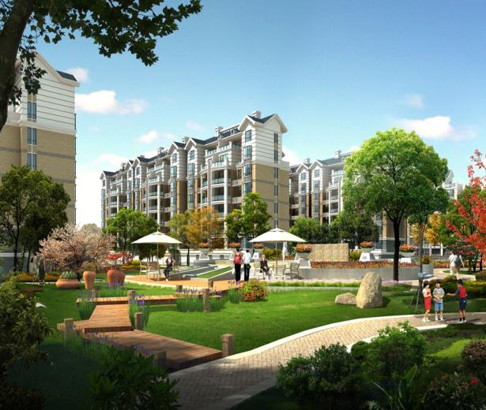
设计自己理想中的小区，并用所学语言进行描述。

