Slide 1
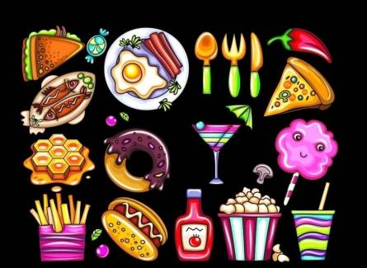
Food and drinks
第二课时
WWW.PPT818.COM

Slide 2
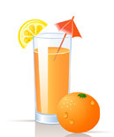
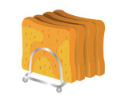
Say and spell
juice
milk
egg
water
bread
biscuit

Slide 3
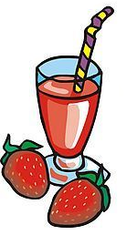
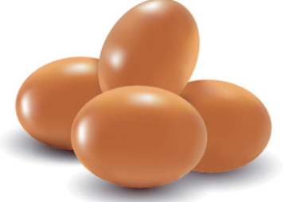
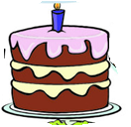
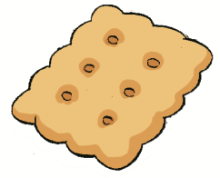
Ask and answer
What do you have?

Slide 4
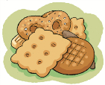
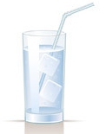
Ask and answer

Slide 5
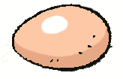
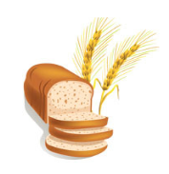
Look and write
What ________ you ______?
I have some ________, and ______________.
What _____________?
I have _____________, ______________ and ______________.

Slide 6
Think and choose
The teacher and children are in the ________.
A. park B. classroom.
2. They are having a ________.
A. lesson B. picnic
3. They have some food, drinks and ________.
A. toys B. fruit

Slide 7
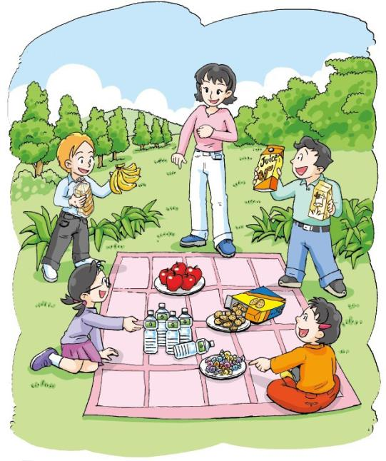
What do they have?

Slide 8
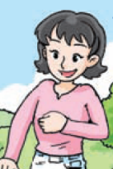
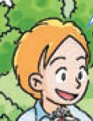
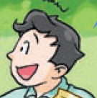
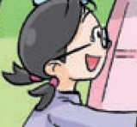
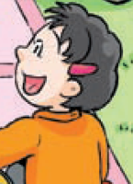
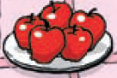
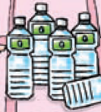
Think and match

Slide 9
I have some apples and biscuits.
What do you have, children?
I have some bread and bananas.
I have some orange juice and milk.
We have some water and candy.

Slide 10
Act it out

Slide 11
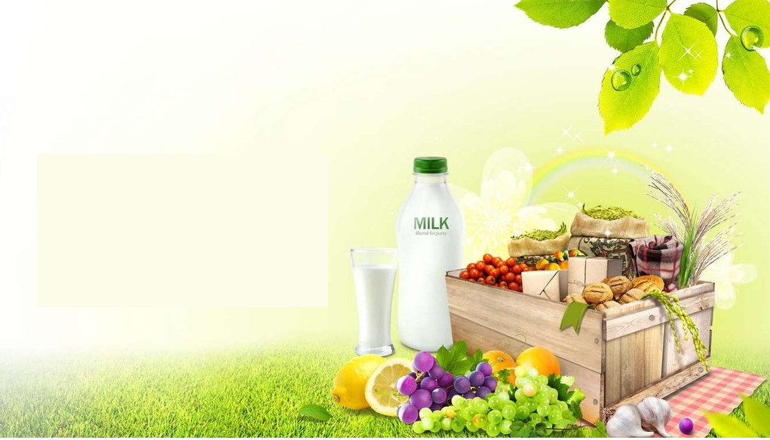
Make a dialogue
Picnic
Food
Drinks
Fruit
Toys

Slide 12
Think and talk
Picnic
Food
Drinks
Fruit
Toys
What do you like ?

Slide 13
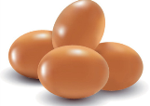
Think and choose
I like …
Food

Slide 14
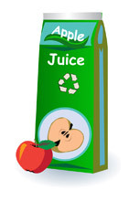
Think and choose
I like …
Drinks

Slide 15
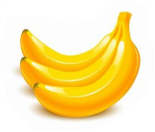
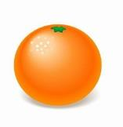
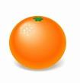
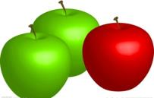
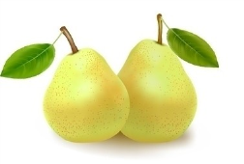
Think and choose
I like …
Fruit

Slide 16
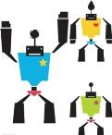
Think and choose
I like …
Toys

Slide 17
Look and say
Picnic
What do you have for the picnic?
Food
Drinks
Fruit
Toys
Let’s have a picnic.

Slide 18
Think and say
Picnic
What do you have for the picnic?
Food
Drinks
Fruit
Toys
Let’s have a picnic.

Slide 19
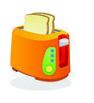
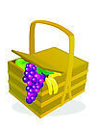
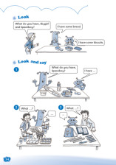
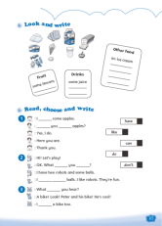
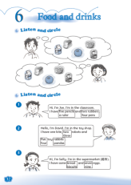
Homework
1 Read and act Listen and say.
2 Write about your picnic. Use three or more sentences.
3 Complete Workbook pages 32, 34 and 35.

