Slide 1
Unit 3 We are going to travel.
人教精通版六年级下册
WWW.PPT818.COM

Slide 2
>>Warm-up
Hangzhou is in Zhejiang Province in the east of China.
The most famous place there is the West Lake.
Beijing is the capital of China.
There are many interesting places to visit.
Harbin is in the north of China.
It is in Heilongjiang Province.
Xi’an is in Shaanxi Province.
It is famous for the terracotta army.
Sanya is in the south of China.
It is in Hainan Province.

Slide 3
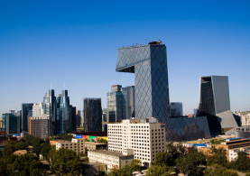
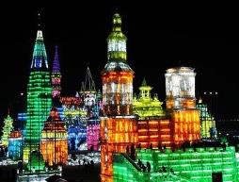
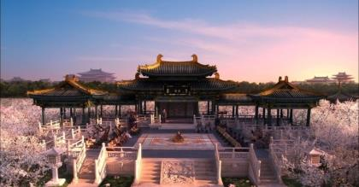
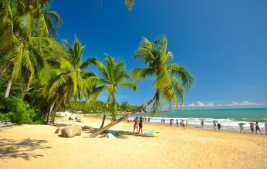
>>Lead-in
Where are you going to travel/visit?
Talk about your travel plan.

Slide 4
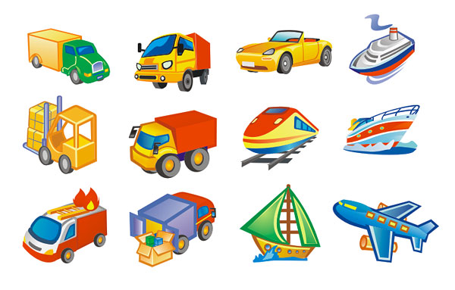
>>Presentation
How are you going there?
Are you going there by plane/train/car…?

Slide 5
>>Practice
Just practise

Slide 6
>>Presentation
We’re going to Hangzhou by plane.
We’re going to Xi’an by train.
We’re going to Wuhan by ship.
We’re going to … by ...
地点
交通工具

Slide 7
>>Practice
We’re going to Shanghai by plane. What about you?
Pair Work
We’re going to…

Slide 8
>>Practice
Just write
travel
know
旅行
知道
hear
lake
听见
湖泊
We’re going to Hangzhou by plane.
地点
交通工具

Slide 9
>>Presentation
Let’s plan a trip
What do you think about Shanghai?
I want to visit Wuhan.
I want to visit Shanghai.
It’s a big city.

Slide 10
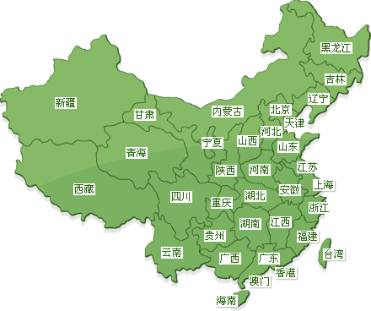
>>Practice
Look at the map, find an interesting place to visit
and tell your reasons.

Slide 11
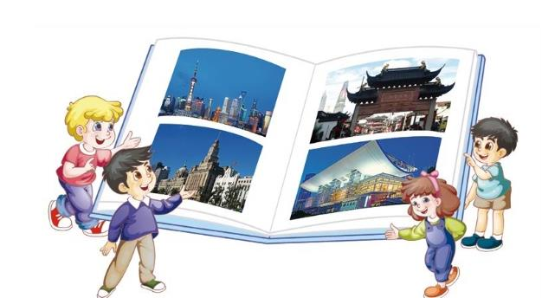
>>Practice
Group Work
We’re going to visit Shanghai.
Talk about your trip.

Slide 12
>>Presentation
Let’s chant

Slide 13
>>Summary
四会单词：
travel
know
hear
lake
如何表达“我们打算乘飞机去杭州”？
We are going to Hangzhou by plane.

Slide 14
>>Homework
1. 观看课文动画，按照正确的语音、语调朗读课文。
2 . 熟读Let’s chant说唱部分。
3 . 预习Lesson15。
close

