Slide 1
Unit 7
Protect the Earth
第二课时
WWW.PPT818.COM

Slide 2
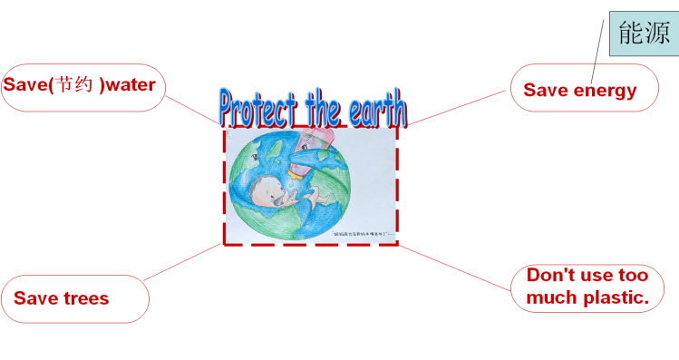
Introduce
I can use ___ to ____.
We should _______.
We should not _______.

Slide 3
Words
use… to…
“use + 名词 + to + 动词原形”意思是用某物做某种东西。
to后接动词原形。
常用短语： protect the earth 保护地球
eg： She always uses too much water to clean things.
她总是用太多的水来清洗东西。
小练习： In the past, we often ____(use) wood to make fire..
used

Slide 4
Words
Use··· to···扩展
(1)used to表示过去常常做某事。
eg： I used to play football after school。
过去我常常在放学后踢球。
(2)be used to + doing： “习惯于···”,to是介词,后需加名词或动名词。
eg： Sarah is used to taking a walk。
Sarah习惯于散步了。

Slide 5
Words
should
/ʃʊd/
Should “应该” ,后接动词原形,是较委婉地建议某人做某事。
当表示较委婉的拒绝某人做某事时：用其否定形式“shouldn’t+ 动词原形”。
eg ： We should finish our homework every day.
我们每天都应该完成家庭作业。
小练习： （ ）Water is useful, we _____ reuse and save it.
A. should B. shouldn’t C. will
A

Slide 6
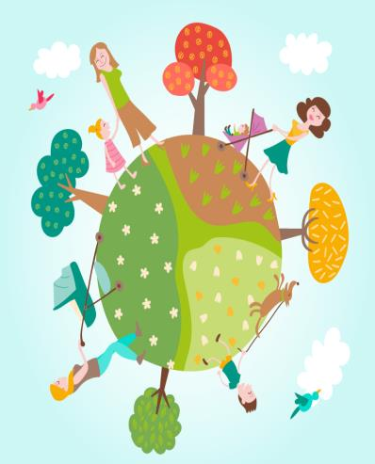
Dialogues
Group work：Write more sentences with learned sentences and report in class .

Slide 7
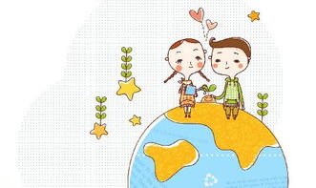
Expand
can作情态动词用法
(1)(表示能力)能···;会···
eg：She can drive，but she can’t ride a bicycle.
他能开车,但是不会骑自行车。
(2)(表示可能、许可)能够···;可以···
eg： You can’t park your car in this street.
你不可以在这条街上停车。

Slide 8
Expand
could/be able to 区别
could表示“原来具备某种能力,现在没有这种能力了”。
但was/were able to则表示过去成功地做成了某事。
eg： I could swim all the way across the lake，but I can’t now. 我原来能游过这个湖,但现在不能了。
The fire spread through the hotel very quickly but everyone was able to get out. 大火很快蔓延了整个旅馆,但全体人员都脱离了危险。

Slide 9
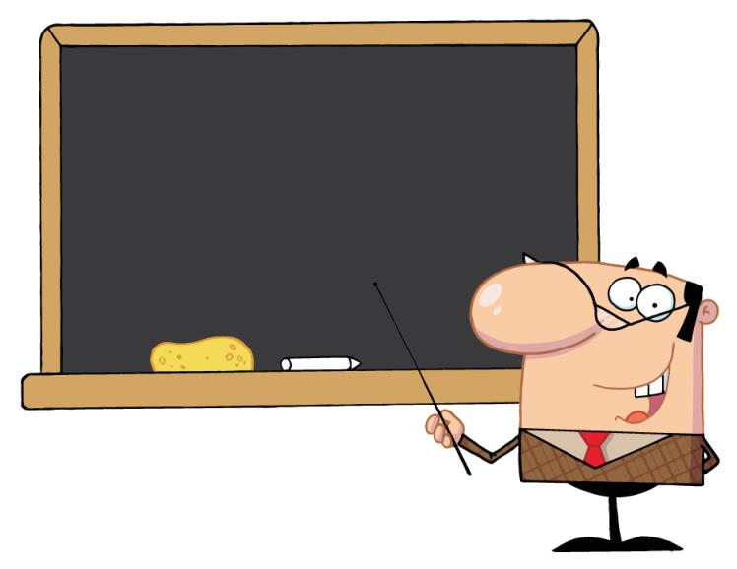
Summary
Use··· to···
should

Slide 10
Exercise
( )1.The oil is .
A. use B. reuse C. useful
( )2.To keep the air clean, don’t to work every day.
A. walk B. run C. drive
C
C

Slide 11
Exercise
( )3.We often use to clean things.
A. coal B. oil C. water
( )4.There some paper on the desk.
A. has B. is C. are
C
B

Slide 12
Exercise
( )5.People cut down trees every day.
A. lot of B. many C. much
( )6.We can use paper a toy plane.
A. make B. making C. to make
B
C

Slide 13
Exercise
( )7.There are plastic bags on the ground.
A. too much B. too many C. so much
( )8.To protect the Earth ,we should use______.
A. plastic bags B. plastic bottle C. glass bottle
B
C

Slide 14
Homework
Collect more examples of environmental damage, write a small report， report showing in the class.

