Slide 1
陕旅版小学英语三年级下册
Unit5 Do You Like Candies?
第3课时
WWW.PPT818.COM

Slide 2
教学目标
运用“四会”词cake, tea, banana, grapes, bread, candy, cookie造句，
并用所学单词和句型进行对话。
二. 学习 What do you like?句型及其回答。

Slide 3
我问你答
Do you like …?
Yes, I do.\ No, I don’t.
Does the monkey like …?
Yes, it does.\No, it doesn’t.

Slide 4
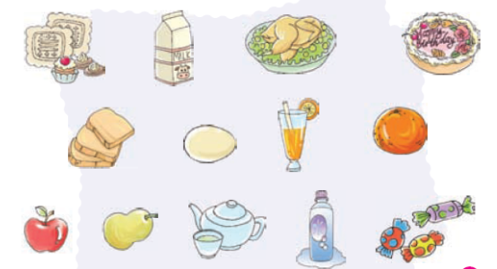
What do you like？
I like … very much. They are nice.

Slide 5
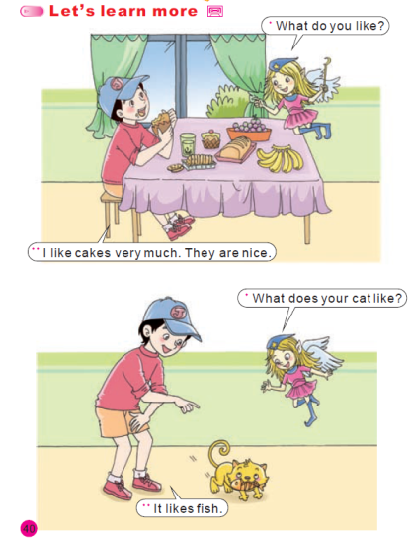
Part B，听录音，跟读Unit5PartBLetslearnmore课文录音.mp3

Slide 6
演一演
小组内分角色读对话,并上台表演对话。

Slide 7
随堂练
1.单词拼写并说出汉语意思
c _ k _
t_ _
b _n_n
c_ndy
do_s
c_ _kie
gr_p_s
br_ _d
li_e
wh_t

Slide 8
2.挑战自我 ——将听到的句子写出来，并翻译。
Do you like candies?
Yes, I do.
What do you like?
I like cookies very much. They are nice.

