Slide 1
Changes in our lives
第二课时
WWW.PPT818.COM

Slide 2
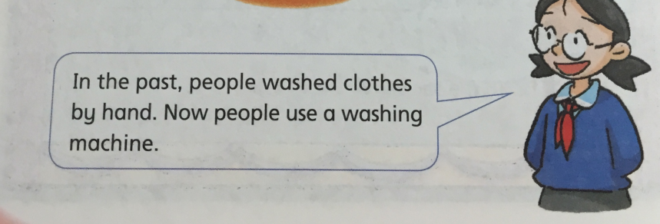
Review
Show time!

Slide 3
Warm up

Slide 4
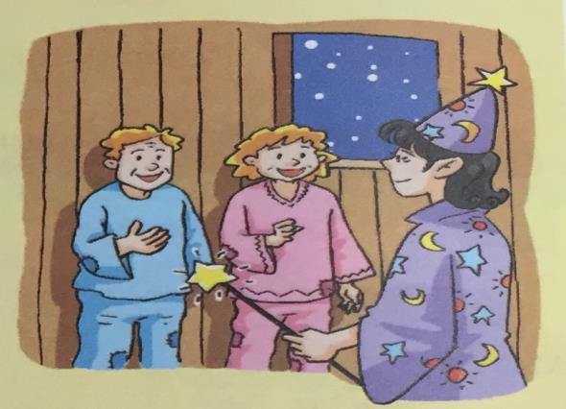
Presentation
How did the old man and woman feel?
What happened?

Slide 5
Listen and judge
1.Doris lived in a big, new house.
2.The farmers need some wishes.
3.The fairy wanted to give them some gold.
4.The farmers were poor, but they were very happy.
×
( )
×
( )
( )
√
( )
√

Slide 6
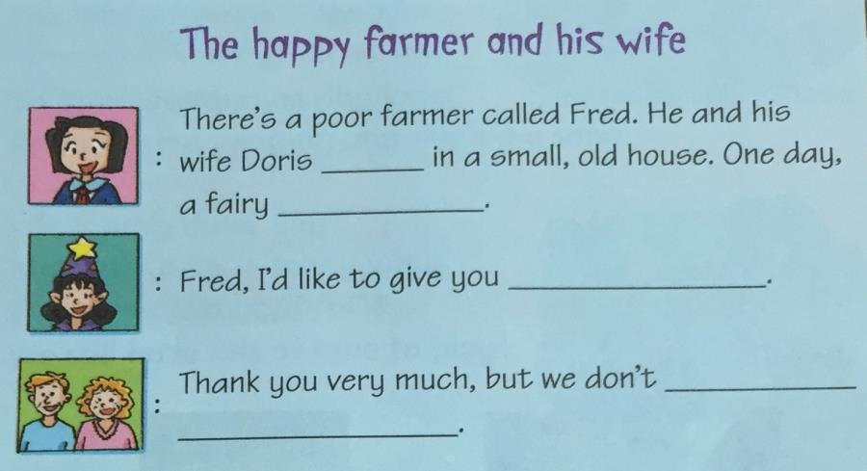
Read and answer
lived
visited them
three wishes
need
any wishes

Slide 7
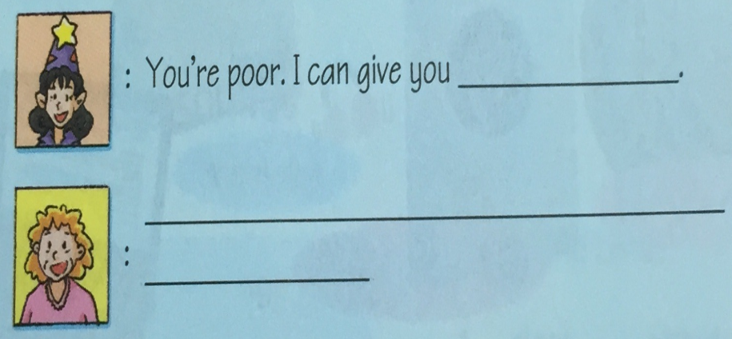
Read and write
some gold
Thank you. We’re poor, but
we’re happy.

Slide 8
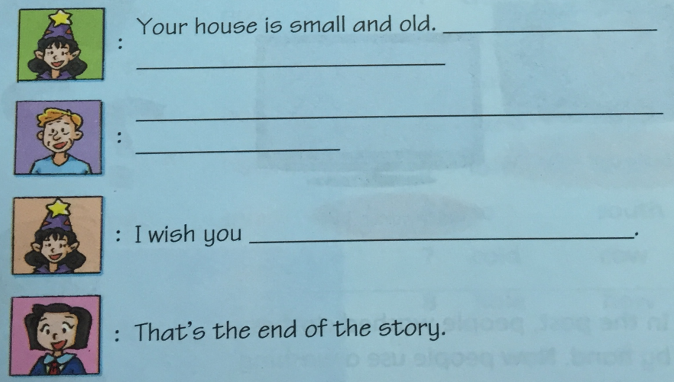
Read and write
I can give you a
big, new house
Thank you. Our house is small and old, but
it’s warm and nice.
a happy life

Slide 9
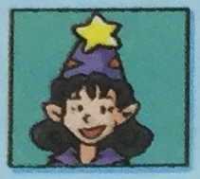
Role-play
There is a poor farmer called Fred….
Fred, I’d like to give you …
Thank you very much,…

Slide 10
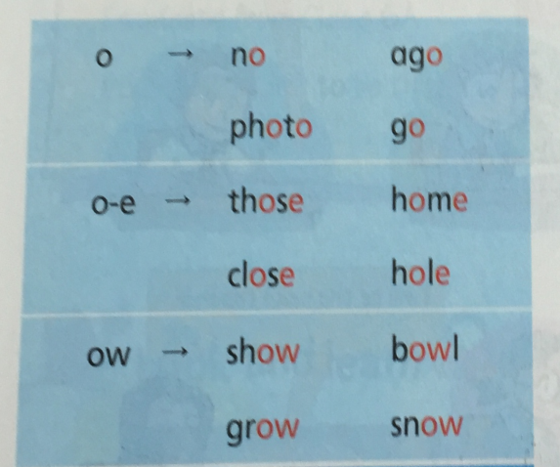
Sounds
tomato
…
nose
…
window
…

Slide 11
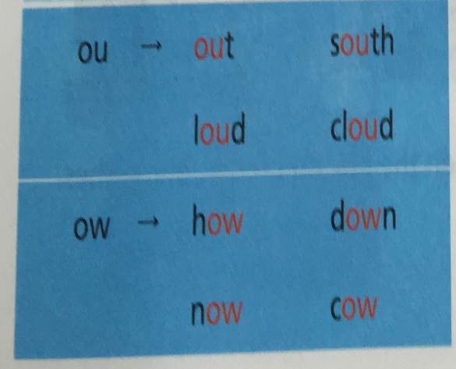
Sounds
mouth
…
flower
…

Slide 12
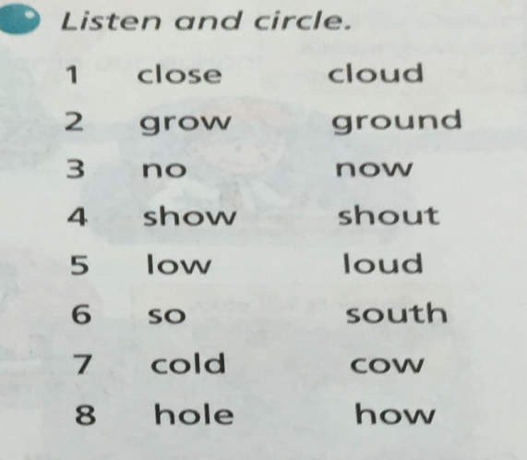
Listen and circle

Slide 13
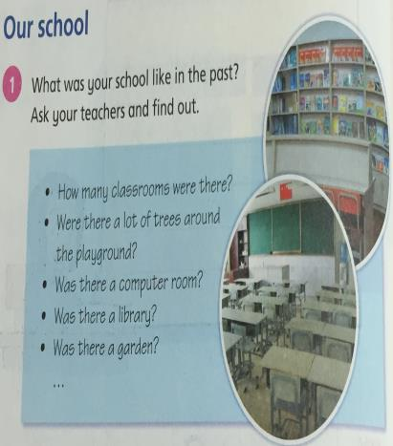
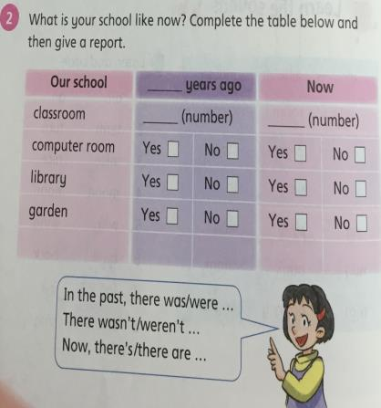
Homework
Finish Part 1-2

