Slide 1
Unit 7 Topic 1
We're preparing for a food festival.
Section C
WWW.PPT818.COM

Slide 2
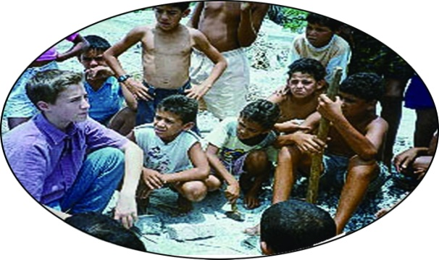
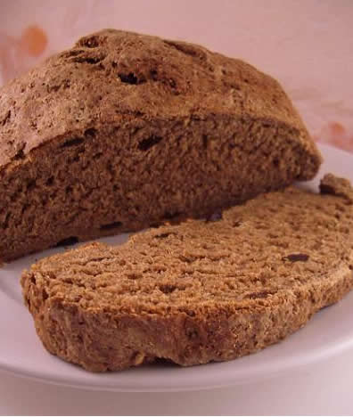
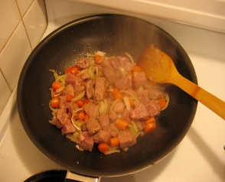
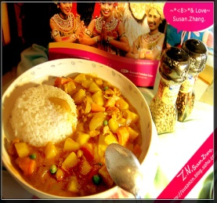
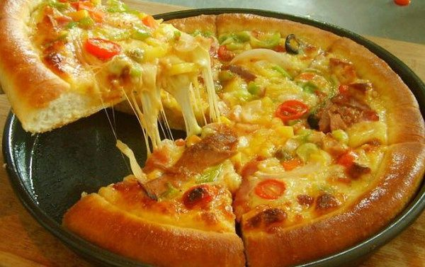
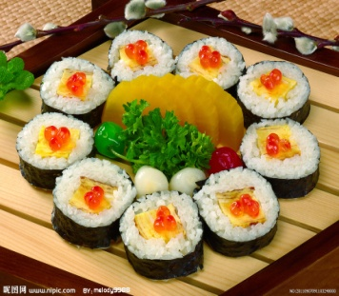
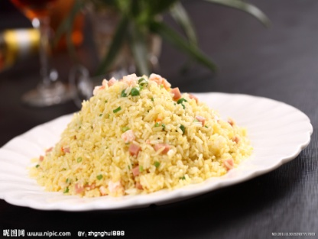
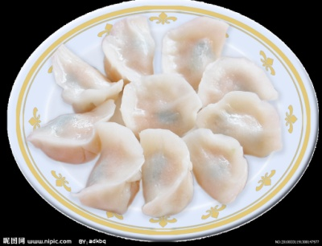
Say something that you know from Section A and B.The following information and pictures may help you.
Craig Kielburger
Free the Children
700 school rooms
build a school in Kenya
raise money
food festival
on the playground
on Sunday
prepare delicious food
such as
...

Slide 3
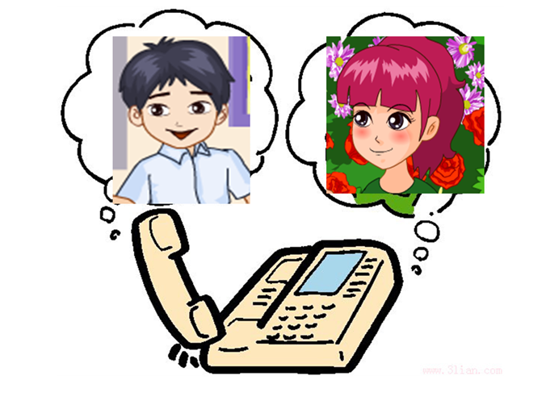
Jane is talking to Kangkang on the phone now.What are they talking?
No,he can't. And he regrets that he cannot come.
regret
member
gather
group
v.感到遗憾，惋惜
n.痛惜，懊悔，遗憾
Kangkang,can Craig come to our food festival?
n.成员，会员
v.召集，聚集；收集
n.组，组群
v.（使）成群，成组
What a pity.I'm a big fan of Craig.I want to become a memeber of Free the Children.And I will gather my friends to join the group.

Slide 4
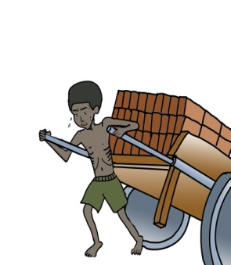
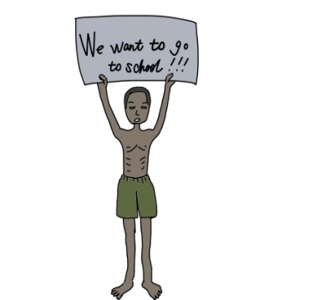
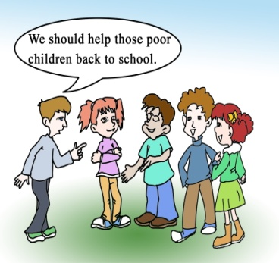
You will become a better reader if you can predict,use your known knowledge and find key words and ideas while you read.
1.The story of a Pakistani boy changed Craig's life.
2.Children went to work in factories because they didn't want to go to school.
3.Craig believes that as a child he can not make a change.
4.More children will study in Craig's schools in Kenya.
( )
( )
( )
( )
adj.巴基斯坦的

Slide 5
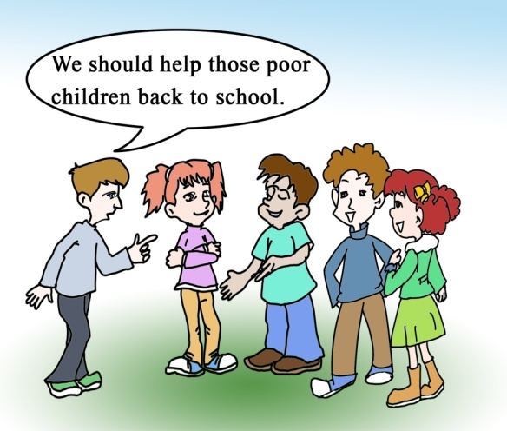
Look at the pictures and decide whether the following statements are ture or false before reading.Then read and check.
1.The story of a Pakistani boy changed Craig's life.
2.Children went to work in factories because they didn't want to go to school.
3.Craig believes that as a child he can not make a change.
4.More children will study in Craig's schools in Kenya.
( )
( )
( )
( )
T
F
F
T

Slide 6
Listen and answer the following questions.
1.Where did Craig spend his childhood?
2.What’s Craig’s favorite food?
3.Did Craig gather his friends and start a group?
4.How many members does Free the Children have now?
5.What's the motto of Free the Children?
In Canada.
His favorite food is fried chicken.
Yes,he did.
About 100 000 members.
Children helping Children.

Slide 7
Key points of 1a
1.Thank you for inviting me to your food festival.
Thank you for doing sth.“因...而感谢”
E.g:感谢你帮助我。Thank you for helping me.
2.He knew children should go to school instead of working in factories all day.
instead of “代替；而不是”
E.g:我是否可以要可乐来代替果汁？
Could I have cola instead of juice?
3.He decided to fight against the bosses.
fight against“与......作斗争/抗争”
4.As a result,a bad man killed him.
as a result “结果”

Slide 8
1b
Read 1a again and complete the tables.
December 17,1982
Birthday:__________________________
Birthplace:_________________________
Favorite food:_______________________
What kind of person:_________________
What changed his life:________________
________________
What group he started:________________
Canada
1.Craig
fried chicken
like to help people
an article about
a twelve-year-old boy
Free the Children
Started working at the age of___________
Decided to fight against_______________
Was killed at the age of_______________
2.the Pakistani
boy
four
the bosses
twelve
Fomer name:_______________________
Purpose:___________________________
Motto:_____________________________
Members:__________________________
Countries:__________________________
the Twelve Twelve-Year-Olds
to help child workers go to school
3.Free the
Children
Children Helping Children
100 000
35

Slide 9
Suppose you are a reporter and interview Kangkang about Craig and Free the Children. Make a conversation with the help of 1b.
1c
You may begin like this:
A:Hello,Kangkang! Would you please tell us something about Craig?
B:Sure,Mr./Ms. ...

Slide 10
3
Complete the invitation to one of Kangkang's friends.Then share it with the whole class.
An invitation should be brief,in a proper form and include who, when, what and where in it.
Dear David,
I would like to______you to the international food festival at Beijing International School at 11:00 a.m. on Sunday, May 16th.We students will ______many delicious international _____ and sell them in order to ______ money for a village school in Kenya.
Hope to see you then!
Sincerely,
Kangkang
invite
cook
foods
raise
in order to 为了，以便于
E.g:他努力学习是为了找到一份好的工作。
He studies hard in order to find a good job.

Slide 11
Dear friend,
I’d like to invite you...
...
Hope to see you then!
Sincerely，
(name)

Slide 12
Project
Disscuss with your partner what you will do for Free the Children. You can use the following phrases:
make a poster about Free the Children
ask others to join
tell my parents about it
write a letter to them
raise money/clothes/toys
...

Slide 13
Exercises in class
根据汉语完成下列句子。
1.他在乡下度过他的童年。
He spent his_________ in the countryside.
2.他不专心听老师讲课，结果他考试不及格。
He didn't listen to the teacher carefully in class,___ ____ ____,
he failed the exam.
3.在你们小组里面有多少个成员？
How many ________ are there in your ________?
4.我们应该走路而不是坐公车上学。
We should walk ______ ______ taking a bus to school.
5.为了按时到达学校，他每天都不得不早点起床。
He gets up early every day______ ______ ______ get to
school on time.
childhood
as a result
members
group
instead of
in order to

Slide 14
Summary
We learn:
1. Some new words:
regret,gather,group,member,roof
2. Some phrases
instead of,as a result,in order to,fight against
We can:
1.Predict,use our known knowledge and find key words and ideas while we read.
2.Interview somebody about something.

Slide 15
Homework
1. Read 1a aloud and try to repeat.
2. Finish Section C in your workbook.
3. Preview Section D.

