Slide 1
Starter Module 2
My English lesson
Unit 3 I’m twelve.
WWW.PPT818.COM

Slide 2
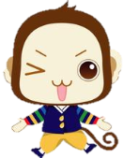
学习目标
1) 能掌握以下单词：eleven~ twenty, boy, girl, desk, chair, bag, book
2) 能掌握以下句型：
① —How old are you? —I’m twelve.
②—How many…are there? —Eleven…

Slide 3
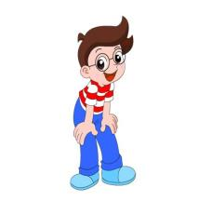
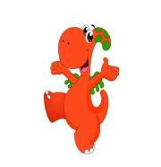
Revision
Pair work
A: Hello. Are you a new student here?
B: Yes, I am.
A: What’s your name?
B: I’m…
A: What’s your student number?
B: It’s…
A: What’s your telephone number?
B: My telephone number is…

Slide 4
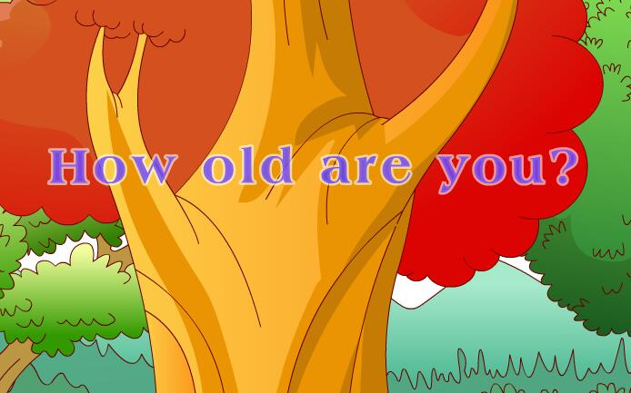
Warming-up

Slide 5
Presentation
How many girls are there?
Eleven./ There are eleven girls.
girls
girl

Slide 6
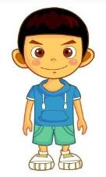
How many boys are there?
Twelve./ There are twelve boys.
boys
boy

Slide 7
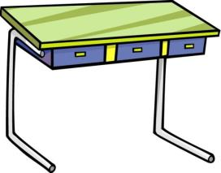
How many desks are there?
Thirteen. /There are thirteen desks.
desks
desk

Slide 8
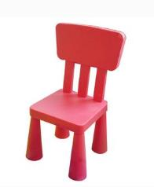
How many chairs are there?
Fourteen./There are fourteen chairs.
chairs
chair

Slide 9
How many books are there?
Fifteen./There are fifteen books.
books
book

Slide 10
How many bags are there?
Sixteen./There are sixteen bags.
bags
bag

Slide 11
How many pens are there?
Seventeen./There are seventeen pens.
pens

Slide 12
How many cars are there?
Eighteen. /There are eighteen cars.
cars

Slide 13
How many bananas are there?
Nineteen. /There are nineteen bananas.
bananas

Slide 14
How many oranges are there?
Twenty. /There are twenty oranges.
oranges

Slide 15
知识探究 how many… are there?用法
How many … are there?有多少……？
这是询问人或物的数量的句子，结构为__________
____________________。其答语为_____________ ____________________。
如：—How many students are there?
—There are twenty students./Twenty.
How many
+某人/物+are there?
直接回答数量
或There are/is…

Slide 16
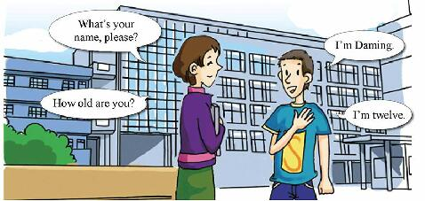
如何询问别人的年龄？
Listen and read.
What’s your name, please?
I’m Daming.
How old are you?
I’m twelve.

Slide 17
Listen and repeat.
11
eleven
12
twelve
13
thirteen
14
fourteen
15
fifteen
16
sixteen
17
seventeen
18
eighteen
19
nineteen
20
twenty

Slide 18
Match.
eleven
thirteen
seventeen
nineteen
twelve
fourteen
twenty
eighteen
sixteen
fifteen
11
12
13
14
15
16
17
18
19
20

Slide 19
Listen and point.
1. 11+4 = 15 2. 12+6 = 18
3. 14+6 = 20 4. 17+2 = 19
“+”读作and。“=”读作“is”。

Slide 20
5 Listen and write.
1. 11+______ = _______
2. _____ +4 = _______
3. ______+2 = _______
4. 3+ ______ = _______
5. _______+1 = _______
6. 2+ ______ = ________
6
17
15
19
18
20
13
16
16
17
12
14

Slide 21
6 Listen and write.
——————————
——————————
——————————
——————————
——————————
——————————
——————————
——————————
1.
——————————
——————————
——————————
——————————
——————————
——————————
——————————
——————————
——————————
——————————
——————————
——————————
——————————
——————————
——————————
——————————
——————————
——————————
——————————
——————————
——————————
——————————
——————————
——————————
——————————
——————————
——————————
——————————
——————————
——————————
——————————
——————————
9.
seventeen
eleven
5.
nineteen
2.
6.
10.
fourteen
thirteen
twenty
3.
fifteen
7.
twelve
4.
eighteen
8.
sixteen

Slide 22
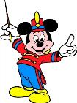
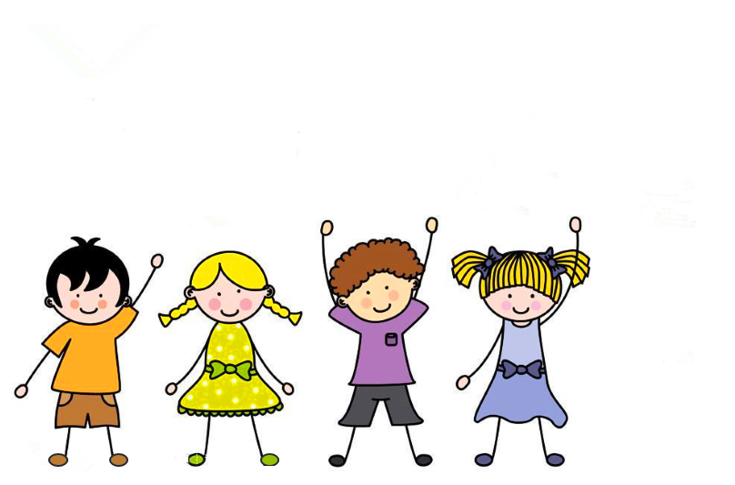
Play a game.
指挥家
How old are you?
I’m six.
How old are you?

Slide 23
Listen and match.
13
15
18
19
12
16
11
14
17
20
boys girls desks chairs books bags

Slide 24
Work in pairs. Ask and answer.
How many… are there? | Numbers
boys | 15
girls | 18
desks | 13
chairs | 19
books | 11
bags | 16
15
How many boys are there?

Slide 25
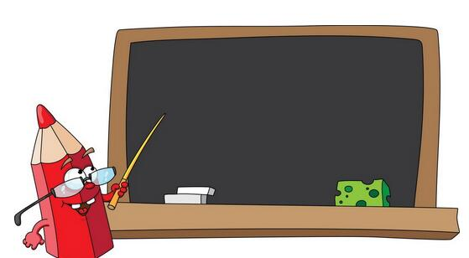
Give a report
A few foreigners will come to visit our school. They need a guide to show them around. Who wants to be their guide and introduce our school to them?
Hello! Welcome to our school. My name is… I’m 13. I’m in Class 7. There are 15 classes
in our school and there are 20 students in my class…

Slide 26
Summary
eleven
twelve
girl(s)
boy(s)
thirteen
How many+名词+are there?
fourteen
How old are you?
fifteen
sixteen
I’m…
chair(s)
desk(s)
bag(s)
book(s)
seventeen
There are…/直接回答数目.
eighteen
nineteen
twenty

Slide 27
Homework
Remember the key points in this unit.
Finish the report.

