Slide 1
Unit 2 Topic 1
Pollution has caused too many problems.
Section C
WWW.PPT818.COM

Slide 2
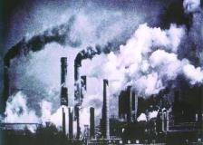
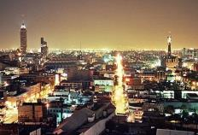
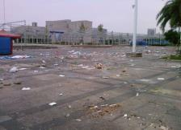
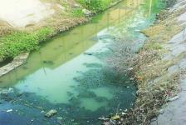
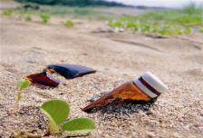
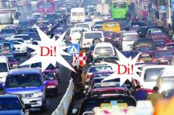
Speak out the names of the pollution.
air pollution
light pollution
litter
water pollution
soil pollution
noise pollution

Slide 3
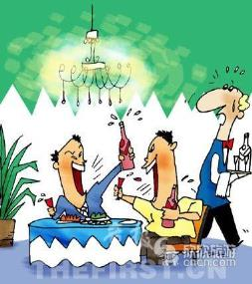
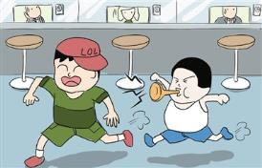
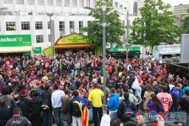
noise pollution
n. 种类；
v. 把……分类
Noise is a sort/kind of pollution.
There are all sorts/kinds of noises.
They make us uncomfortable and unpleasant.
adj. 使人不舒服的
adj. 令人不快的

Slide 4
Let’s write down the things that can make noises.
piano
noises made by
bus
cat
wind

Slide 5
Read 1a and complete the following tasks.
Task 1
Underline the topic sentence of the passage
in 1a.
Noise is also a kind of pollution and is harmful to human’s health.
Try to find out the topic sentence to understand the content of a paragraph.
Give a proper title to this passage.
Noise Pollution

Slide 6
Task 2
How does noise harm people’s health?
a. People often ____ ______.
b. People often feel ____________ and
__________.
c. People may become _____ or _____.
d. Your point:
_____________________________.
go deaf
uncomfortable
unpleasant
sick
deaf

Slide 7
Task 3
Answer the questions.
3. Which phrase has the same meaning as “is
harmful to”?
4. Which sentence shows that many teenagers’
hearing in America is not good?
5. Why is the hearing of many young Americans
not good?
“do harm to”.
Many teenagers in America can hear no better than 65-year-old people do.
Because they always listen to loud pop music.

Slide 8
1b Read 1a and match the words with their meanings.
Task 4
1. produce A. to hurt someone
2. deaf B. a type or a kind
3. print C. not be able to hear
4. harm D. to grow or make
something
5. sort E. to put words or
pictures onto paper
using a machine

Slide 9
Task 5
Change the following sentences into the ones that have the same meanings.
a. Not all people know noise is also a kind of pollution.
_____ ________ know(s) noise is a kind of pollution
____ ______.
b. Many teenagers in America can hear no better than 65-year-old people do.
In America, many teenagers’ hearing is ____
_____ ____ 65-year-old people’s.
Not everyone
/some people
as well
WHY?
as
weak as
Because they always listen to loud pop music.

Slide 10
Difficult sentences
People who work and live in noisy conditions
often go deaf.
定语从句
在嘈杂的环境中工作和生活的人容易变聋。
deaf adj. 聋的
e.g. Beethoven was deaf.
go deaf 变聋
e.g. He _____ _____ because of the traffic accident.
went deaf

Slide 11
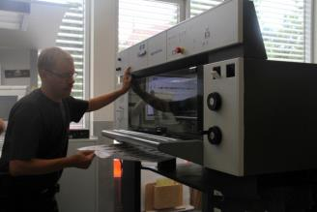
Difficult sentences
…many of the workers who print newspapers
and books lose their hearing.
定语从句
很多印刷报纸和书籍的工人丧失听力。
print v. 印刷
e.g. Look! The man is printing
something.
hearing n. 听力，听觉
a printer
lose one’s hearing 丧失听力

Slide 12
2 Complete the following passage with the correct form of each word.
Noise is a kind of _________ (pollute). Cars and machines produce too much noise. It makes people feel ___________ (comfortable) and __________ (pleasant). It also does great ______ (harm) to people’s _________ (hear). Noise is very ________ (harm) to human’s _______ (healthy).
pollution
uncomfortable
unpleasant
harm
hearing
harmful
health

Slide 13
Has noise pollution caused you any problems? If yes, share your feelings with your classmates.
What about other kinds of pollution?
3 Choose one kind of pollution and discuss it in
groups. The following questions may help you.
1. What is … pollution?
2. What makes the … pollution?
3. What problems does it cause?
4. In what way is it harmful to people’s life?
5. What has been done to solve these problems?
…

Slide 14
4 Write a short report about a kind of pollution based on 2 and 3. The topic sentence of each paragraph is given below.
… pollution is…
… pollution is harmful to people’s health…
The government has tried many ways to solve the problem…

Slide 15
One possible version:
Air pollution is becoming more and more serious in today’s world. Some chemical factories produce terrible gas and make the air bad. Buses and cars also produce waste gas. In our daily life, burning gas, oil and coal also creates air pollution. The air pollution may cause a lot of problems. It is harmful to people’s health. It can cause breathing problems, sore eyes and even cancer. It can also harm the plants, and the farmers will get less harvest. Luckily, the government has tried many ways to solve the problem, such as making laws to prevent the factory from polluting the air.

Slide 16
Exercises
单项选择
( ) 1. —The little girl was born____, and she can’t hear
anything.
—Oh, I’m sorry to hear that.
A. lazy B. blind
C. deaf D. lovely
( ) 2. — What happened?
— There is a girl_____ on the street. She couldn’t find her
mother.
A. cry B. crying
C. to cry D. cries
( ) 3. The ______ boy tried to climb up the tree, but he failed.
A. 5-year-old B. 5-years-old
C. 5 year old D. 5 years old
C
B
A

Slide 17
Exercises
用所给单词的正确形式填空。
1. They are doing their homework carefully. You’d better not
________(disturb) them.
2. It is known that smoking does great _______(harm) to us.
3. They had all ______ (sort) of juice to drink at the party last
night.
4. Our government has solved some _____________ (environment)
problems.
改为同义句。
1. The boy had hearing loss when he was born.
The boy _____ _____ _________ when he was born.
2. Some students go to school on Saturdays.
____ _____ students go to school on Saturdays.
disturb
harm
sorts
environmental
lost his hearing
Not all

Slide 18
summary
We learn:
1. Some words:
deaf, print, hearing, loss, recently, disturb,sort,
uncomfortable, unpleasant, sentence, meaning
2. Some phrases:
go deaf, lose one’s hearing, hearing loss,
no better than, do harm to
3. Some sentences:
However, not all people know noise is also a kind
of pollution is harmful to human’s health.
We can:
1. Find out the topic sentence to understand the
content of a paragraph.
2. Write a passage according to the topic sentences.

Slide 19
Homework
1. Read 1a.
2. Write a report according to Part 4.
3. Finish Section C in your workbook.
4. List Grammar and Functions in
this topic.
5. Preview Section D.

