Slide 1
Unit 2 Topic 3
Must we exercise to prevent the flu?
Section C
WWW.PPT818.COM

Slide 2
Review
Work in pairs and check if the following habits are good. If not, give your advice.
 Always be happy.
 Eat a lot of potato chips.
 Smoke and drink.
 Drink enough water.
 Play sports.

Slide 3
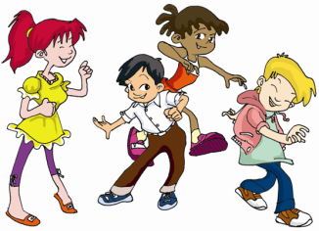
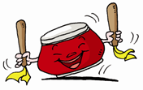
Happiness is important to our health .
happiness n. 开心，快乐

Slide 4
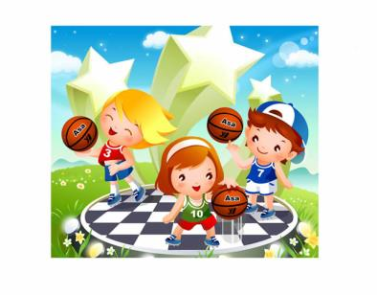
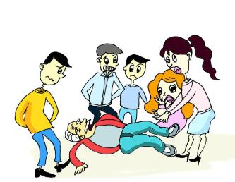
Playing sports can build us up, but we should stay safe .
stay safe 保证安全
It’s necessary to learn about first aid .
急救

Slide 5
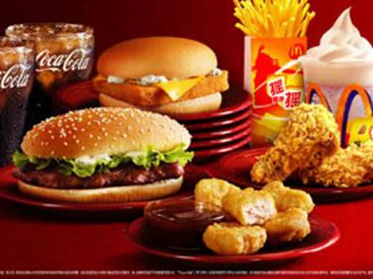
We had better not eat lots of potato chips.
They are fast food. （洋快餐）
Fast food will make you fat and unhealthy.

Slide 6
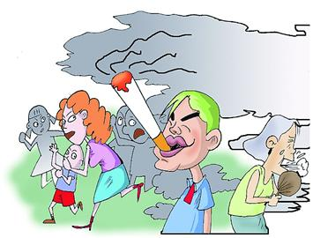
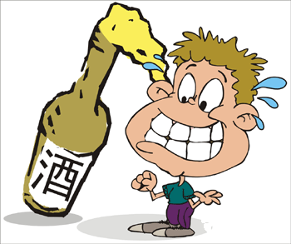
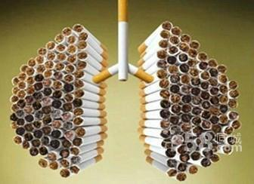
We must stay away from smoking and drinking.
远离
We should say no to smoking and drinking.
和……说不

Slide 7
1a Look, listen and say.
You need to have healthy eating habits. Breakfast gives you enough energy for the morning. So don’t go to school without it. Fruit and vegetables are good for your health, but fast food, like potatoes chips, will make you fat and unhealthy. So eat the right food to keep you healthy.
Playing sports can also help you keep fit. But
sometimes accidents can happen, so try to stay safe when you play them. It’s necessary for you to learn about first aid. Then you can help yourself or others if an accident happens.

Slide 8
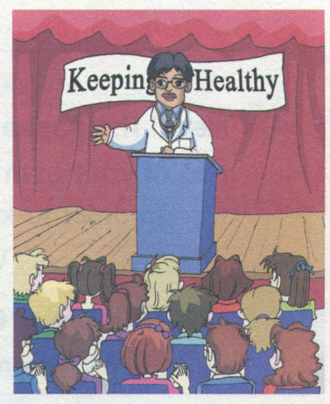
Happiness is important to our health. It is the best
medicine. When you are ill, try to be happy and you’ll
be feel better. On the other hand, you may feel ill if you
are always unhappy. So, be happy to be healthy.
You must stay away from smoking and drinking.
many students think it’s cool to smoke and drink. But
they don’t know smoking or drinking can cause many
illness. You should say no to smoking and drinking.

Slide 9
Listen to 1a and find out the main idea of the passage.
What’s the main idea of the passage?
A: We should eat the right food to keep fit.
B: It’s necessary to do exercise.
C: Happiness is important to our health.
D: A talk about how to keep healthy.

Slide 10
1a
Listen again and answer the questions.
(1) Can we go to school without breakfast?
(2) Are fruit and vegetables good for our
health?
(3) Why should we say no to smoking and
drinking?
No, we can’t.
Yes, they are.
Smoking and drinking can cause
many illnesses.

Slide 11
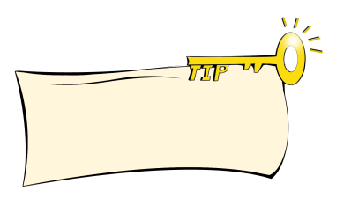
Listen and find out the topic sentence in each paragraph.
1a
P₁: ______________________________
P₂: ______________________________
P₃: ______________________________
P₄: ______________________________
You need to have healthy eating habits.
Stay safe when you are playing sports.
Happiness is important to your health.
You must stay away from smoking and drinking.
The topic sentence expresses the main idea of a paragraph.

Slide 12
Read 1a and complete the structure of the text.
Keeping Healthy
Have healthy _______ habits.
Play _________.
Be _________.
Stay away from ___________ and ___________.
Eat _______.
breakfast
eating
Eat _______________.
fruit and vegetables
sports
Don’t eat _______.
fast food
happy
smoking drinking

Slide 13
Read 1a again and discuss what the red words refer to in the passage.
1c
breakfast
So don’t go to school without it.
So try to stay safe when you play them.
It’s the best medicine.
But they don’t know smoking or drinking…
sports
the students
happiness

Slide 14
反身代词
1. 反身代词表示“自己，本身，亲自”。反身代词的形式可以归纳为：
 | 单数 | 复数
第一人称 | myself | ourselves
第二人称 | yourself | yourselves
第三人称 | himself/herself/itself | themselves
数
人称

Slide 15
2. 反身代词的用法：
作动词或介词的宾语。如：
David teaches himself English.
They enjoyed themselves at the party last night.
You must learn to look after yourself.

Slide 16
(2) 作主语或宾语的同位语。如：
I myself don’t like that dress at all.
I have to mail the letter myself.

Slide 17
Key points
need to do sth. 需要做某事
每个人都需要遵守交通规则。
Everyone ________ obey the traffic rules.
2.It’s necessary for sb. to do sth.
对某人来说做某事是有必要的
对我们来说，学好英语是有必要的。
_____________ us ______ English well.
needs to
It’s necessary for
to learn

Slide 18
Key points
3. on the other hand 另一方面
在另一方面，喝酒会带来很多疾病。
________________, drinking can cause many illnesses.
4. stay away from sth. 远离某物/某事
老师告诉我们要远离毒品。
The teacher tells us ____________ drugs.
5. say no to sth. 对……说不
Everyone should ________ wars.
On the other hand
to stay away from
say no to

Slide 19
Retell the passage
Retell the passage with the help of 1b. Then write it down. You can add two of your own ideas.
2
In order to keep healthy, we should _____________, ______________, __________ and _________. We should also _________ and ________.

Slide 20
Task
Make a survey in groups of six about how to keep healthy. Then report the result to the class.
Name | How to keep healthy
 | should/had better/ must do | had better not/ shouldn’t do
1
2
3

Slide 21
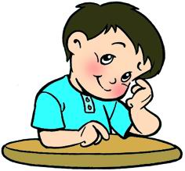
Report
You can report like this:
Health is important to everyone. So we should have healthy eating habits. We’d better eat healthy food like fruit and vegetables, because they are good for our health. Don’t eat fast food. We should also do exercise often to keep fit.

Slide 22
Exercises
根据中文提示完成句子。
1.吃合适的食物对我们健康是很重要的。
2. 照顾好父母是必须的。
3. 我们应该远离危险的东西。
4. 你会生病，如果你总是不开心。
It’s _________ for us to eat the _______ _______.
important
right food
______ ______ our parents well is ___________ .
Looking after
necessary
We should ______ _______ _______ the danger.
stay away from
You will _____ ______ if you are always _________.
fall ill
unhappy

Slide 23
根据句意和首字母提示写出单词。
1. Doing morning exercises is h_______ for us to keep healthy.
2. Kate is very clever. She can teach h______ English.
3. Doctors’ duty is to s_____ the patients.
4. I don’t like oranges at all. In fact I h_____ them.
5. We called Tom last night, but there was no a_________.
elpful
erself
ave
ate
nswer

Slide 24
单项选择
1. The old man lived in the house _____, but he
lived happily.
A. by themselves B. by himself
C. by herself D. by myself
2. The young pioneer helped the blind man _____ the street.
A. cross B. through
C. across D. to across
3. – What do you _____ the new teacher?
– He is kind, helpful and brave.
A. think about B. think of
C. think over D. think
B
A
B

Slide 25
4. – How much did you spend ____ the MP4?
– 300 Yuan. I think it was a little dear.
A. with B. for C. on D. in
5. Ling Fang’s mother works in another city, and she has to talk with her mother ____ the phone.
A. in B. with C. of D. on
C
D

Slide 26
summary
Learn some new phrases.
need to do sth. 需要做某事
stay away from sth. 远离某物/某事
say no to sth. 对……说不
on the other hand 另一方面
It’s necessary for sb. to do sth.
Know how to keep healthy in our
daily life.

Slide 27
Homework
1. Retell 1a.
2. Finish the exercises in the exercise book.

