Slide 1
Unit 7 Know Our World
A Class of the World
WWW.PPT818.COM

Slide 2
objectives
To understand the text
To use the words correctly:
prepare pride

Slide 3



Review
Vocabulary

Slide 4
prepare
Amazon
rainforest
Turkey
Nile
Sahara Desert
Cairo
pride
be known for…
in recent years
v. 准备；预备
亚马逊河
n. (热带)雨林
土耳其
尼罗河
撒哈拉沙漠
开罗
n. 引以自豪的事物(或人)；骄傲
因……而众所周知
在最近一些年里

Slide 5
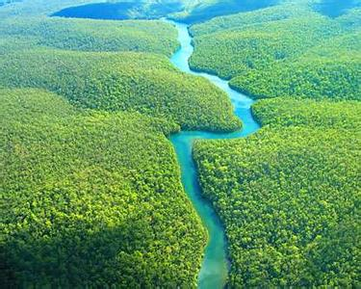
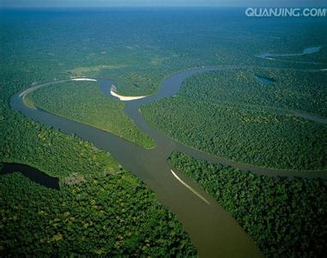
the Amazon

Slide 6
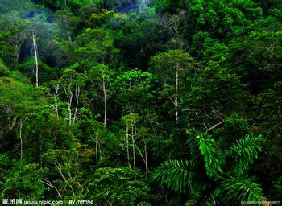
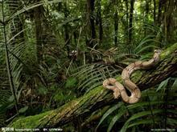
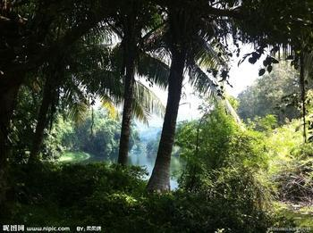
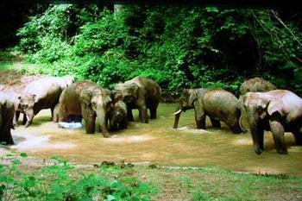
rainforest

Slide 7
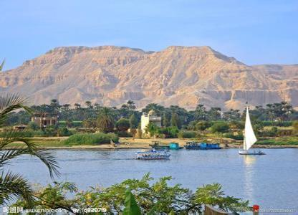
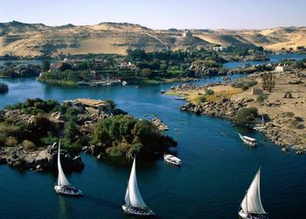
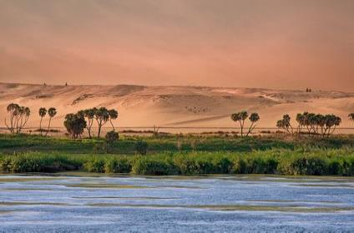
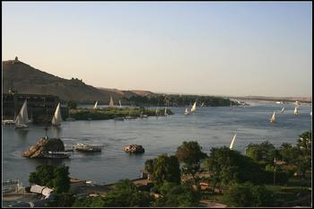
the Nile

Slide 8
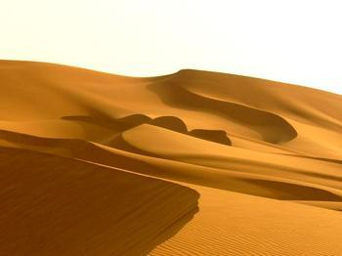
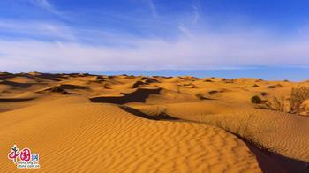
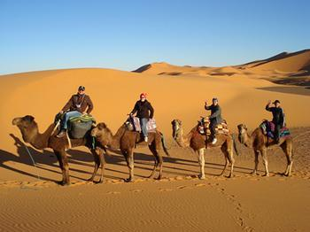
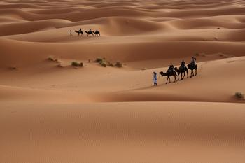
the Sahara Desert

Slide 9
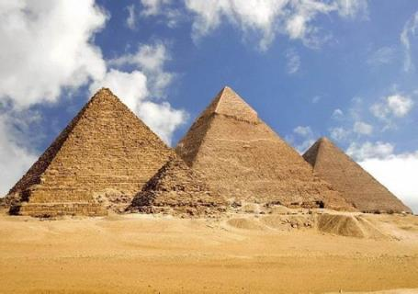
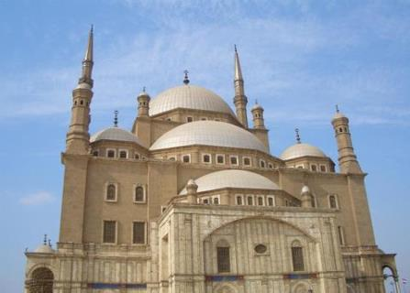
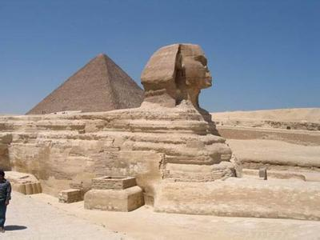
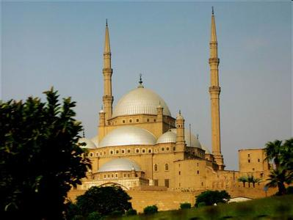
Cairo

Slide 10
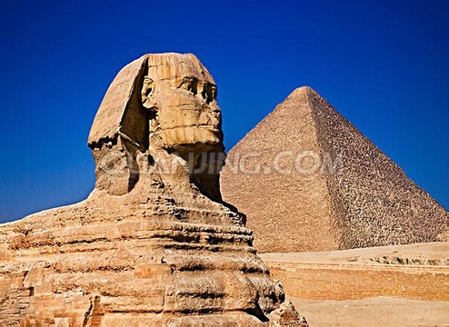
The Pyramids is very mysterious. It’s in Egypt.

Slide 11
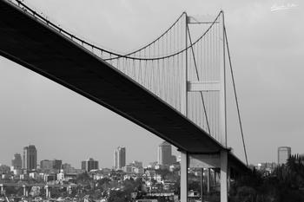
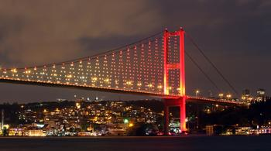
The Bosphorous Bridge connects Europe and Asia. It is in Turkey.

Slide 12
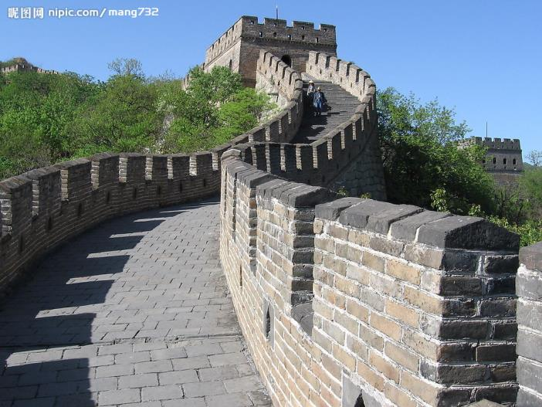
The Great Wall is world-famous. It is in China.

Slide 13
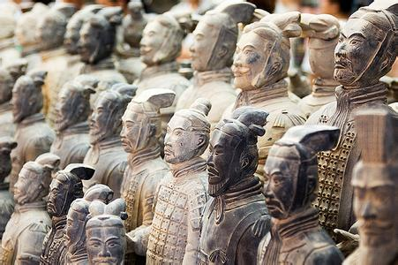
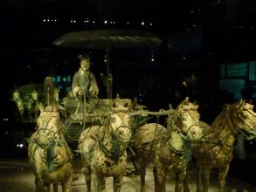
The Terra Cotta Warriors are famous all around the world. It is in China.

Slide 14
Think about it!
1. Which country would you like to visit? Why?
2. What do you know about that country?
3. What languages do people speak
there?

Slide 15





Slide 16

Listen and tick the correct answers.
Where does Ahmed come from?
Brazil. Turkey. Egypt.
2. Where’s the Amazon?
In Brazil. In Turkey.
In Egypt.

Slide 17
3. What connects Europe and Asia?
The Amazon.
The Bosphorous Bridge.
The Nile.
4. What can you do in the Sahara Desert?
Walk in the markets.
Ride a camel.
Take a boat tour.

Slide 18
Reading

Slide 19
Read the lesson again and fill in the blanks.
Brazil is the ______ country in South America. It has a huge river _____ the Amazon.
Turkey is in both _______ and ____. The well-known Bosphorous Bridge ________ Europe and Asia.
largest
called
Europe
Asia
connects

Slide 20
Besides the pyramids in Egypt, there are other things to see and do. Many things in Egypt will _______ you.
China has a long history and rich culture. It has the largest __________. The Great Wall is ______ around the world.
surprise
population
famous

Slide 21
Fill in the blanks with the correct forms of the given words.
Lots of ________ (tour) come to visit that famous place.
That lazy bear always ______ (relax) 15 hours a day. That’s why he’s a little bit heavy now.
The students are busy _________ (prepare) for the coming exams.
tourists
relaxes
preparing

Slide 22
4. A bridge _____ (call) the Golden Gate Bridge _________ (surprise) us a lot. We hope to travel back there again someday.
5. That lady took great _____ (proud) in her sons.
called
surprised
pride

Slide 23


Write a passage about your home city or town.
Task tips:
Where is it?
How big is it?
What is the population?
What is it famous for?

Slide 24
Language Points

Slide 25
1. Many things in Egypt will surprise you.
surprise 使……吃惊
Her beauty surprised me.
我惊讶于她的美貌。
His coming surprised me.
他的到来令我感诧异。

Slide 26
2. All of them are proud of their home countries.
be proud of…，以……骄傲。
= take pride in… 如：
We all have much to be proud of.
我们都有很多值得自豪的东西。
You have every reason to be proud of your country and nation.
你们有理由为自己的国家和民族感到骄傲和自豪。
Take pride in what you do.

Slide 27
Fill in the blanks
repare
We must p______ a room for our guest.
There are a r________ with more trees than you can imagine in Brazil.
His mother ___________ (以……骄傲) his good behaviors in school.
Tokyo is f_______ for the Mount Fuji.
ainforest
takes pride in
amous

Slide 28
highest
5. Himalayas is the ________ (最高的) mountain in the world.
6. North America is the third ______ (large) continent in the world.
7. The population of China is ____________ (最多) in the world.
8. Shanghai and Tokyo are _______________ (两个最大的) cities in Asia.
largest
the largest
two of the biggest

Slide 29

Time for Reflection
take pride in
be proud of
be famous around the world

Slide 30

Homework
Review Lesson 41.
2. Finish off the activities on page 107.

Slide 31
Preview
1. Learn the words in Lesson 42 by heart.
2. Read the text in Lesson 42 and underline the useful phrases.

