Slide 1
Unit 4 Stage and screen
Period One Starting out & Understanding ideas—Comprehending
WWW.PPT818.COM

Slide 2
单元主题语境：人与社会——舞台与荧屏
A perfect tragedy is the noblest production of human nature. —— Addison
一场完美的悲剧就是人性最崇高的产物。
——艾狄生

Slide 3
话题导入
William Shakespeare(26 April 1564－23 April 1616) was an English poet and playwright(剧作家), who is now regarded as the greatest writer of the English language.His surviving works include 38 plays，two long narrative poems(叙事诗)，154 sonnets(十四行诗)，and a few other poems.He is often called England’s national poet.His plays have been translated into every major living language and are performed more often than those of any other playwright.Shakespeare was born and raised in Stratford-­upon-­Avon.At the age of 18，he married Anne Hathaway，with whom he had three children：Susanna，and twins Hamnet and Judith.Sometime between 1585 and 1592，Shakespeare moved to London，where he found success as an actor，writer，

Slide 4
and part­-owner of the playing company the Lord Chamberlain’s Men.He appears to have retired to Stratford around 1613，where he died three years later¹.Shakespeare produced most of his known work between 1590 and 1613.He at first wrote mainly comedies(喜剧) and histories.He then wrote mainly tragedies until 1608，producing what are considered some of the greatest in the language²，including Hamlet，King Lear，and Macbeth.Many of Shakespeare’s plays were published during his lifetime in editions of variable quality and accuracy.Shakespeare was a respected poet and playwright in his own day; but it was not until the eighteenth century that his reputation began its rise to the heights it enjoys today.In the twentieth century，Shakespeare’s work was repeatedly adopted and rediscovered by new movements in scholarship and performance.

Slide 5
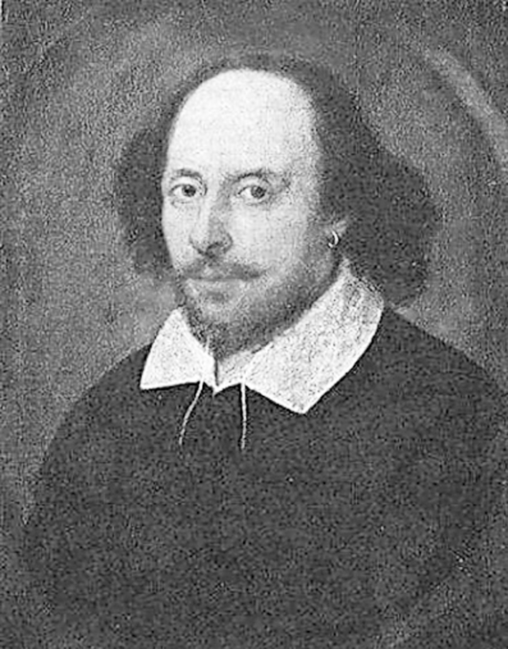
靓句运用于写作
1.We took them to the tea room in our school，where I introduced the history of tea­-making and different kinds of tea and so on.(2018·北京卷，书面表达)
2.Then I showed them how to make tea.I sat at a table，explaining every step of the process while making tea.(2018·北京卷，书面表达)

Slide 6
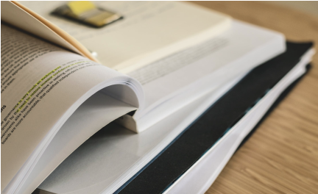
PART 1
读前清障
PART 2
语篇理解

Slide 7
PART
1
读前清障
识记单词 快速顺畅阅读

Slide 8
匹配左边的单词和右边的汉语意思
[第一组]
1.movement A.(乐器的)弦
2.aspect B.歌剧
3.string C.方面
4.version D.运动，动作
5.opera E.版本

Slide 9
[第二组]
6.revenge A.(使)结合，(使)组合
7.transform B.强烈的情感
8.incredible C.报复，报仇
9.emotion D.难以置信的
10.combine E.使改观，使变形，使转化

Slide 10
[第三组]
11.exaggerated A.鞭子
12.whip B.精力充沛的，充满活力的
13.backflip C.(声音或动作)夸张的
14.energetic D.爆发的，爆炸(式)的
15.explosive E.直体后空翻

Slide 11
PART
2
语篇理解
精读精练 萃取文本精华

Slide 12
Step 1 Fast­-reading
1.What’s the main idea of the passage?
A.Hamlet is the most important play by Shakespeare.
B.Peking Opera is an art form that has a long history.
C.A brief introduction to the content(内容) of The Revenge of Prince Zidan.
D.Peking Opera uses different forms to convey(传达) the same theme as
Western Opera.
√

Slide 13
2.Read the passage and match each paragraph with its main idea.
Para.1 A.The author’s attitudes before and after experiencing The
Revenge of Prince Zidan.
Para.2 B.The author’s opinion about Hamlet and Shakespeare.
Para.3 C.Why the author went to see The Revenge of Prince Zidan.
Para.4 D.Something in Peking Opera that surprised the author.
Para.5 E.The performers’ movements were incredible.

Slide 14
Step 2 Careful-reading
Read the passage carefully and choose the best answer.
1.The author knows a lot about Hamlet because .
A.he/she is learning English literature
B.Hamlet is one of Shakespeare’s masterpieces(代表作)
C.he/she has read the play several times
D.all the above
√

Slide 15
2.The history of Peking Opera dates from .
A.the Han Dynasty(朝代)
B.the Song Dynasty
C.the Ming Dynasty
D.the Qing Dynasty
√

Slide 16
3.What can’t help the author understand the theme of the play The Revenge of Prince Zidan?
A.The music.
B.The performers’ movements.
C.The performers’ voices.
D.The mime.
√

Slide 17
4.According to the passage，which of the following statements is TRUE?
A.Hamlet is a western play that can only be performed on the stage.
B.A jinghu can produce similar sound to that of a violin.
C.All the female voices are very high.
D.The audience can see real horses on the stage in a Peking Opera play.
√

Slide 18
5.What’s the author’s attitude towards The Revenge of Prince Zidan after he/she has seen it?
A.It is admirable.
B.It is not worth seeing.
C.It is not better than Hamlet.
D.It could hardly get the theme of Hamlet across to the audience.
√

Slide 19
Step 3 Post-reading
After reading the passage，please fill in the following blanks.
As a high school student in a western country，I once thought Western Opera was the best in the world，but this view 1. (change) when I saw The Revenge of Prince Zidan—the Peking Opera version of Hamlet.In the play，the traditional Chinese 2. (instrument) brought a new sound to my 3. (west) ears.The costumes and masks were also 4.________
(amaze).The music，exaggerated movements and mime could help get the meanings 5. to the audience.The voices 6. (sound) unique.Although the stage was simple，it could represent the whole world.
was changed
instruments
western
amazing
across
sounded

Slide 20
The performers were so energetic 7. they could do backflips like athletes on the stage.Peking Opera,8. dates back to the 18th century,9._________
(combine) music，singing，drama，poetry and costume design together.It is so 10. (attract) to me that I have fallen in love with it.
that
which
combines
attractive

Slide 21
Step 4 Sentence-­learning
1.Having seen quite a few productions of Hamlet and read the play many times，I was full of confidence—until the Peking Opera came to town!
[句式分析] 本句是一个复合句。Having seen quite a few productions of Hamlet and read the play many times为现在分词的完成式作 状语，强调该动作在句子的谓语动词之前发生。现在分词作状语时，分词的逻辑主语和句子的主语要保持一致，一般用在句首。
[自主翻译] _________________________________________________________
______________________________________________________________
原因
因为以前看过很多《哈姆雷特》的戏剧并读过很多遍《哈姆雷特》的剧本，我充满了自信，直到京剧版的《哈姆雷特》在我的家乡演出。

Slide 22
2.At first，I thought what I heard was a violin，but later I learnt that it was an instrument with two strings called jinghu.
[句式分析] 本句为并列句，由 连接。what I heard was a violin为thought的
从句，what I heard为从句的主语；that it was an instrument with two strings called jinghu为learnt的 从句，called jinghu 为过去分词短语作定语，修饰instrument。
[自主翻译] __________________________________________________________
___________________________________________
but
宾语
宾语
一开始我以为听到的是小提琴的声音，但是后来我得知这(声音)是一个由两根弦组成的叫作京胡的乐器发出的。

Slide 23
3.So，if you want to see a show that combines music，singing，drama，poetry and costume design with explosive effect，The Revenge of Prince Zidan ticks all the right boxes!
[句式分析] 本句为一个复合句。在if 引导的条件状语从句中，还含有一个由that引导的 从句，即that combines music，singing，drama...，修饰先行词 。
[自主翻译] _________________________________________________________
___________________________________________________
定语
a show
所以，如果你想看一场集音乐、歌唱、戏剧、诗歌以及服装设计于一体的演出，《子丹王子复仇记》 符合你所有的要求！

