Slide 1
Unit4 January is the first month.
人教精通版六年级上册
WWW.PPT818.COM

Slide 2
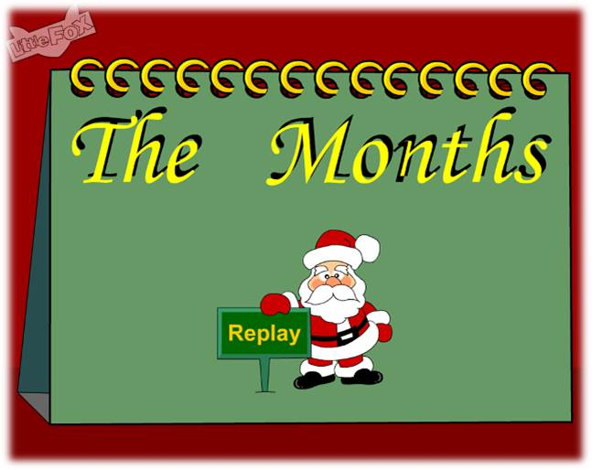
>>Warm-up
Let’s sing

Slide 3
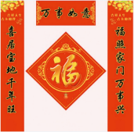
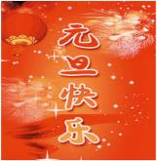
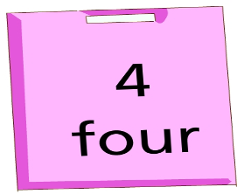
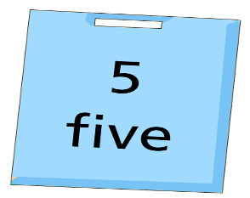
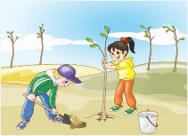
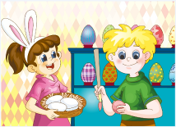
>>Warm-up
Let’s review
Which month or festival is it?
2
1
Quick
response
3
4

Slide 4
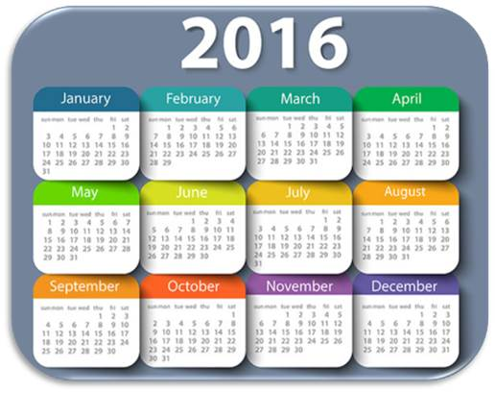
>>Presentation
Let’s learn
What month goes after April?
May
May is the fifth month of the year.

Slide 5
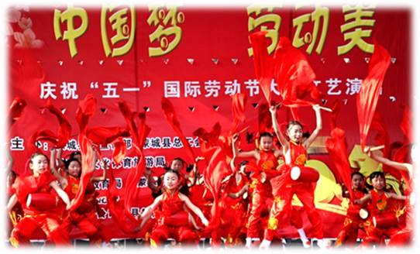
>>Presentation
Let’s learn
What festival is in May?
Labour Day
(May Day)

Slide 6
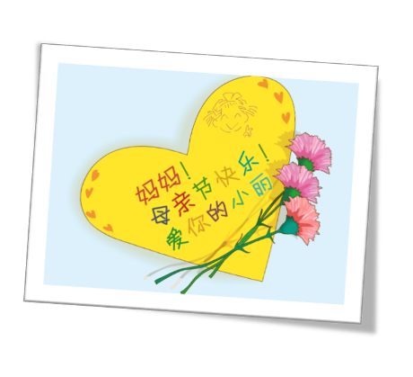
>>Presentation
Let’s learn
Mother’s Day
每年五月的第二个星期日

Slide 7
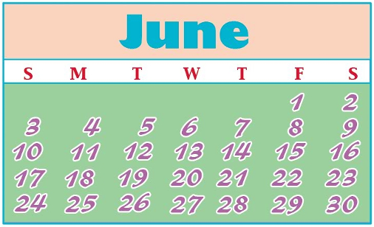
>>Presentation
Let’s learn
What’s the sixth month of the year?
June

Slide 8
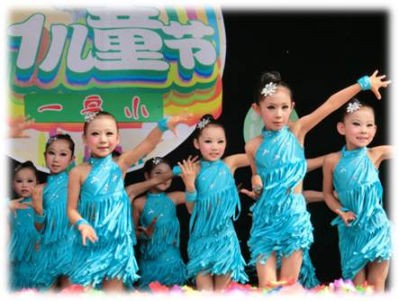
>>Presentation
Let’s learn
What festival is in June?
Children’s Day

Slide 9
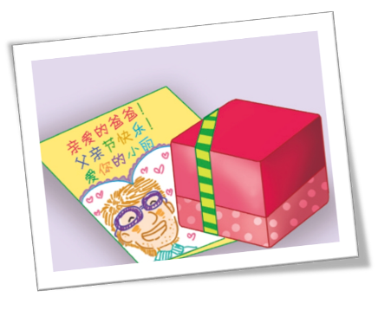
>>Presentation
Let’s learn
Father’s Day
每年六月的第三个星期日

Slide 10
>>Practice
Game1
大小声
Labour Day
Mother’s Day
May
June
Children’s Day
Father’s Day

Slide 11
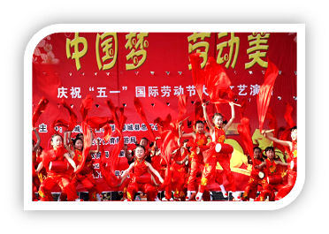
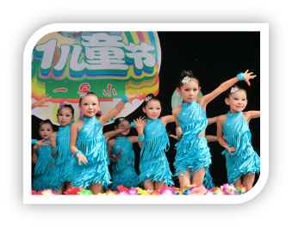
>>Practice
Game2
What’s missing

Slide 12
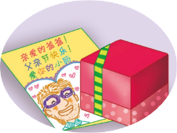
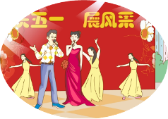
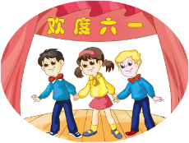
>>Presentation
Listen and answer
What do people do on Labour Day?
People sing and dance to celebrate it.
What do children do on Children’s Day?
Many children perform to celebrate.

Slide 13
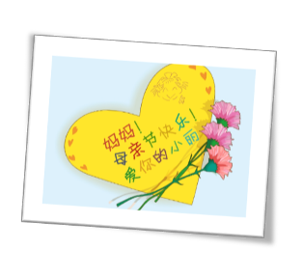
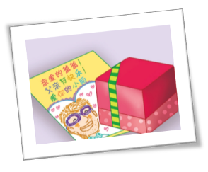
>>Presentation
>>Presentation
Read and say
What do they do on Mother’s Day and
Father’s Day?
They give gifts to their mothers and fathers to show their love.

Slide 14
>>Presentation
Just read and talk
Listen and imitate
May is the fifth month of the year.
Labour Day, or May Day, is on May 1st. People sing and dance to celebrate May Day. Mother’s Day is also in May.
We give gifts to our mothers to show our love.

Slide 15
>>Presentation
Just read and talk
Listen and imitate
June is the sixth month of the year.
The first day of June is Children’s Day in China.
Many children perform to celebrate.
Father’s Day is in June, too.
We also give gifts to our fathers to show our love.

Slide 16
>>Practice
Let’s read
Read together.
(齐读)
Read in pictures.
（分图读）
Read in groups.
(分组读）

Slide 17
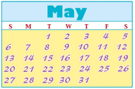
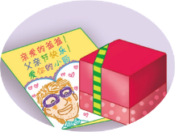
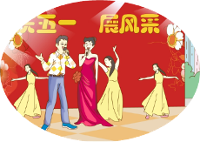
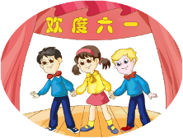
>>Practice
Pair work
Which month or festival do you like? Why?

Slide 18
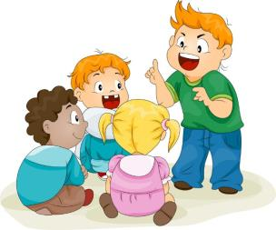
>>Practice
Group work
Do you like May and June? Tell more festivals in these
two months.

Slide 19
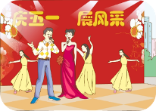
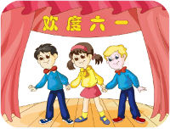
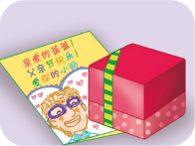
>>Summary
本课学习主要学习的月份有:
May
June
本课学习主要学习的节日有:
Labour Day
Mother’s Day
Children’s Day
Father’s Day

Slide 20
>>Homework
1.跟读课文动画或录音，按照正确的语音、语调朗读课文。 2.在四线三格中正确抄写本课所学的新单词和短语，五英一汉，并听写一遍。
3.预习 Lesson 24。

