Slide 1
Unit 1
My future
WWW.PPT818.COM

Slide 2
job
teacher
doctor
nurse
driver
cook
worker
[ti:tʃə(r)] n. 教师，教员，老师
[dɒktə(r)] n.博士; 医生，大夫
[nɜ:rs] n.护士，看护; 奶妈，保姆
[draɪvɚ]
farmer
[kʊk]
[fɑ:rmə(r)]
[wɜ:rkə(r)]

Slide 3
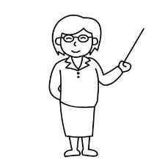
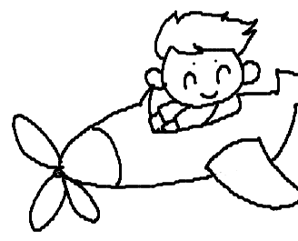
a teacher
teach_______
a doctor
help people
science
English
math
music
art
Chinese
PE
What do you want to be?
I want to be a _________.
I want to__________.
a cook
cook food
a pilot
fly a plane
[paɪlət]
[pleɪn]

Slide 4
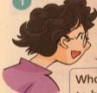
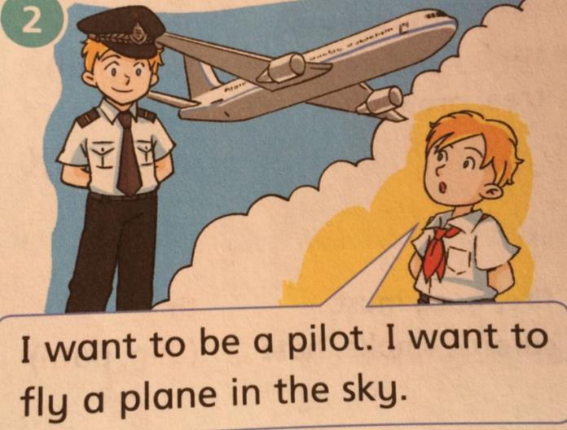
listen and say
Ms Guo: What do you want to be, children?
[skaɪ]

Slide 5
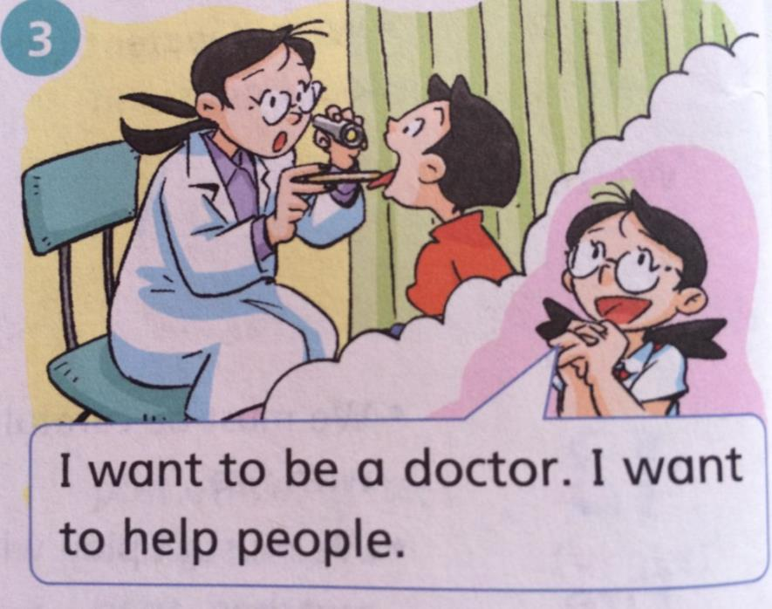

Slide 6
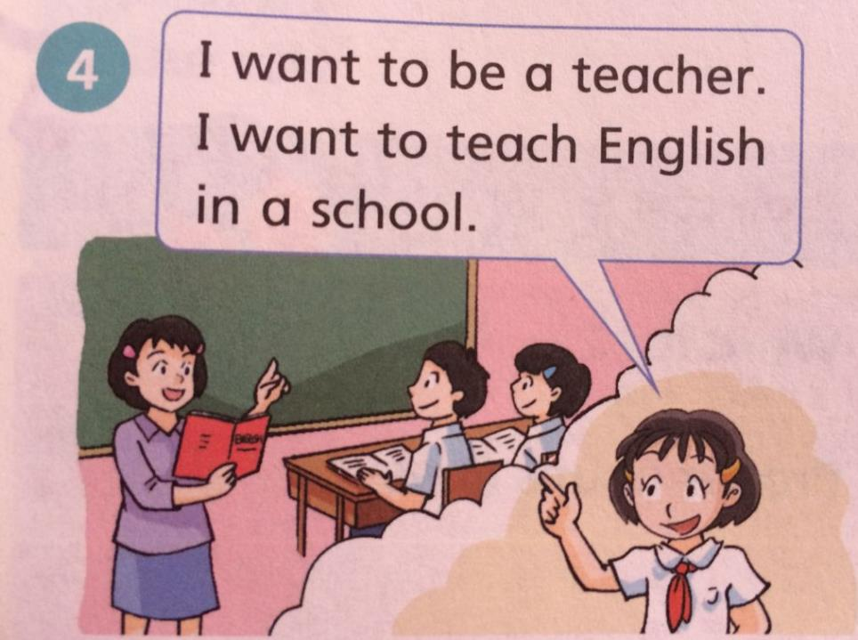

Slide 7
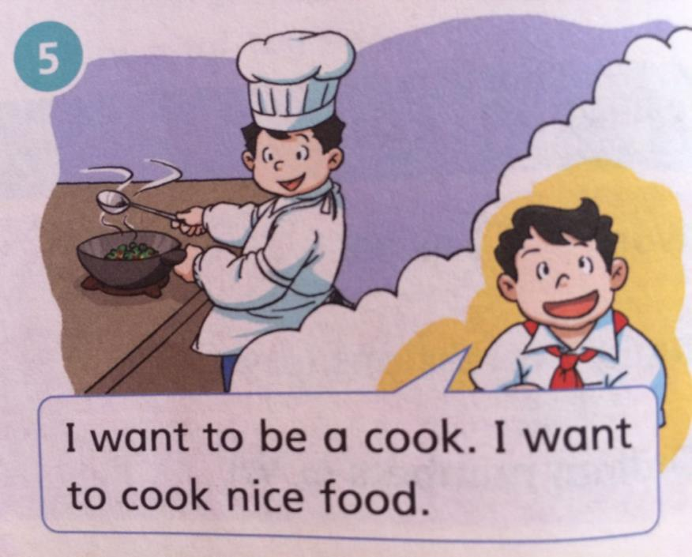

Slide 8
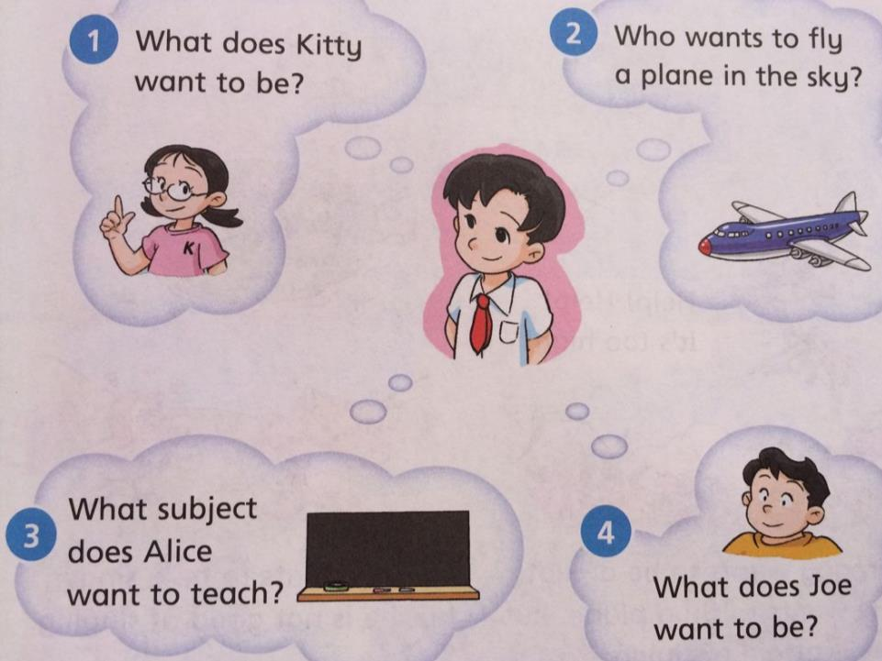
[sʌbdʒekt]

Slide 9
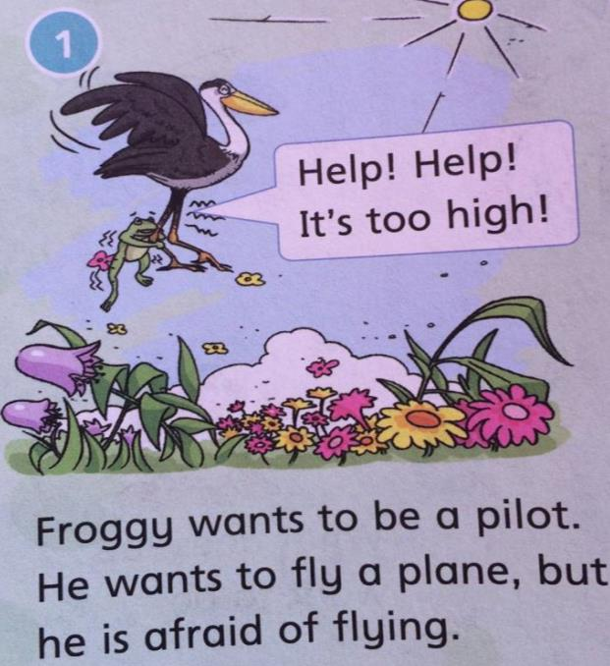
['frɒgɪ]
Froggy's
new job
[haɪ]
[əfreɪd]

Slide 10
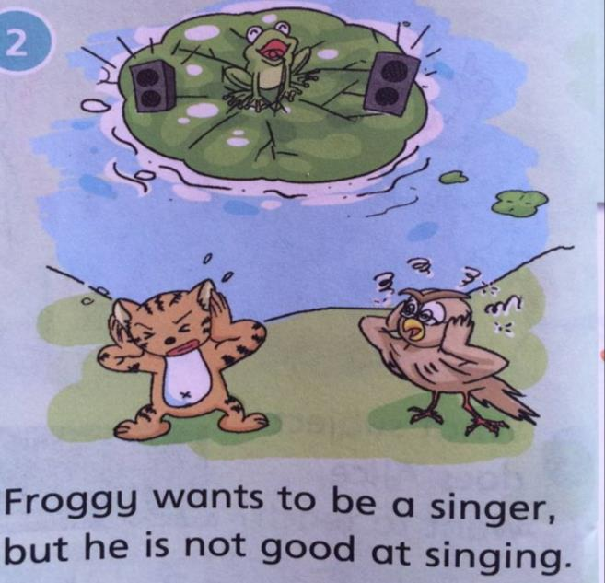
sing+er=singer
clean+er=cleaner
dance+ r=dancer
er

Slide 11
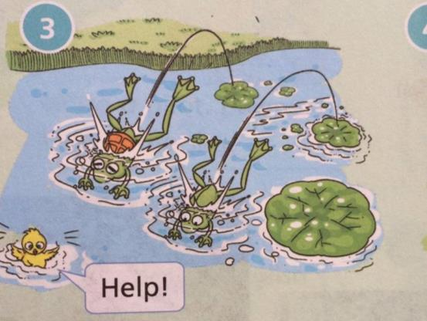
[laɪfgɑ:rd]
life+guard=lifeguard
救生员
[tʃɪk] n.小鸡
One day, a chick falls into the lake! A life- guard jumps into the lake. Froggy jumps into the lake too. They save the chick.
[seɪv]

Slide 12
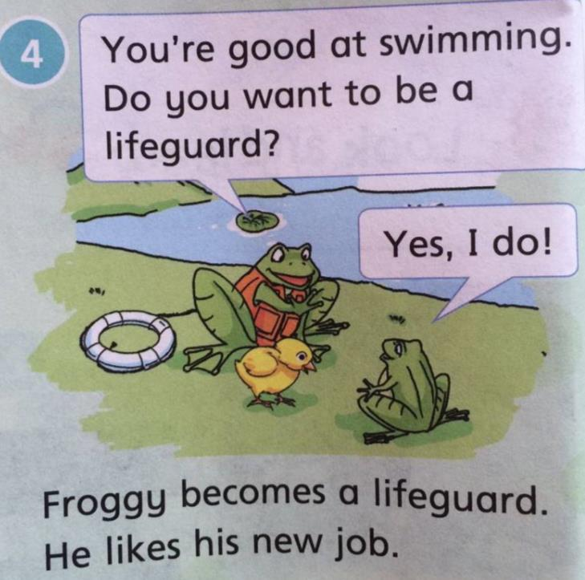
[bɪkʌm]

Slide 13
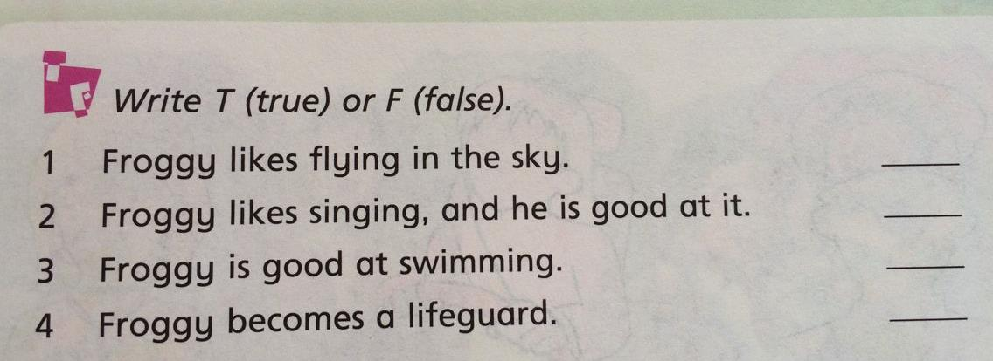
F
F
T
T

Slide 14
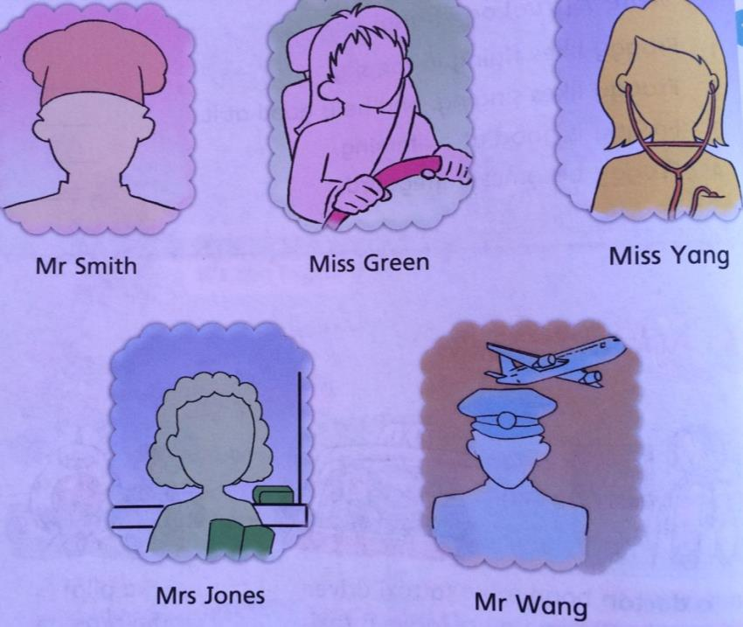
Mr 先生 Mrs 夫人
Ms 女士 Miss 小姐，老师

Slide 15
Mr Smith
cook
Mrs Jones
doctor
Miss Yang
Mr Wang
pilot
Miss Green
teacher
taxi dirver
1、 _______helps people. She is a_______.
2、 _______teaches children. She is a_______.
3、 _________flies a plane. He is a_________.
4、 _________cooks nice food. He is a______.
5、 _________drives a taxi. She is a ________.

Slide 16
sk---------
[sk]
Martin sits at his desk
Making a funny mask.
“Is it nice?” he asks.
Grandma puts on the mask
And Martin laughs.
[mɑrtn:]
[mæsk]
[æsk]
[læf]

Slide 17
Summary
What do you want to be?
I want to be_____.
I want to ___________.
Do you want to be a ______?
Yes, I do.
No, I don’t.

