Slide 1
Unit 5 Topic 3
Now it is a symbol of England.
Section D
WWW.PPT818.COM

Slide 2
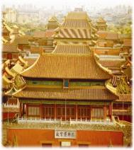
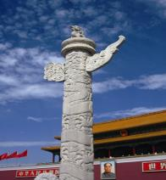
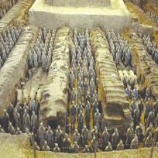
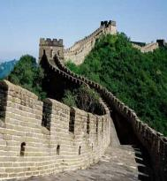
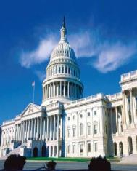
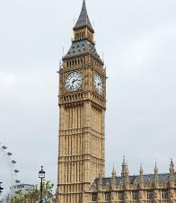
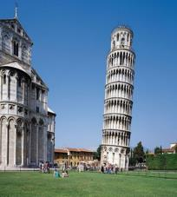
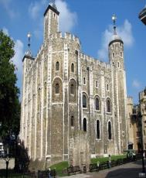
Introduce the famous buildings you know or you have learned in this unit.

Slide 3
Read through Sections A-C and fill in the blanks in Grammar.
Grammar
1. Not only Tom but also I ______ (have/has)
a car.
2. Neither he nor she ____(are/is) an engineer.
3. Probably either you or I ____(are/am) wrong.
4. Both he and Jack _____(is/are) fired.
have
is
am
are

Slide 4
Notes:
both…and…连接主语时，谓语动词要用复数形式；
neither… nor…, not only…but also…和either…or…连接主语时，谓语动词则要遵循就近一致原则。

Slide 5
Translate the sentences in Functions into Chinese.
Functions
That’s a good description.
那是很形象的描述。
I really hope I can visit some of these places some day.
我真的希望有朝一日我能去参观这些地方。
I think we have learned a lot from the famous people around the world.
我认为我们已经从这些世界名人身上学到了很多。

Slide 6
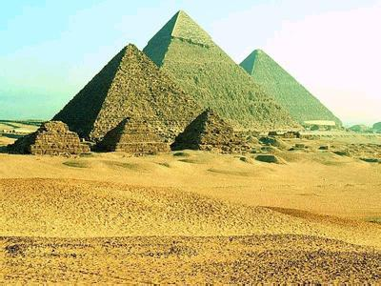
the Egyptian Pyramids
adj.埃及的，埃及人的
n.金字塔

Slide 7
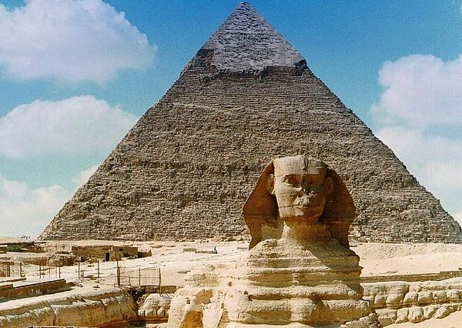
The King, Khufu, built the Great Pyramid as his tomb.
n.坟墓；冢

Slide 8
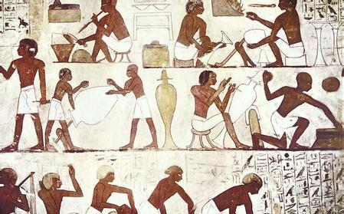
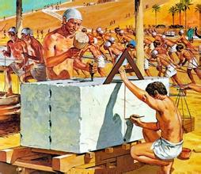
It took 100 000 people over 20 years to complete it.
v.完成

Slide 9
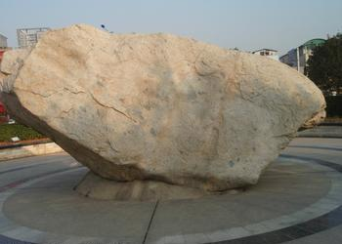
The biggest stone weighs as much as 15 tons.
n.吨

Slide 10
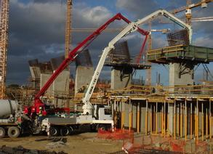
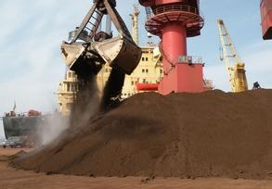
Each stone was fixed so well, though the ancient workers didn’t have any modern tools.
v.安装
n.工具

Slide 11
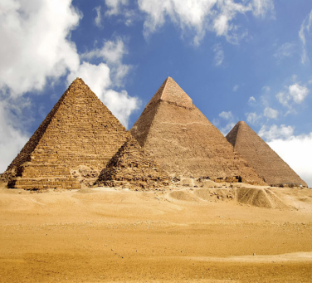
1a Look at the picture and talk about it with your partner. Then read the passage and choose the best title for it.
A. The Great Pyramid
B. The Seven Wonders
C. The Largest Pyramid

Slide 12
1b Read 1a again and complete the table.
The Great Pyramid
Country |  | Building time
Use |  | Material
Length |  | Number of workers
Height |  | Elapsed time
Mystery | how the ancient Egyptians built it without modern ____________ or _____________
Significance | showing the ___________ and the ______________ of ancient Egyptian working people
Egypt
around 2 560 B.C.
as a tomb
stones
230.4 meters
100 000
146.5 meters
over 20 years
machines
equipment
wisdom
achievements

Slide 13
Key points
1. Studies show that it took 100 000 people over 20 years to complete it.
It takes/took sb. +时间+ to do sth. 做某事花费某人多少时间
2. order sb. to do sth. 命令某人去做某事
3. continue to do sth. 继续做某事

Slide 14
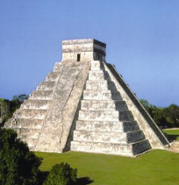
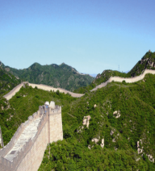
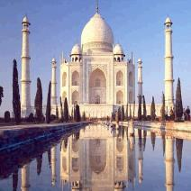
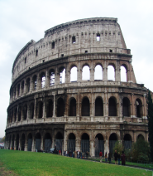
2 Here are four pictures of the New Seven Wonders of the World. Match them and describe the pictures in groups.
4
2
3
1
1. The Colosseum of Italy 2. The Great Wall of China
3. The Taj Mahal of India 4. The Chichén Itzá of Mexico

Slide 15
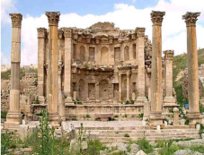
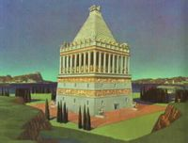
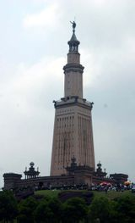
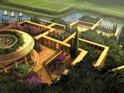
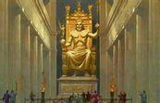
Project
Making Posters about the Seven Wonders of the World
1. Choose one of the Seven Wonders of the World.
阿尔忒弥斯神殿
金字塔
毛索洛斯墓庙
亚历山大灯塔
巴比伦空中花园
宙斯神像
罗德岛巨像

Slide 16
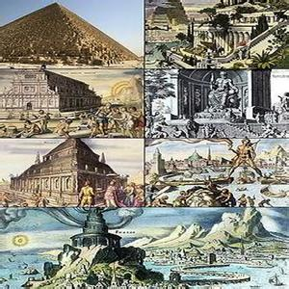
Project
Making Posters about the Seven Wonders of the World
2. Search for more information about the Seven Wonders of
the World and make posters.

Slide 17
Project
Making Posters about the Seven Wonders of the World
3. Share the posters with your classmates.

Slide 18
Sum up
Words:
complete v. 结束，完成
ton n. 吨
fix v. 安装；修理
tool n. 工具
Phrases:
order sb. to do sth. 命令某人去做某事
continue to do sth. 继续做某事

Slide 19
Sum up
Sentences
Studies show that it took 100 000 people over 20 years to
complete it.
It takes/took sb. +时间+ to do sth. 做某事花费某人多少时间

Slide 20
Sum up
Grammar
并列连词
either…or… 或……或……；不是……就是……
both…and… ……和……两者都
not only…but also… 不但……而且……
neither…nor… 既不……也不……

Slide 21
Homework
1. Review the key points of this topic.
2. Write a passage to introduce one of
the Seven Wonders of the World.

