Slide 1
Unit 5 Lesson 3
It will snow.
WWW.PPT818.COM

Slide 2
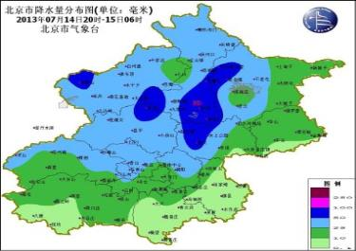
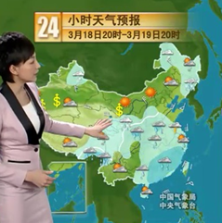
Weather report

Slide 3
snowy
rainy
cloudy
weather
windy
sunny

Slide 4
Let’s learn!
1. sun n. 太阳
→ sunny adj. 晴朗的
2. rain n. 雨
→ rainy adj. 多雨的；下雨的
3. cloud n. 云
→ cloudy adj. 多云的

Slide 5
4. snow n. 雪；v. 下雪
→ snowy adj. 多雪的；下雪的
5. wind n. 风
→ windy adj. 多风的；刮大风的
6. storm n. 暴风雨
→ stormy adj. 有暴风雨的
7. shower n. 阵雨
→ showery adj. 有雷阵雨的

Slide 6
How’s the weather in Shenyang tomorrow?
It will snow in Shenyang tomorrow.

Slide 7
How’s the weather in Beijing tomorrow?
In Beijing, it will be sunny tomorrow.

Slide 8
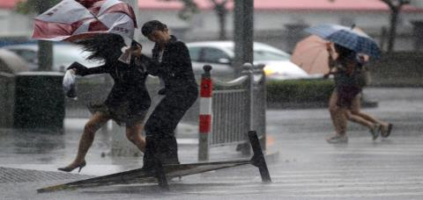
How’s the weather in Shanghai tomorrow?
Shanghai will be rainy and windy.

Slide 9
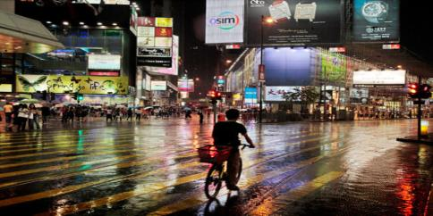
How’s the weather in Hong Kong tomorrow?
It will rain in Hong Kong tomorrow.

Slide 10
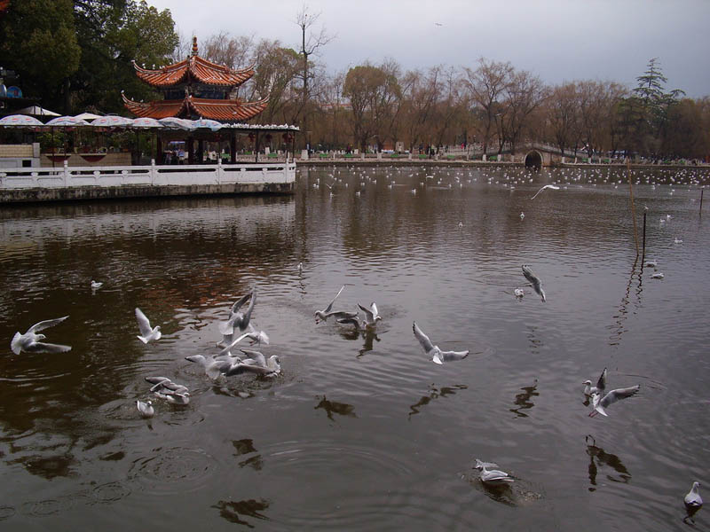
How’s the weather in Kunming tomorrow?
It will be windy.

Slide 11
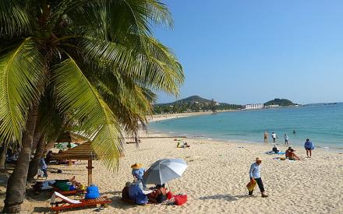
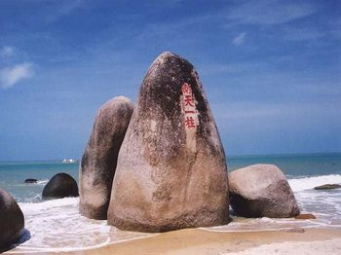
How’s the weather in Hainan tomorrow?
sunny
It will be_______.

Slide 12
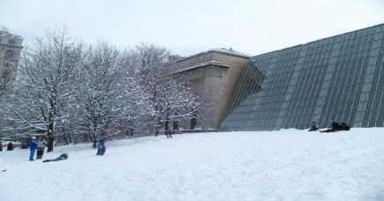
How’s the weather in America tomorrow?
snowy
It will be_______.

Slide 13
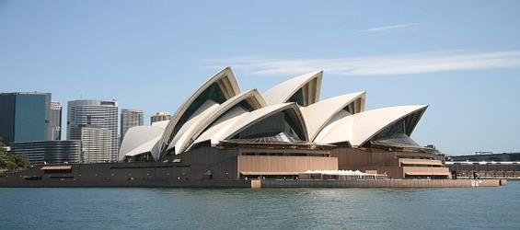
How’s the weather in Australia tomorrow?
sunny
hot
It will be ______ and _____ there.

Slide 14
Words and expressions
cloud
shower
snow
storm
cloudy
rainy
snowy
sunny
n. 云；云雾
n. 阵雨
n. 雪；v. 下雪
n. 暴风雨
adj. 多云的
adj. 多雨的；下雨的
adj. 多雪的；下雪的
adj. 晴朗的

Slide 15
practice
根据句子意思，用适当的单词填空。
1. Mum, how’s the weather tomorrow?
It will be_______.
2. How’s the weather in Shenyang tomorrow?
It will ______.
3. It will be _______ tomorrow.
sunny
snow
snowy

