Slide 1
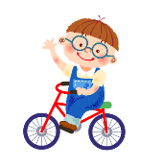
Starter Module 1 My teacher and my friends
Good morning, Miss Zhou
开学啦
WWW.PPT818.COM

Slide 2
Welcome to
No.5 Middle school!
Please tell everyone:
“What's your name?”

Slide 3
Go For It！（学习目标）
1. To learn how to introduce yourself.
2. To learn how to greet other people.
3. To learn how to write the 26 letters.

Slide 4
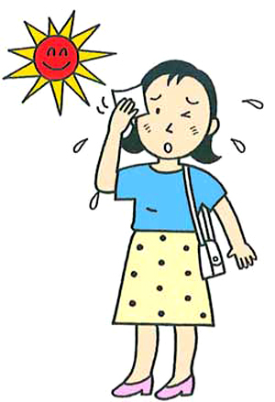
Let’s learn: three time sections
['mɔ:nɪŋ]
[ɑ:ftə'nu:n]
morning
afternoon
['i:vnɪŋ]
evening

Slide 5
Guessing game:
evening
afternoon
evening
morning

Slide 6
When you meet your friend in these sections, What can you say?
Good morning!
15:00
Good afternoon!
7:00 am
Good evening!
19:00

Slide 7
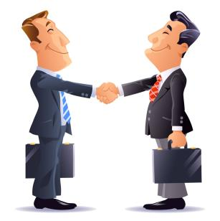
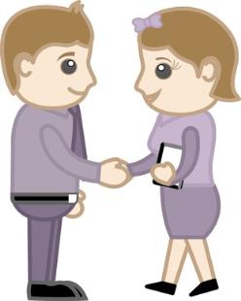
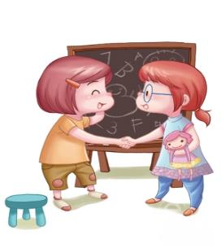
9:00 a.m
14：30
20：00

Slide 8
9:00 a.m
Good
morning!
Good
morning!

Slide 9
14：30
Good
afternoon!
Good
afternoon!

Slide 10
20：00
Good
evening!
Good
evening!

Slide 11
When you want to leave, What can you say?
Goodbye
Goodbye

Slide 12
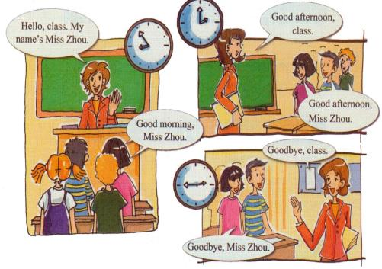
Listening
— _______, class. My name’s Miss Zhou.
— _____________, Miss Zhou.
— Good afternoon, class.
— _____________, Miss Zhou.
— Goodbye, class.
— ___________, Miss Zhou.
Hello
Good morning
Good afternoon
Goodbye

Slide 13
Match the correct answers
Hello，my name’s Daming.
a) Goodbye, Tom.
Hello，my name’s Daming.
a) Goodbye, Tom.
Good morning, Lingling.
Good morning, Lingling.
b) Hello, my name’s Lingling.
b) Hello, my name’s Lingling.
Good afternoon, Carla
c) Good morning, Carla.
Good afternoon, Carla
c) Good morning, Carla.
Good bye, Mike
d) Good afternoon, Mike.
Good bye, Mike
d) Good afternoon, Mike.

Slide 14
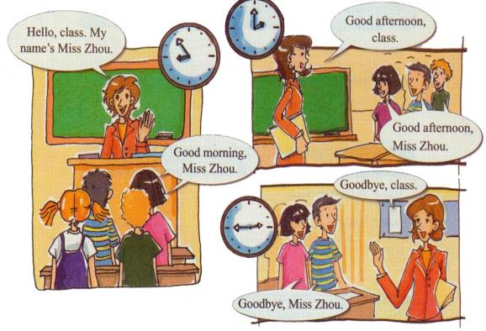
Speaking in groups

Slide 15
Challenge Time
Secrect guests!

Slide 16
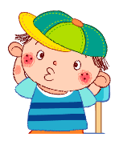

Slide 17
Can you remenber the words in the song?
V
V is
for vase

Slide 18
Can you remenber the words in the song?
X
X is for Xylophone

Slide 19
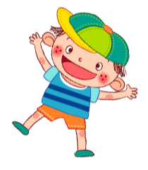
Can you finish this blanks?
A
b
C
d
F
h
I
a
e
g
j
K
l
M
N
P
R
S
T
o
q
V
W
X
Y
u
z

Slide 20
Summary
The way to introduce yourself:
Hello, My name is ....
The way to greet other people:
Good morning
Good afernoon
Goodbye
The way to write the letters

Slide 21
1.用所学的交际用语和新朋友打招呼。
Homework
2.用所学的交际用语和你的家人打招呼。
3.认真书写26个字母。

Slide 22
THANK YOU

