Slide 1
Unit 1
It’s taller than
many other buildings.
WWW.PPT818.COM

Slide 2
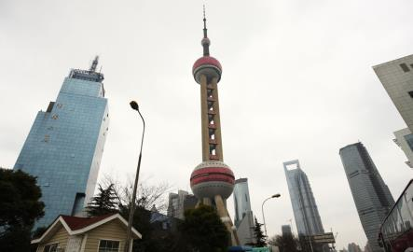
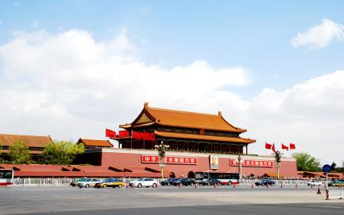
Warm-up
Look at the pictures. Where are the buildings?
The Oriental Pearl TV Tower Of Shanghai
东方明珠
Tian’anmen Square
天安门广场

Slide 3
Words
and
expressions

Slide 4
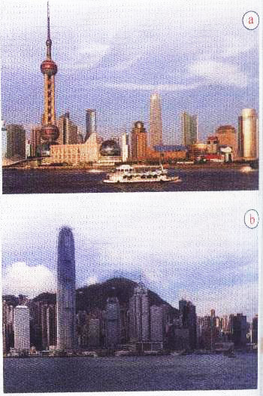
1. Look at the pictures and talk about them.
high
hill
population river
wide

Slide 5
Now listen and complete.
Shanghai
Place: (1)_______________
Population: (2)_____ million
Jin Mao Tower: (3) _____ metres high
Place: (4)___________
Population: (5)______ million
Victoria Peak: (6) ____ metres high
23.5
420.5
hundred / thousand / million / billion前有具体的数字，不能加S，不能说 five hundreds,要说five hundred。
没有具体数字，则是hundreds of+名词复数
Hong Kong
seven
552

Slide 6
Everyday English
Hey!
How was your weekend?
Pretty good!

Slide 7
Now complete the passage about Shenzhen.
Shenzhen is on the coast near Hong Kong. It became important in the (1) _____. Before that it was a (2)_____. Today the population of Shenzhen is more than (3) _____ million. There are many tall buildings in Shenzhen. A famous one is the (4) ____________. It is (5) _______ than many other buildings in Shenzhen.
village
1980s
ten
more than“超过”，后面加数目，相当于over。
反义词：less than“少于”
Diwang Tower
taller

Slide 8
3. Complete the sentences with the correct form of the words.
big busy clean large new small wide
1. About thirty years ago, Shenzhen was a _____ village,
but today it is a very _______ city.
2. Shenzhen is a _______ city than Hong Kong.
3. Shenzhen is getting ______ and ______. The streets
are ______ and ______.
4. Shenzhen will become as _____ as Hong Kong.
5. The population of Shenzhen is _____ than that of many
other cities in China.
small
big
newer
bigger
busier
wider
cleaner
busy
larger

Slide 9
4. Listen and notice how the speaker streeses the underlined words.
— Shenzhen is larger in population than Beijing.
— No, it isn’t. It’s smaller.
2. — Hong Kong is newer than Shenzhen.
— No, it isn’t. It’s older.
3. — Shenzhen is as old as Hong Kong.
— No, it isn’t. It’s newer.
4. — Hong Kong is as busy as Shenzhen.
— No, it isn’t. It’s busier.

Slide 10
5. Compare Shenzhen with your home town. Make notes in the table.
Shenzhen | Your home town
a big city

Slide 11
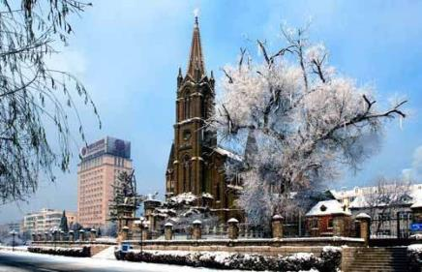
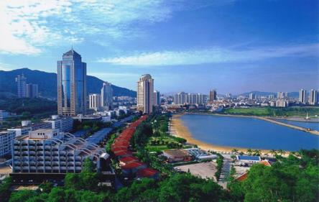
6. Work in pairs. Talk about the differences between Shenzhen and your home town. Use big, small, hot, cold, tall or new.
— Is your home town bigger than Shenzhen?
— No, it isn’t. It’s smaller than Shenzhen.

Slide 12
Language points

Slide 13
Well, it's on the coast near Hong Kong.哦，它是临近香港的沿海城市。
on the+方位词+coast of... “在......的......海岸”
Xiamen is a city on the south coast of China.
厦门是中国南海岸的一座城市。
In fact, it only became important in the 1980s.实际上，它到了20世纪80年代才变得重要。
▲in the 1980s “在20世纪80年代”
例如：in the 2010s意思是“在21世纪10年代”。

Slide 14
It's getting bigger and busier.深圳变得越来越大，也越来越繁华。
get，此处是系动词， “变得，成为”，后接形容词比较级作表语。
The weather is getting hotter and hotter.
天气变得越来越热。
变得；成为 | The day is getting longer and longer.
收到；得到 | I got a lot of presents for my birthday.
搬来；拿来 | Please get me some water!
到；抵达 | He got home at 6 o'clock.

Slide 15
Some day it will become as busy as Hong Kong, I'm sure.我确信，有朝一日它会变得和香港一样繁华。
▲as+adj/adv的原级+as... “和......一样......”，表两者之间同级比较。
▲否定形式为not as+adj/adv的原级+as...
Jack is as tall as me. 杰克和我一样高。
▲be busy doing sth.
be busy with sth.忙于做某事
I am busy doing my homework.我忙于做作业。

Slide 16
What's the population of Shenzhen?深圳人口是多少？
population是一个地区的或国家的整体人口，作主语时谓语动词用单数。表达人口多用larger，人口少用small。
The popolation of the city is very small. 这个城市人口少。
询问人口不能用how much或how many，只能用what.
What's the population of+地区？

Slide 17
Its streets are much wider and cleaner too. 它的街道也更宽阔更干净。
▲much用在形容词前面，形容词要用比较级。
even+形容词比较级。
Mary's room is much bigger than mine.
玛丽的房间比我的大得多。
My bag is even heavier than yours.
我的包比你的重得多。
much修饰不可数名词，many修饰可数名词。

Slide 18
Remember to visit the Diwang Tower.记得去参观地王大厦。
▲remember to do sth.“记得去做某事（事没做）”。
▲remember doing sth.“记得做过某事（事已做）”。
Remember to close the door when you leave.
记得走的时候关门。
+to do
事没做
remember记得
forget忘记
regret遗憾
+doing
事做过

Slide 19
中考链接

Slide 20
1. Peter is busy____at school, but he never forgets____
exercise every day.
A. working; doing B. working; to do
C. at work; doing D. to work; to do
2. Mike always does his homework as___as his sister,
and they often get good grades in the exams.
A. good B. well C. better D. best

Slide 21
3. —What a hot day!
—The weather report says it will be much___tomorrow.
A. hot B. hotter C. hottest D. hoter
4. Every year, ____farmers go to big cities to work.
A. million B. millions
C. million of D. millions of

Slide 22
比较级

Slide 23
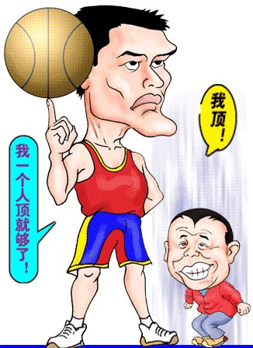

Slide 24
形容词的比较级
比较级
用于两者之间的比较
Yao Ming is taller than Pan Changjiang.
Notes:
24

Slide 25
比较级和最高级的变化规则
一般
加er
二般
以e结尾，
加r
large
wide
hot
big
三般
以辅音+y结尾变y为i，
加er
tall
long
四般
以重读辅元辅结
尾，双写尾字母，
加er
easy
heavy
small
hungry

Slide 26
比较级的变化规则
五般
两个或两个音节以上
直接加more
六般/不一般
不规则
beautiful
more beautiful
clearly
more clearly

Slide 27
1. nice ____ 2. hot ______
3. slow ______ 4. good/well ______
5. beautiful _____________
7. bad/ill ______
8. much/many _______
9. little _______
hotter
nicer
slower
better
more beautiful
worse
more
less

