Slide 1
Unit 1 I like red
WWW.PPT818.COM

Slide 2
Task 1:Draw The Olympic Rings
（Pay attention to their colors）

Slide 3
Culture Note (文化点滴)：
The colours of the interlinked Olympic rings were chosen by the International Olympic Committee (IOC) , to represent the union of the 5 continents , Australia , Africa , America , Asia and Europe and further signify the meeting of the worlds athletes at the Olympic Games.
国际奥委会选择五个相连的圆环作为其标志，并选择了相应的色彩。五个圆环代表五大洲：大洋洲、非洲、美洲、亚洲和欧洲。更深一层的意思是代表着全世界的运动员都聚集在奥林匹克运动会上
The five colours of the rings from left to right are blue, black and red across the top with yellow and green along the bottom , these colours may be found on most flags of the world.
五种颜色从左到右分别是：上方三个
蓝、黑、红，下方黄和绿。
这五种颜色都为各国国旗上的常见颜色。

Slide 4
Colors

Slide 5
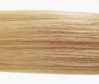
red
orange
yellow
green
blue
Purple
black
White
Pink
blond
brown
grey

Slide 6
Long blond hair

Slide 7
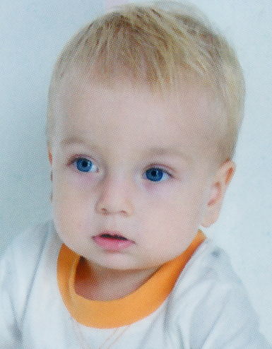
Short blond hair

Slide 8
What color is the sky?
The sky is blue.

Slide 9
What color is the snow?
What color is the dog?
The snow is white.
The dog is black.
white

Slide 10
What color are the flowers?
The flowers are pink.

Slide 11
What color is the church?
The church is gray.

Slide 12
What color is the tree?
The tree is green.

Slide 13
What color is the sign?
The sign is yellow.

Slide 14
What color is the balloon?
The balloon is purple.

Slide 15
What color is the sunset?
The sunset is orange.

Slide 16
What color are the roses?
The roses are red.

Slide 17
What color is the tree?
The tree is brown.

Slide 18
What is this color?
blue
green
red
yellow
black

Slide 19
Do you like red?
What colour is it?
It’s red.
Yes, I do.
No, I don’t.
What color do you like?
I like yellow.

Slide 20
I can talk
场景一：和妈妈在商场买衣服，选一件你最喜欢的颜色的衣服

Slide 21
关于颜色的表达
A black-letter day 倒霉的日子
Black dog 沮丧
Blue Monday（烦闷的星期一）
Blue music（伤感的音乐）
A white night （不眠之夜）
a white elephant (白象, 累赘物,无用之物）
A yellow dog 忘恩负义之徒
green hand (生手；新手）
green house（温室）

Slide 22
Task 2:link
a.in the red
b.in the black
c.a black day
d.a white day
e.a blue day
f.green-eyed
g.blue in the face
h.black-hearted
i.out of the blue
A.黒心肠的
B.盈利的
C.倒霉的一天
D.负债经营的
E.吉日
F.忧郁的一天
G.突如其来的
H.脸色发青
I.嫉妒的

Slide 23
Writing Practice
Write each word 3x

Slide 24
red
 | blue
orange
 | yellow

Slide 25
green
 | pink
black
white

Slide 26
 | brown
gray
 | purple

