Slide 1
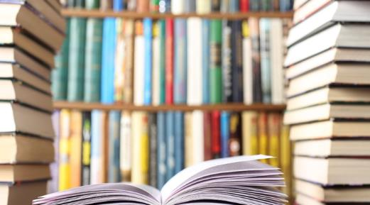
Unit 4
I used to be afraid of the dark.
第3课时
WWW.PPT818.COM

Slide 2
课内基础自测
Ⅰ.根据句意及汉语提示写出所缺的单词
1．A lot of ________ (蚂蚁) come and go in front of my house. Maybe it
will rain soon.
2．The teacher told us some interesting facts about ________(昆虫).
3．I always feel ________(紧张的) before the exam. What should I do?
4．He doesn't like to do housework. In fact, he ________(厌恶) it.
5．My elder brother used to be on a soccer ________(队).
ants
insects
nervous
hates
team

Slide 3
Ⅱ.根据汉语意思完成句子
1．他的父母以前总是很忙碌。
His parents ________ ________ ________ very busy.
2．我们总是为孩子们的安全而担心。
We always ________ ________ children's safety.
3．那个男孩一直很快乐。
The boy is happy ________ ________ ________.
used to be
worry about
all the time

Slide 4
4．莉萨擅长演讲。
Lisa is good at ________ ________ ________.
5．他一年至少读六本书。
He reads ________ ________ six books a year.
making a speech
at least

Slide 5
Ⅲ.按要求完成下列各题
1．The girl used to be afraid of ants. (改为否定句)
The girl ________ ________ ________ be afraid of ants.
2．She used to be on the tennis team. (改为一般疑问句)
_______ ________ ________ ________ be on the tennis team?
3．They used to live in the countryside. (改为反意疑问句)
They used to live in the countryside, ________ ________？
didn't use to
Did she use to
didn't they

Slide 6
4．My elder brother walks to school every day. (改为同义句)
My elder brother goes to school ________ ________ every day.
5．My father is always busy with his work. (改为同义句)
My father is busy with his work ________ ________ ________.
on foot
all the time

Slide 7
课后巩固提升
任务型阅读
Josh's family used to live in a small town. Their house was on a quiet street with lots of trees. There was a yard where Josh and his sister often played. Josh's mom had a flower garden and she took good care of the flowers.
Josh went to middle school in the small town. The town had a primary school, a middle school, and a high school. Josh's family shopped in small stores.

Slide 8
One day, Josh's mom got a new job in the city. Then the family moved to an apartment in the noisy city. There isn't a yard anymore. Josh and his sister have to go to the park to play. And Josh's mom has to grow flowers in a window box.
The city has many schools for children. Josh's parents have chosen a school for him near their apartment. It is larger than Josh's old school. There are many supermarkets in the city. The family enjoy shopping there. Josh likes to visit different museums and libraries in the city.

Slide 9
Josh's life in the city is different from that in the small town. He knows more people, goes to more places and learns more! But some things are the same. He is with his family. And it is still his job to learn at school and help at home. He makes new friends here and sends e­mails to the old ones.

Slide 10
根据短文内容，完成句子，每空一词。
1．Josh and his sister used to play in the ________．
2．There were ________ schools in the small town.
3．Josh's mom likes to grow ________ very much.
4．Josh's family go shopping in ___________ now.
5．Josh keeps in touch with(与……保持联系) his old friends by
________．
yard
three/3
flowers
supermarkets
e­mail

Slide 11
谢 谢 观 看！

