Slide 1
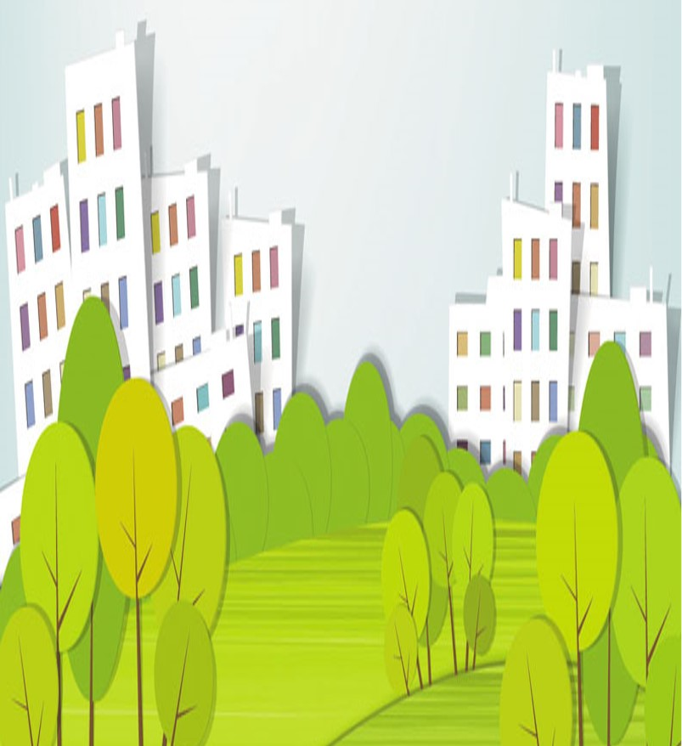
Unit6
Keep our city clean
WWW.PPT818.COM

Slide 2
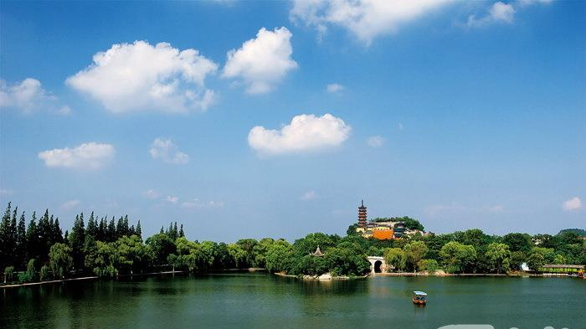
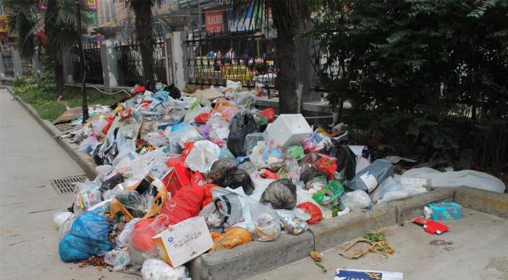
clean 干净的
Keep our city clean!
保持我们的城市整洁
dirty and messy
又脏又乱

Slide 3
Would you like to be a volunteer to keep our city clean?
你愿意做个志愿者去保持我们城市整洁吗？

Slide 4
Task1
了解城市污染的现状
Task2
提出解决问题的建议
Task3
完成倡议书发出倡议

Slide 5
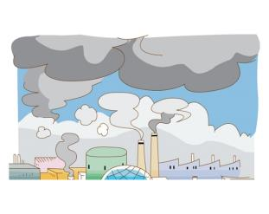
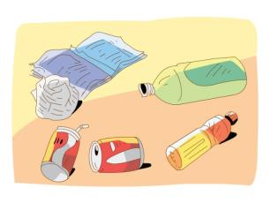
Task1
了解城市污染的现状
Watch and choose: What makes our city dirty？
A
B
clouds
smoke
C
D
rain
rubbish

Slide 6
Task1
了解城市污染的现状
Watch and choose: What makes our city dirty？
A
B
clouds
smoke
烟雾
C
D
rain
垃圾
rubbish

Slide 7
Read and find.细读课文，找出污染的具体危害,读一读。
factory
工厂（单数）
chair
Smoke from _______ makes ________ dirty.
Black smoke from _______ makes _______ dirty, too.
Rubbish makes ___________ messy and dirty.
Rubbish in the _________ makes ___________ dead.
cars
the air
空气
factories
the air
the streets
head
river
the fish
死的
Notes:
7

Slide 8
Read and find.细读课文，找出污染的具体危害。
Smoke from _______ makes ________ dirty.
Black smoke from _______ makes _______ dirty, too.
Rubbish makes ___________ messy and dirty.
Rubbish in the _________ makes ___________ dead.
cars
the air
factories
the air
the streets
river
the fish
Notes:
8

Slide 9
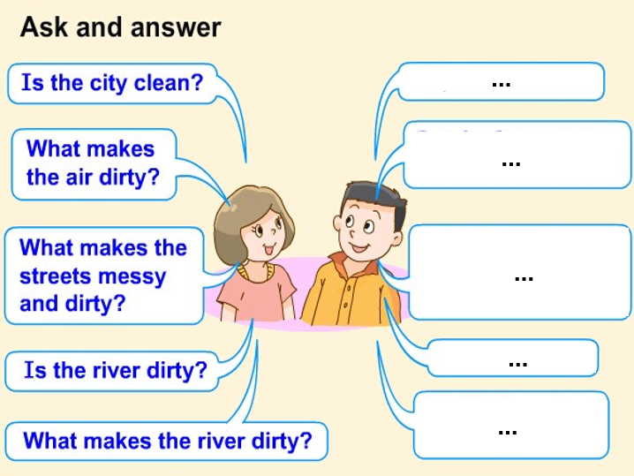
Do you know anything about the city pollution?
你对城市污染有所了解了吗？

Slide 10
Task2
提出解决问题的建议
Read and find:(和同桌读课文P59并找出答案)
What can we do to keep our city clean?
？

Slide 11
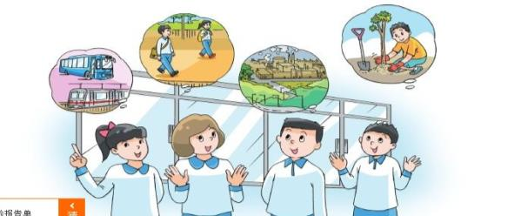
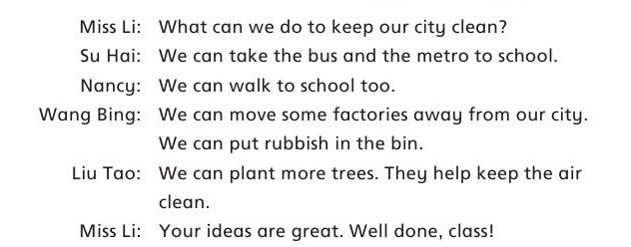
What can we do to keep our city clean?
地铁
从……移走
垃圾箱
更多的
Notes:
11

Slide 12
Think and write 想一想，写一写
What can we do to keep our city clean?
. We can take and to school.
. We can also to school.
. We can move some away from the city.
. We can put in the bin.
. We can plant more .
the bus
the metro
walk
factories
rubbish
trees

Slide 13
What other ideas？你还有其他的建议吗？
We can...

Slide 14
Let's read!
Listen and repeat.
Read in roles.
Read together.

Slide 15
Try to retell.
根据板书内容，试着复述课文。
Our city is not…now. …makes the air dirty. …makes…dirty….
To keep our city clean, we can…. …

Slide 16
Task3
完成倡议书发出倡议
Dear friends:
Our city is not clean now._____________makes the air dirty. ___________makes_____________dirty.
__________________________________.
To keep our city clean, we can_________________ __ .________________________.________________________.
Protecting the environment is everyone ’s duty (保护环境，人人有责).Let's do it right now.
_________

Slide 17
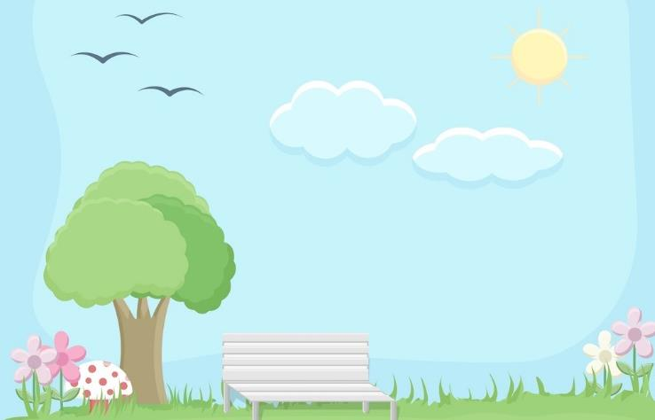
Homework：
1.Read the text and try to
retell the text.
熟读课文,并试着复述课文。
2.Read your proposal to your
parents and other people.
(把你的倡议书读给你的父母和更多的人听)

