Slide 1

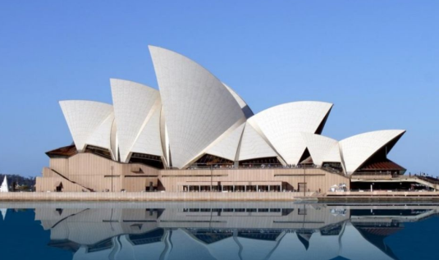
A friend in Australia
9
第一课时
WWW.PPT818.COM

Slide 2
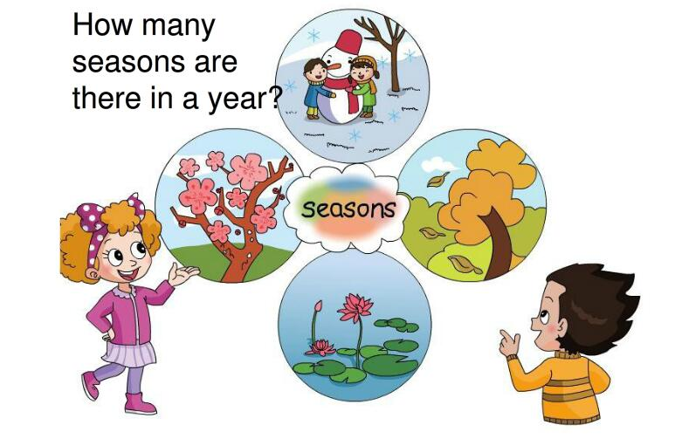

Slide 3

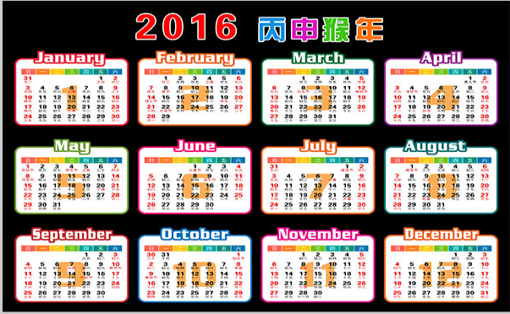
months
1
The year of Monkey
Notes:
3

Slide 4
abbreviation
abbreviation
January
Jan.
July
Jul.
February
August
Aug.
Feb.
September
Sept.
March
Mar.
October
Oct.
April
Apr.
November
Nov.
May
May
December
June
Dec.
Jun.

Slide 5
Play a game
January
Jan.
July
Jul.
February
August
Aug.
Feb.
September
Sept.
March
Mar.
October
Oct.
April
Apr.
November
Nov.
May
May
December
June
Dec.
Jun.

Slide 6
Let's chant
February
April
March
Warm, warm, warm.
Rainy, rainy, rainy.
It’s warm and rainy in February.
We can ride a bike.
Spring

Slide 7
Let's chant
May
June
July
hot, hot, hot.
sunny, sunny, sunny.
It’s hot and sunny in July.
We can swim.
Summer

Slide 8
Let's chant
September
October
August
cool, cool, cool.
windy, windy, windy.
It’s cool and windy in October.
We can fly a kite.
Autumn

Slide 9
Let's chant
November
December
January
cold, cold, cold.
snowy, snowy, snowy.
It’s cold and snowy in January.
We can make a snowman.
winter

Slide 10
Think and say
Work in pairs
A: When’s your birthday?
B: My birthday is in _________.
A: How’s the weather in________?
B: It’s__________.
A: What can you do in________?
B: We can__________.

Slide 11
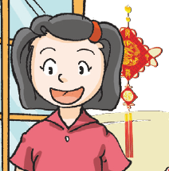
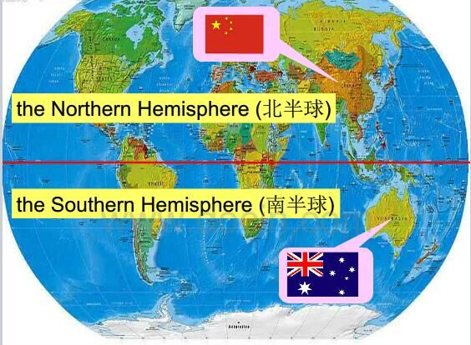

Beijing
China
Jill
summer
Amy
winter
Sydney
Australia
Notes:
11

Slide 12
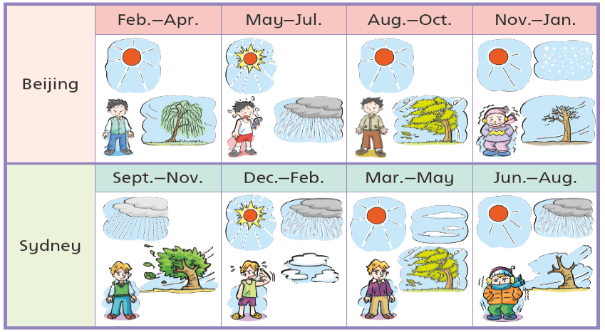
spring
summer
autumn
winter
Notes:
12

Slide 13
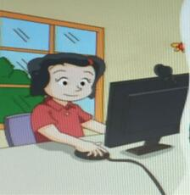
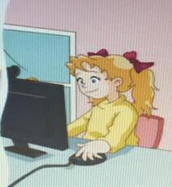
Jill and Amy talk on the computer
Hello,Amy. I’m in Beijing.
We can make a snowman. How’s the weather in Sydney in January?
It’s cold and snowy in Beijing in January.
What can you do?
Jill
Hi,Jill. How’s the weather in January in Beijing?
What can you do in January?
It’s hot and sunny in Sydney in January.
We can swim.
Amy
Notes:
13

Slide 14

Miss Ho and Amy talk on the computer
We can swim.
How’s the weather in July in Sydney?
Hello, Amy. I’m in Shenzhen.
It’s hot and sunny in July in Shenzhen.
What can you do?
Miss Ho
Hi, Miss Ho. How’s the weather in Shenzhen?
It’s cold and snowy in July in Sydney.
We can make a snowman.
What can you do?
Amy
Notes:
14

Slide 15
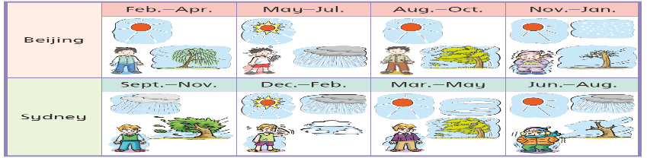
Think and say
Work in pairs
shenzhen
A: Hello, Amy. I’m in Shenzhen.
B: How’s the weather in ________?
A:It’s ________ in________ in Shenzhen.
B: What can you do?
A: We can ___________in Shenzhen. How’s the weather in _________in Sydney?
B:It’s ________ in ______in Sydney.We can _______.

Slide 16
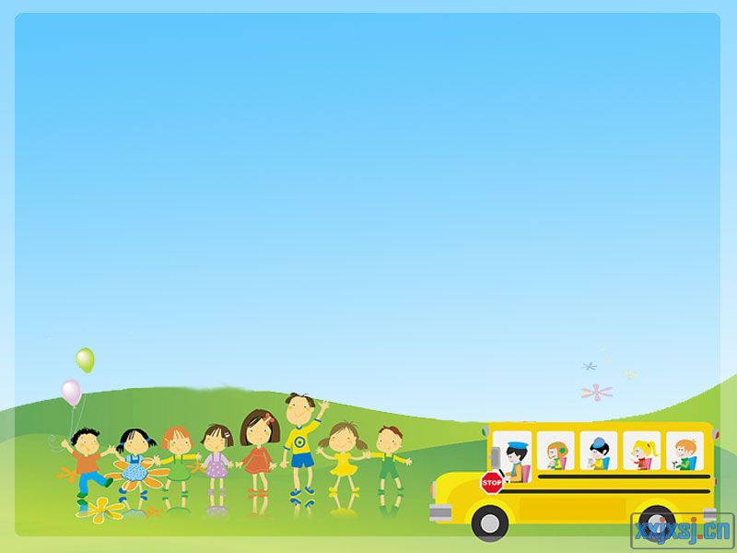
Sum up
How’s the weather in________?
It’s______________.
1
The year of Monkey

Slide 17

Think and complete
My favourite month
Example:
My favorite month is March, because my birthday is in March . It is the season of spring. I live in Shenzhen. It’s warm in March in Shenzhen. We can ride a bike in March. How about you?

Slide 18

Think and complete
My favourite month
My favorite month is_________, because my birthday is in_______. It is the season of _______. I live in______. It’s __________ in _______ in_______. We can _____________ in_________. How about you?

