Slide 1
Unit 4 Body
Unit 4 Body
Lesson 3 I have two eyes.
Lesson 3
I have two eyes.
WWW.PPT818.COM

Slide 2
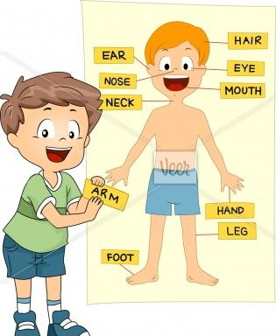
Free talk
A: This is my head.
B: This is my arm.
A: This is my leg.
B: This is my foot.
A: I have a nose.
B: I have a nose,too./ Me.too!
A: ……

Slide 3
你能
找出
它们的
共同点
吗？
你能
找出
身体中
成对的
部位吗？
head
nose
face
mouth

Slide 4
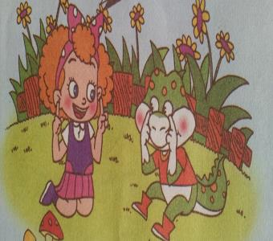
Listen
I have two
___.
ears

Slide 5
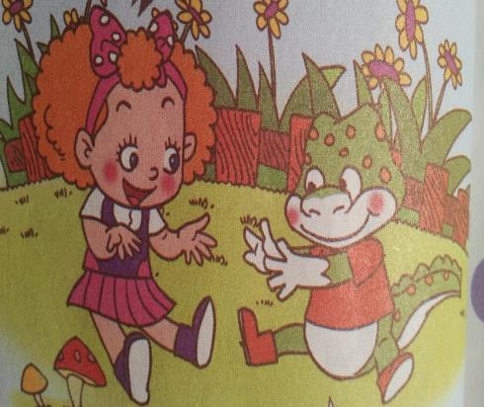
Listen
I have _____ _____.
two
arms

Slide 6
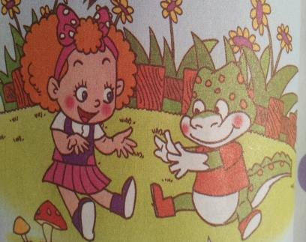
Listen
I have two _____.
hands

Slide 7
Listen
I have two ____.
eyes

Slide 8
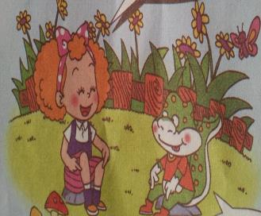
Listen
I have two ___.
legs

Slide 9
英语模仿秀

Slide 10
chant
ear, ear, I have two ears;
eye, eye, I have two eyes;
hand, hand, I have two hands;
arm, arm, I have two arms;
leg, leg, I have two legs.

Slide 11
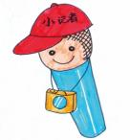
Groupwork
A: Look! I have two eyes.
B: I have two hands.
C: I have two arms.
D: I have two legs.
E: I have a nose.
……

Slide 12
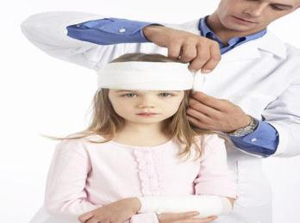
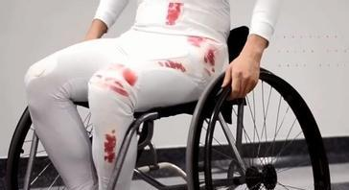
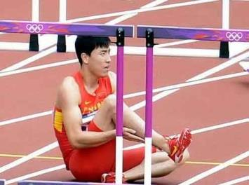
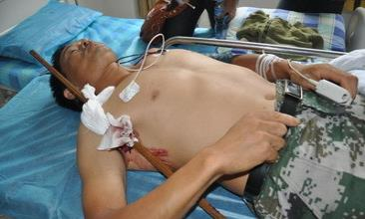

Slide 13
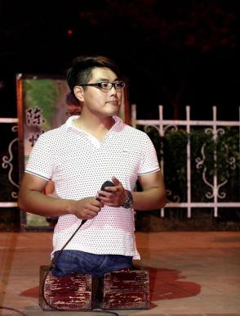
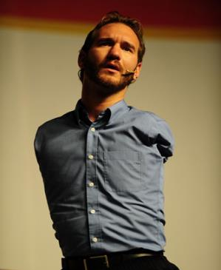
We are very lucky to have a healthy body. So what should we do?

Slide 14
summary
What have we learnt today?
(今天我们学到了什么呢？)

Slide 15
Exercises
一、选择填空
1. I have two ______.
A. ear B. ears C. eye
2. I have a _____.
A. hands B. faces C. face
3. I have_____ arms.
A. a B. too C. two

Slide 16
二、选出不同类的单词。
1. A. nose B. foot C. you
2. A. Mr. B. mouth C. head
3. A. brother B. tail C. face
4. A. have B. eye C. arm

