Slide 1
Unit 12
What did you do last weekend?
R 七年级下册
第4课时
WWW.PPT818.COM

Slide 2
Lead-in
How much do you know about camping?

Slide 3
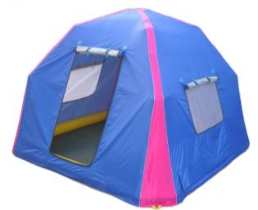
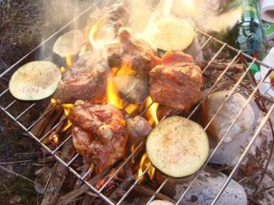

Slide 4
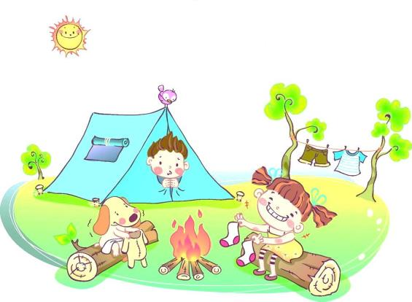

Slide 5
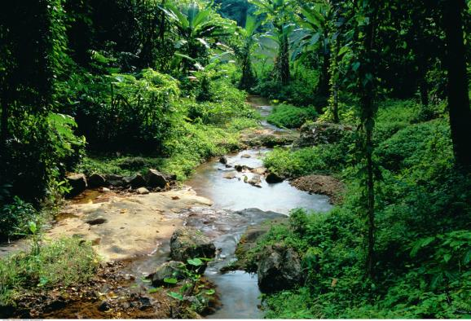

Slide 6
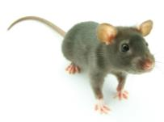
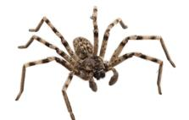
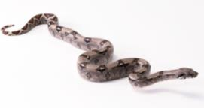
What kinds of animals are people sometimes afraid of? Why? Make a list.
2a
mouse
spider
snake

Slide 7
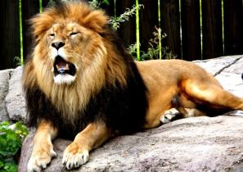
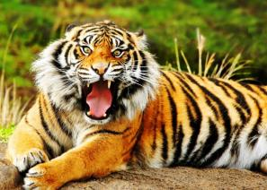
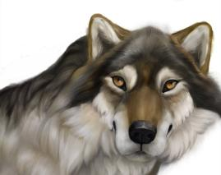
lion
tiger
wolf

Slide 8
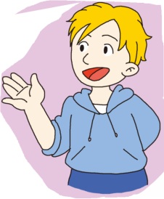
I think people are afraid of tigers, lions and snakes because they’re scary.

Slide 9
Read about Lisa’s weekend and answer the questions.
2b
1. How was Lisa’s last weekend?
2. Where did Lisa and her family go last weekend?
3. How did Lisa feel when she saw the snake?

Slide 10
4. What did Lisa and her sister do?
5. What did their parents do? Why did they do that?
6. What lesson did Lisa learn from the weekend?

Slide 11
How was Lisa’s last weekend?
Where did Lisa and her family go last weekend?
How did Lisa feel when she saw the snake?
It was interesting but scary.
They went camping in a small village in India.
She was so scared that she couldn’t move.

Slide 12
4. What did Lisa and her sister do when they saw the snake?
5. What did their father do?
They shouted to their parents to let them know the danger.
Their dad started to jump up and down in their tent.

Slide 13
6. What lesson did Lisa learn from the weekend?
Snakes don’t have ears, but they can feel things moving. It was important not to go near a snake.

Slide 14
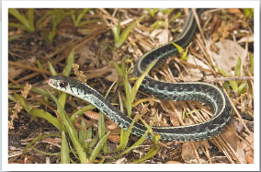
A Weekend to Remember
My sister finished high school two weeks ago. As a special gift, our parents took
us to India. Last weekend
was interesting but scary.

Slide 15
We went camping in a small village in India. First，we took a long bus ride to a lake in the countryside. There we put up our tents and made a fire to keep us warm and cook food on. On the first night，we just sat under the moon and told each other stories. But I was so tired that I went to sleep early.
使……保持在（某一状态）
生火

Slide 16
The next morning, my sister and I got a terrible surprise. When we looked out of our tent, we saw a big snake sleeping near the fire. I was so scared that I couldn’t move. We shouted to our parents to let them know about the danger.
名词，危险；危险物，威胁

Slide 17
My dad started to jump up and down in their tent. This woke the snake up and it moved into the forest near the lake. My dad told me later that snakes don’t have ears but can feel things moving. He also told me it was important not to go near a snake. This was a very useful lesson for me.

Slide 18
Language points
1. ride
ride此处作可数名词，意为“（乘车的）旅行, 旅程”。
take a ride 兜风
ride 还可作动词，意为“骑（马等）；乘（车）等”。
例句：你妹妹会骑自行车吗？
Can your sister ride a bike?

Slide 19
2. put up 搭起
put up 还可意为“举起；张贴；建造”。
put的过去式是它本身。
例句：你能帮我贴广告吗？
Can you help me put up some ads?

Slide 20
拓展： put 相关短语
put off 推迟；脱掉
put out 扑灭；赶走
put on 穿上

Slide 21
3. on the first night 在头一天夜里
on the first night 表示“在具体某一天的上午、下午或晚上”等时间，常用介词on。
例句：在10月1日的晚上，她得到了一份特别的礼物。
On the evening of October 1st,she got a special gift.

Slide 22
拓展：英语中表示一天中的时间
in the morning 在上午
in the afternoon 在下午
in the evening 在晚上
at night 在夜里

Slide 23
4. each other 互相；彼此
each other＝one another
英语中each other为代词，在及物动词之后可直接用作宾语；而在不及物动词之后，则要借助介词。
例句：我们互相学习。
We learn from each other.

Slide 24
5. But I was so tired that I went to sleep early.
so…that… 如此……以至于……
引导结果状语从句。
so是副词，常常用来修饰形容词或副词。
例句：他是如此小，以至于他不能上学。
He is so young that he can’t go to school.

Slide 25
辨析：so…that…与 so that
so…that…
“so+形容词或副词+that ” 意为“如此……以至于……”， 引导结果状语从句。
例句：她如此忙，以至于没有时间休息。
She was so busy that she had no time to rest.

Slide 26
so that
so that引导目的状语从句，意为“以便；为了”。
从句中常用can/could/may/ should等情态动词或助动词。
例句：小男孩攒钱以便可以在母亲节给母亲买一个礼物。 The little boy saved money so that he could buy his mother a present on Mother’s Day.

Slide 27
6. The next morning, my sister and I got a terrible
surprise.
get a surprise 吃惊
surprise为可数名词，意为“惊奇；惊讶”。
例句：当我再次见到她时我吃了一惊。
I got a surprise when I met her again.

Slide 28
拓展：
surprise还可作不可数名词，意为“惊奇，吃惊”。
常用短语：
in surprise 惊奇地，惊讶地
to one’s surprise 令某人惊讶的是

Slide 29
surprise, surprised 与 surprising
作名词时，意为“惊奇，惊讶”。
surprise
作动词时，意为“使吃惊”。
为形容词，意为“感到吃惊的”，相当于
amazed。主语通常是人。
surprised
为形容词，意为“令人吃惊的”，相当于
amazing。通常修饰物。
surprising

Slide 30
7. look out of 向……外看
out of 为动态介词，表示“从……里面向外”。
反义词：into
look out 有“当心；小心”的意思。
例句：Look out! Here comes the car.
小心！汽车来了。

Slide 31
8. When we looked out of our tent, we saw a big
snake sleeping near the fire.
see sb. doing sth. 看见某人正在做某事
see sb. do sth. 看见某人做（了）某事
表示看见某人做某事的全过程。
类似的词：hear, watch, feel等，具有相同的用法。

Slide 32
9. let
let sb. do sth. 让某人做某事
let为使役动词，其后需接省略 to 的动词不定式短语作宾语补足语。
例句：咱们相互帮助。
Let’s help each other.

Slide 33
牛刀小试
I saw her __________(play) basketball on the playground just now.
我刚才看见她正在操场上打篮球。
I saw him _______(go) out.
我看见他出去了。
playing
go

Slide 34
Put the phrases in order according to the
passage. Then use them to retell the story.
2c
____ snake went into the forest
____ put up our tents and cooked food
____ learned a useful lesson
____ saw a snake and shouted to parents for help
6
2
8
4

Slide 35
____ snakes can’t hear but they can feel things moving
____ my dad jumped up and down in his tent
____ took a bus to a small village in India
____ told stories under the moon, then went to sleep
7
5
1
3

Slide 36
Exercise
My home is far from our school. I often go to school by bus. It’s about an hour’s ______.
A. rode B. walk C. riding D. ride
D
This boy was born ________ the morning of July 6th, 2010.
A. in B. at C. on
C

Slide 37
3. The movie is ______wonderful ______I want to
see it again.
A. too; to B. so; that
C. as; as D. so; as
B

Slide 38
4. The boy got a _____ when he saw his father in
his school.
A. surprising B. surprised
C. surprise D. more surprised
C

Slide 39
5. I saw Li Ming ____ near the river on my way home.
A. plays B. playing
C. to play D. played
B
6. — When did you _____ lunch yesterday?
— At about 12:30.
A. have B. had C. having D. has
A

Slide 40
7. Don’t _______ so often. It’s bad for your health.
A. get up B. stay up
C. look up D. come up
B
8. It’s cold outside. _____ your coat before you go out.
A. Put on B. Turn on
C. Put up D. Give up
A

Slide 41
9. We can ________ ______ some posters to make
people know the latest movie Ant-Man.
put up
10. Let’s _______ (go) to school together.
（用所给词的正确形式填空）
go

