Slide 1
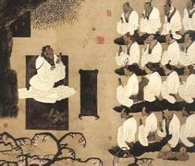
Unit 5 Topic 2 He is really the pride of China. Section A
WWW.PPT818.COM

Slide 2
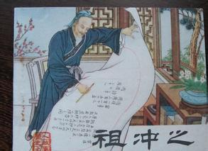
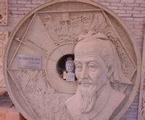
Zu Chongzhi (429 A.D.- 500 A.D.)
公元

Slide 3
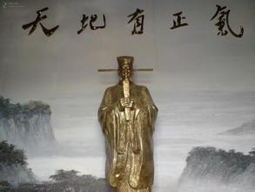
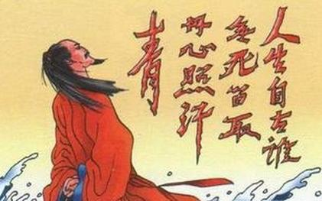
Wen Tianxiang (1236 A.D.-1283 A.D.)

Slide 4
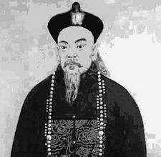
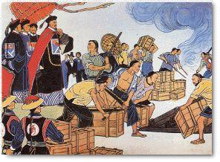
Lin Zexu (1785 A.D.-1850 A.D.)

Slide 5
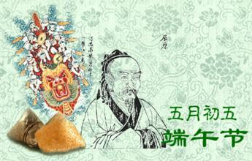
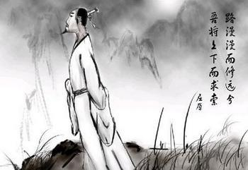
Qu Yuan (340 B.C.- 278 B.C.)
公元前

Slide 6
Confucius was born in the year 551 B.C.

Slide 7
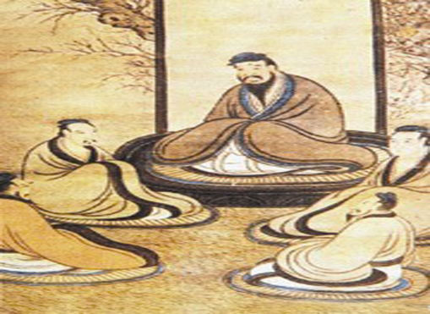
n. 思想家
adj.明智的
He was a great thinker with many wise ideas.

Slide 8
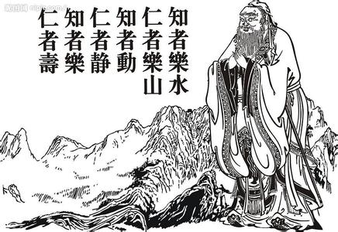
n.仁慈，善良
His main ideas are about kindness and
good manners.

Slide 9
He was also a famous philosopher whose wise sayings have influenced many people in different countries.
n.哲学家
v.影响

Slide 10
Listen to 1a and complete the table.
1b
Confucius
pioneer | in the field of ________
thinker | many ideas about human ________and behavior, especially his ideas about _______ and good manners
philosopher | influencing _____ people in different countries with his ____ sayings
education
nature
kindness
many
wise

Slide 11
Listen, look and say.
1a
动画1a

Slide 12
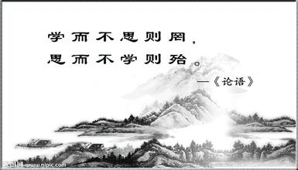
key points
1. Confucius, a pioneer in the field of education.
in the field of 在……领域
2. His main ideas are about kindness and good manners.
kindness and good manners “仁” 和“礼”
3. He who learns but does not think is lost; he who thinks but
does not learn is in danger.
学而不思则罔，思而不学则殆。

Slide 13
Attributive clauses
1. He was a great thinker who had many wise
ideas about human nature and behavior.
2. He was also a famous philosopher whose wise
sayings have influenced many people in
different countries.
3. He was really a great man from whom I can learn a lot.
谁（宾格）

Slide 14
Put the following sentences in the correct order. Then tell about Confucius’ life story in groups by adding some information from 1a.
2
( ) A. But Confucius received a good education when he was young.
( ) B. At the age of 55, Confucius began to travel around China. He
tried to search for good rules of behavior.
( ) C. And when he was 17, his mother died.
( ) D. In his thirties, Confucius began to teach. He spent the rest of
his life teaching.
( ) E. Five years later, he passed away (去世).
( ) F. When he was 68 years old, Confucius returned to Lu, his home
state.
( ) G. Confucius was born in the state of Lu in the year 551 B.C.
( ) H. When he was 3 years old, his father died.
4
6
3
5
8
7
1
2

Slide 15
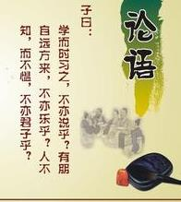
Read these wise sayings of Confucius and discuss their meanings with your partner.
3
１. When I walk along with two others, I may be able to learn from them.
三人行，必有我师。
２. What you know, you know; what you don’t know, you don’t know.
知之为知之，不知为不知。
３. Learn the new while reviewing the old.
温故而知新。
４. Isn’t it a pleasure that friends come to see you
from far away?
有朋自远方来，不亦乐乎？
５. Do not do to others what you would not have them do to you.
己所不欲，勿施于人。

Slide 16
Try to answer the questions. Then listen to the conversation and check them.
4a
1. What was the name of the first united dynasty in
China’s history?
The Qin dynasty .
2. When was it set up and how long did it last?
It was set up in 221 B.C. and lasted 15 years.
3. Who was its ruler?
Qin Shihuang.

Slide 17
Listen to the conversation again and fill in the blanks.
4b
The Qin dynasty is an important dynasty in China’s history. It was the _____ one after China was united. Qin Shihuang was the first emperor. He was a ________man. His real name was Ying Zheng. In _______, he defeated the other six states and set up his own empire. He wished that his empire could ______ forever. However, it only lasted _____ years. After it came to an end, Liu Bang became the first emperor of the Han dynasty.
first
powerful
221 B.C.
go on
15

Slide 18
Key points
1. In 221 B.C., he defeated the other six states and set up his own empire.
在公元前221年，他打败了其它六国，并建立了自己的王国。
（set up 建立）
2. He wished that his empire could go on forever.
他希望他的帝国能永远持续下去。
3. After it came to an end, Liu Bang became the first emperor of the Han dynasty.
在它（秦）灭亡之后，刘邦成为汉朝的第一位皇帝。
（come to an end 结束）

Slide 19
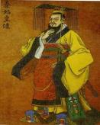
The Qin dynasty is an important dynasty in China’s history. It was the ______ one after China was united. Qin Shihuang was the first emperor. He was a _______ man. His real name was Ying Zheng. In _______, he defeated the other six states and set up his own empire. He wished that his empire could ______ forever. However, it only lasted ___ years. After it came to an end, Liu Bang became the first emperor of the Han dynasty.
first
powerful
221 B.C.
go on
15

Slide 20
Sum up
Words and phrases:
wise 明智的 influence 影响
whom 谁（宾格） in the field of 在……领域
pass away 去世 set up 建立
come to an end 结束
Attributive clauses:
1. He was a great thinker who had many wise ideas
about human nature and behavior.
2. He was also a famous philosopher whose wise sayings
have influenced many people in different countries.
3. He was really a great man from whom I can learn a lot.

Slide 21
Sum up
Sayings:
1. He who learns but does not think is lost; he who thinks but does not
learn is in danger.
学而不思则罔，思而不学则殆。
2. When I walk along with two others, I may be able to learn from them.
三人行，必有我师。
3. What you know, you know; what you don’t know, you don’t know.
知之为知之，不知为不知。
4. Learn the new while reviewing the old.
温故而知新。
5. Isn’t it a pleasure that friends come to see you from far away?
有朋自远方来，不亦乐乎？
6. Do not do to others what you would not have them do to you.
己所不欲，勿施于人。

Slide 22
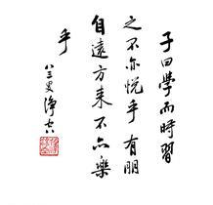
Homework
Read the conversation in 1a aloud.
Prepare a brief introduction of Confucius according to 2 and you can add some information from 1a.
Search for some information about Zheng He.

