Slide 1
Unit 3 Writing Home
Lesson 13 Let’s Buy Postcards!
WWW.PPT818.COM

Slide 2

Warming up
Let’s sing a song!

Slide 3
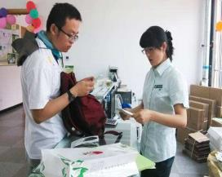
Leading in
请同学来介绍图片
Look! Danny is in the shop now. He wants to buy some postcards. He is talking with the salesman.

Slide 4
Danny wants to send some postcards. He is buying them in the shop. How many does he want to buy? Maybe he is thinking about it.

Slide 5

Who can make a sentence with want to and simple present sense?
I want to buy some fruit.
Do you want to watch movie with us?
I want to play the violin after school.
I usually go to school by bus.
He gets up at six every morning.
Her mother often goes out for a walk after supper.

Slide 6

Presentation
What can we see on a postcard?
Where do we write a letter?
Where do we write an email?

Slide 7

What do Jenny, Danny and Li Ming want to buy?
Where are they now?
What does Jenny’s postcard have?
How much is Danny’s postcard?
How many postcards does Danny want to buy?

Slide 8
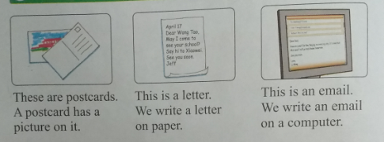
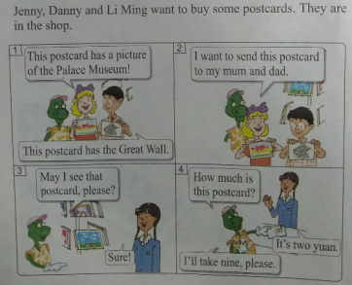
Listen to the tape and follow it.

Slide 9

Consolidation and extension
Show some pictures of yourselves in the shop.
I want to buy some apples.

Slide 10

使用课本句式介绍自己的照片
I want to buy a toy.

Slide 11
“want to…”和进行时
I want to read English stories this evening.
She wants to buy a gift for her mother.
Tom is playing the guitar and Kate is singing.
Jenny is doing her homework now.

Slide 12
Summing up
重点句型：
A postcard has a picture on it.
We write a letter on paper.
Jenny, Danny and Li Ming want to buy some postcards.
May I see that postcard, please?
I’ll take nine, please.

Slide 13
Evaluation
小组互评
内容 | 学生A | 学生B | 学生C | 学生D
积极发言
乐于合作
完成情况

Slide 14
Homework
1
用英语讲述今天所见的事情（使用课本句式）
作业
完成Let’s do it!中的练习
2

Slide 15
参考答案
1.
I want to send a postcard to Danny.
I want to send an e-mail to my mom.
2.
How much is the cap? It’s ten yuan.
How much is the T-shirt? It’s fifteen yuan.
How much is the book? It’s twenty-three yuan.
How much is the ball? It’s thirty yuan.

