Slide 1
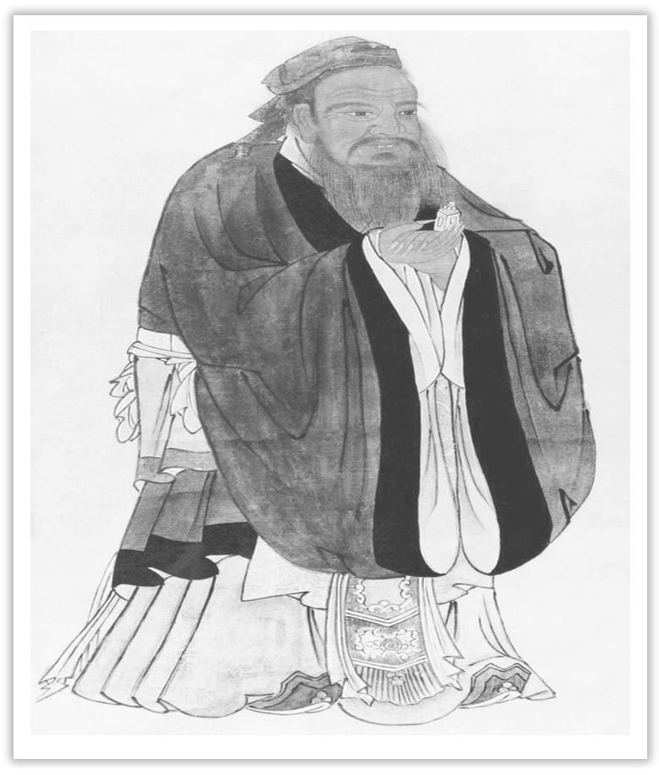
Unit 4 History and Traditions
Section Ⅴ Listening and Talking
WWW.PPT818.COM

Slide 2
1.Translate the following words and phrases.
①courtyard n. ____________ ②snack n. ____________
③eager adj. ______________ ④a historic tourist destination ____________
⑤have no idea ____________ ⑥disappointing adj. ____________
庭院；院子
点心；小吃
热切的；渴望的
历史旅游胜地
不知道
令人失望的

Slide 3
2.Brainstorming：How to describe a historic tourist destination?
The answer is open.

Slide 4
Finish Ex.1 & Ex.2 on Page 43.
Talking—Finish Ex.3 by the example on Page 43.

Slide 5
语言知识积累
表示“兴奋、惊奇和失望”的语句：
I’m too excited to go to sleep!
I’m wild with joy.
I jumped with excitement.
How exciting!
Nothing could be more wonderful!
This is too good to be true.
Your English is really surprising.

Slide 6
Your English is incredible.
I was eager/surprised to see/learn/hear that...
It was so much fun!
What a pity!
What a disappointment!
It was a little disappointing.
It wasn’t as good/interesting/fun as I’d expected.

Slide 7
eager adj.热切的；渴望的
I was eager/surprised to see/learn/hear that...(教材P₄₃)
我渴望/惊奇地看到/了解到/听到……
[合作探究] 体会eager的用法和意义
Given the chance, I would make donations to orphans eager to gain future success through learning.
如果有机会，我想向渴望通过学习取得未来成功的孤儿提供捐助。

Slide 8
In the meantime, those volunteers hold the opposite view that they are fed up with the earth life and eager for living on the Mars.
同时，那些持相反观点的志愿者认为，他们已经厌倦了地球上的生活，渴望到火星居住。
[自主发现]
①be eager ____________ sth 渴望做某事
②be eager for/about sth ____________
to do
渴望得到……

Slide 9
[思考] 表示“渴望……”的其他表达还有哪些？
________________________________________________________________________
[巩固内化] 补全句子
①I _____________________________ the result of the competition between them.
我急于想知道他们之间比赛的结果。
②Most students _____________________________ their progress.
大多数学生渴望进步。
be dying/anxious to do sth/for sth, be thirsty for sth, long to do sth/for sth
am eager to know
are eager for/about

