Slide 1
陕旅版
四年级下册
Unit5 Where Are You Going?
第三课时
WWW.PPT818.COM
0

Slide 2
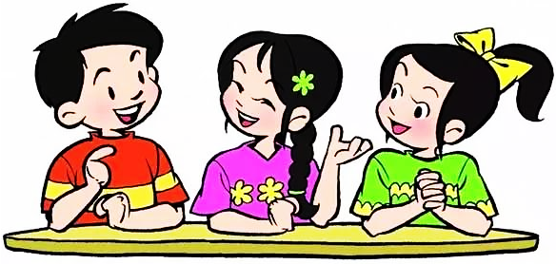
>>Review
Make sentences
Group work
Where is he/she going?…
Where are they/you going? …

Slide 3
>>Warm-up

Slide 4
>>Lead-in
Free talk
What day is Children’s Day?
What are you going to do on Children’s Day?
PPT模板：www.1ppt.com/moban/ PPT素材：www.1ppt.com/sucai/
PPT背景：www.1ppt.com/beijing/ PPT图表：www.1ppt.com/tubiao/
PPT下载：www.1ppt.com/xiazai/ PPT教程： www.1ppt.com/powerpoint/
资料下载：www.1ppt.com/ziliao/ 范文下载：www.1ppt.com/fanwen/
试卷下载：www.1ppt.com/shiti/ 教案下载：www.1ppt.com/jiaoan/
PPT论坛：www.1ppt.cn PPT课件：www.1ppt.com/kejian/
语文课件：www.1ppt.com/kejian/yuwen/ 数学课件：www.1ppt.com/kejian/shuxue/
英语课件：www.1ppt.com/kejian/yingyu/ 美术课件：www.1ppt.com/kejian/meishu/
科学课件：www.1ppt.com/kejian/kexue/ 物理课件：www.1ppt.com/kejian/wuli/
化学课件：www.1ppt.com/kejian/huaxue/ 生物课件：www.1ppt.com/kejian/shengwu/
地理课件：www.1ppt.com/kejian/dili/ 历史课件：www.1ppt.com/kejian/lishi/

Slide 5
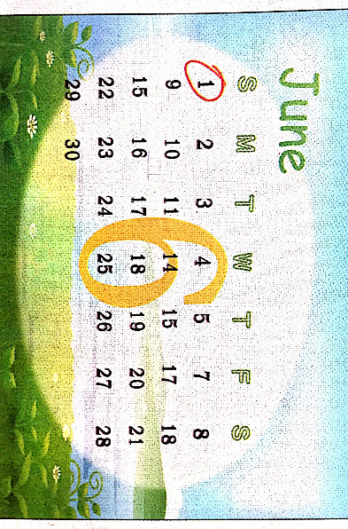
>>Lead-in
Do you know?
What’s the date?

Slide 6
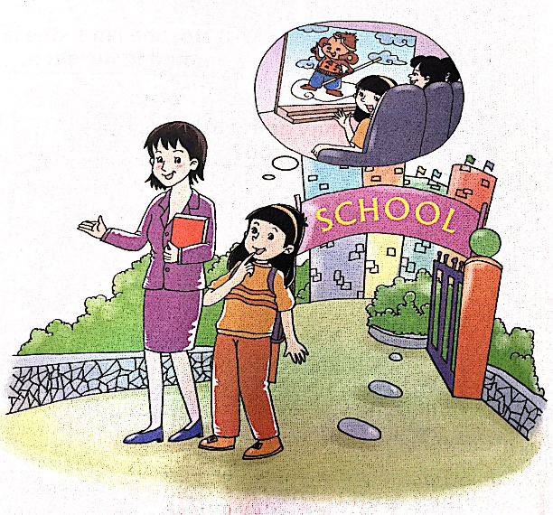
>>Presentation
Look and imagine

Slide 7
>>Presentation
Listen, then ask and answer
Q 1: Is it Children’s Day tomorrow?
Q 2: What’s Li Shan going to do?
Q 3: What is Li Shan’s mother going to do?
Q 4: Is she going to see a film with Li Shan?
Yes, it is.
She is going to see a film.
She is going to work.
No, she isn’t. She is going to work.
答案

Slide 8
>>Presentation
Let’s learn more
Miss Lin: Tomorrow is Children’s Day. What are
you going to do?
Li Shan: Yeah! Children’s Day! I’m going to
see a film.
Miss Lin: What’s your mother going to do
tomorrow? Is she going with you?
Li Shan: No. She is going to work.
Miss Lin: Happy Children’s Day!
Li Shan: Thank you!

Slide 9
>>Practice
Read it by yourselves for one minute.
自读对话一分钟。
一分钟倒计时
60
10
50
Tips:
当你自己朗读时，遇到不会读或不明白意思的单词或句子，可以把它圈起来，请教同学或老师！
20
40
30
开始

Slide 10
>>Practice
Role play
角色扮演，小组先进行练习，然后展示，其他同学评价。
 | 小组合作，声音洪亮，有感情地正确朗读课文。 |  | C
 | 小组合作默契，声音洪亮，脱离课本，口语表达较准确流利，感情与肢体语言较丰富。 |  | B
 | 小组合作默契，声音洪亮，能结合已有知识或生活，对内容有创新，口语表达准确流利，感情与肢体语言丰富。 |  | A
Good
Great
Excellent

Slide 11
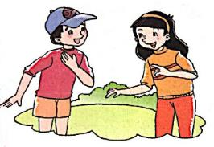
>>Practice
Do a survey and report
Li Shan: What are you going to do
on Children’s Day?
Liu: I’m going to …
Then talk about it in the class
Name
Activity
Name
Activity
Liu Zhaoyang

Slide 12
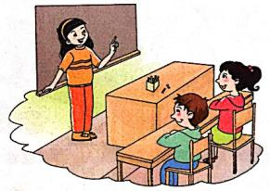
>>Practice
Do a survey and report
Li Shan: … is going to …
… and … are going to …
Tips:
dance
sing a song
see a film
climb the mountain
go to swim
play in the park
watch TV
buy a story book
see the animals in the zoo
play games

Slide 13
>> Summary
本课所学的重点句型：
What are you going to do?
I’m going to …
e.g.
What are you going to do on Children’s day?
I’m going to see a film.

Slide 14
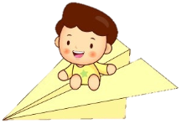
>> Homework
1.听课文录音并跟读，按照正确的语音、语调朗读并表演课文对话。 2.2人一组，分角色表演Let’s learn more课文对话。
3.预习 Unit5 B Read the words。
close

