Slide 1
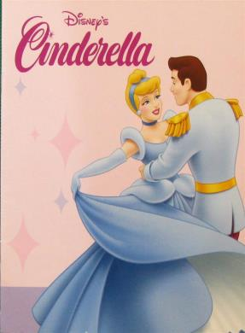
Unit 1
Cinderella
第二课时
WWW.PPT818.COM

Slide 2
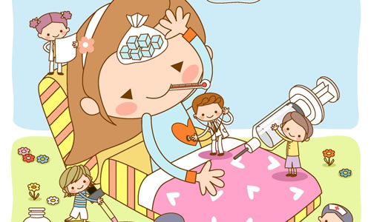
Introduce
--Why don’t you go to bed?
--Because I should do my homework.
--Why doesn’t she go to play with us?
--Because she is ill.

Slide 3
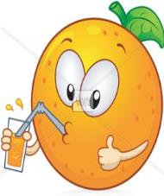
Words
drink [drɪŋk]
名词，意为“饮料”。
eg：Jenny is having soft drinks. 珍妮正在喝软性饮料。
小练习：There are some_____(drink) in the fridge.
A. drink B. drinks
B
拓展：动词，意为饮；喝。
常用短语：喝水 drink water
喝一些果汁 drink some juice

Slide 4
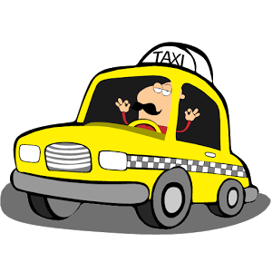
Words
driver [ˈdraɪvə(r)]
名词，意为“司机”
eg：My father is a taxi driver.
driver
小练习：His father is a_______( drive).
拓展：drive后接地点表示开车去某地：drive to sp.
eg：开车去上海 drive to Shanghai
小练习：用所给词的适当形式填空
eg： He is (drive)a bus now.
driving

Slide 5
Expressions
Andrew is having a drink. 安德鲁正在喝饮料。
现在进行时，主语是Andrew, be动词is,现在分词having。
eg：I’m having our English class now.
小练习：用所给词的适当形式填空：
He is________(look) out of the window.
looking
拓展：现在进行时表示正在发生或进行的动作。现在进行时表示动作发生的时间是“现在”，动作目前的状态是“正在进行中”。其固定结构为：主语+be动词+现在分词。

Slide 6
Expressions
I like reading fairy tales. 我喜欢读仙子传说。
like后也可跟动词的ing形式作宾语，强调喜欢做某事。
eg：Do they like playing games? No. They like watching TV.
小练习：用所给词的适当形式填空：
He likes _______(ride) a bike in the park.
riding
拓展：常与would连用，表示想要、愿意，语气较为客气委婉。
Would like后接名词，意为：“想要某物”
如：I would like some grapes. 我想要一些葡萄

Slide 7
Expand
A Smart Tortoise
A tiger is hungry, he is looking for food. He sees a frog in front of him.
“Ha ha! A frog! My dinner!” so he rushes at the frog.
Behind the tiger, there is a tortoise. The little tortoise sees it; he bites the tiger’s tail.
“Ouch!” cries the tiger and he looks back. The frog hears the voice and jumps into water.
“Thank you, little tortoise.” says the frog.
But the tiger is very angry. “Bother it! I’ll throw you to the sky!”
“Thank you, I like flying in the sky,” says the tortoise.
The tiger stops, “I will throw you into the river.”
“Oh,no! I can’t swim; I will die if you throw me into the water.” The tiger threw the tortoise into the water quickly.
“Thank you, Mr. Tiger. Bye-bye.” The tortoise and the frog swim away together.

Slide 8
Expand
聪明的乌龟
一只老虎很饥饿，他正在寻找食物。他看到一只青蛙在他前面。
“哈哈！一只青蛙，我有晚餐啦！”于是，他补向青蛙。
在老虎的后边，有一只乌龟。小乌龟看见了，他猛咬一下啊老虎的尾巴。
“哎呦！”老虎疼得叫起来并回头看看。此时青蛙听见了老虎的声音，他迅速跳进水里。
“谢谢你，小乌龟。”青蛙说。
大事老虎十分愤怒：“讨厌！我要把你扔到天上去。”
“谢谢你，我喜欢在天空飞翔。”乌龟说。
老虎停下来：“那我就把你扔到到水里。”
“哦，不！我不会游泳，如果你把我扔井水里我会死的。”老虎很快就把乌龟仍进水了。
“谢谢你，老虎先生，再见！”乌龟和青蛙一起游走了。

Slide 9
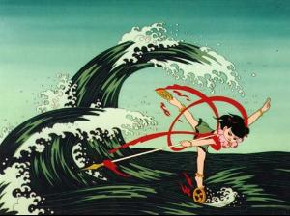
Dialogue
Andrew is having a drink.
安德鲁正在喝一杯饮料。
It’s cold and blue.
饮料冰冷的并且是蓝色的。
Andrea is drawing a dress.
安德里亚正在画一条长裙。
For her friend Sue.
给她得好朋友苏。
I like reading fairy tales.
我喜欢读童话故事。
I like reading stories about the Monkey King and Nezha.
我喜欢读关于哪吒和美猴王的故事。

Slide 10
Expand
中国的经典神话故事
《美猴王》讲述了在花果山上，猴群正在紧张的和混世魔王战斗。一块在花果山上蕴育多年的仙石突然崩裂，从里面诞生出一只石猴来。在老猴王的循循善诱下，石猴由被猴群排挤直至拥护为猴王。为了更好的保护花果山，在大家的劝解下，小石猴决定出海学艺。石猴来到了灵台方寸山向菩提祖师学艺。他不但学有所成，还交到了红孩儿、玉兔、人生果等新朋友，另外也拥有了自己的名字——孙悟空。
哪吒，是中国古代汉族神话传说人物之一，活跃于古典小说《西游记》、《封神演义》。

Slide 11
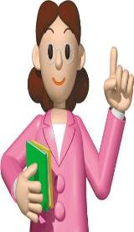
Summary
drink
driver
Andrew is having a drink.

Slide 12
Exercise
can't =_______ aren't=______ they're=_______ let's=_______
that‘s=_______ don’t=________ when‘s=________ you're=______
cannot
are not
they are
let us
you are
that is
do not
when is

Slide 13
Exercise
1.drink 2. go 3.stay 4.look 5. buy 6.have 7.pass 8.carry 9.come 10.watch 11. plant 12.fly 13.study 14.brush 15.do 16.Teach 17. swim 18.jump 19.walk 20.eat 21.copy 22. write 23 sing
3, 4, 5, 9, 11, 15, 17, 18, 19, 20, 22, 23，
动词三单结尾加“ s” ___________________________________________
动词三单结尾加“es”__________________________________________
动词三单结尾去“y”变“ies”____________________________________
特殊情况：______________________________________
7, 10, 14, 16
8, 12, 13, 21
6

Slide 14
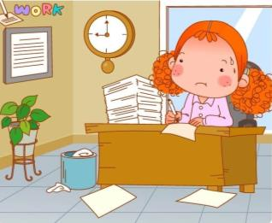
Exercise
（ ）1. Ben_____a new bicycle.
A. have B. has C. are D. were
（ ）2. Mimi_____her bicycle to the park.
A. ride B. riding C. rides D. ridden
（ ）3. A man _____in front of his car.
A. walk B. walks C. walking D. work
B
C
B

Slide 15
Exercise
（ ）4. Sam’s bicycle ______a bell.
A. have B. has C. having D. is having
（ ）5. The girl on the bike _______ “Excuse me”.
A.say B. saying C. says D. Sayes
B
C

Slide 16
Homework
Retell the story！

