Slide 1
Module 9 Unit 1
Best wishes to you!
WWW.PPT818.COM

Slide 2
Learning goals
能听懂、会读、会说、会用本单元的单词: wish、best wishes、primary school、message、keep、forever、joy、future、wonderful、happiness、what；
能听懂会说: Best wishes to you! Good luck to you!
学生能运用已学语言给同学写毕业祝福语。

Slide 3
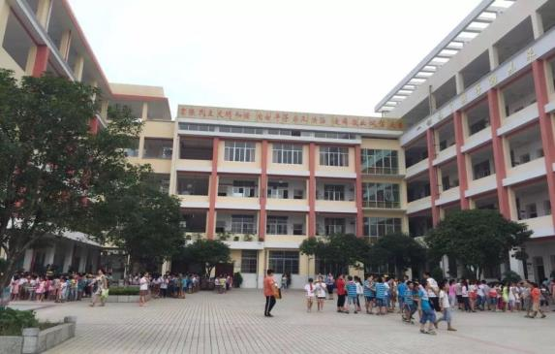
Lead-in
We ’re going to say goodbye to our primary school soon .

Slide 5
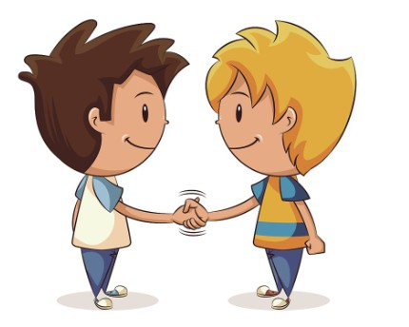
课文学习
1 Listen and chant.
Best wishes to you!
Good luck to you!
You are a great friend.
And I will miss you.

Slide 6
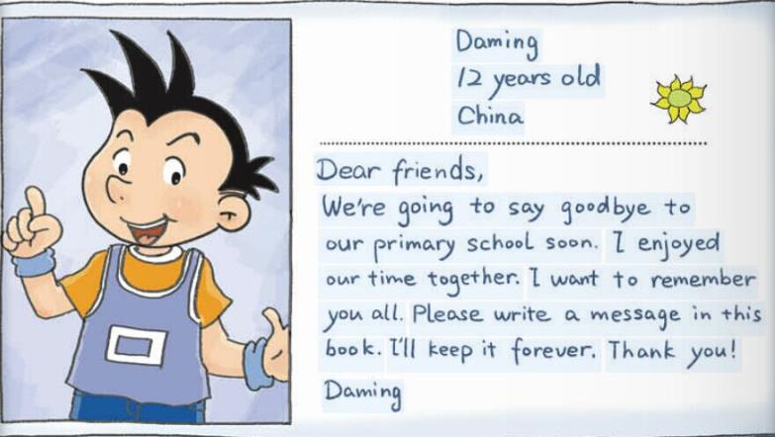
2 Listen and read.
What does Daming ask his friend to do?

Slide 7
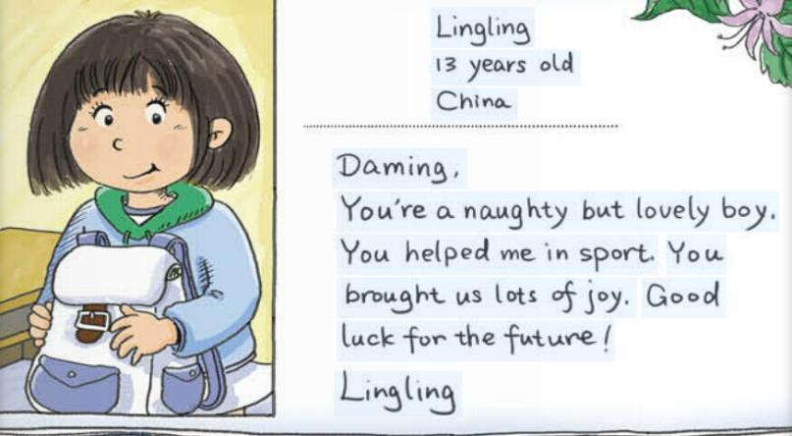
What did Daming help Lingling in?

Slide 8
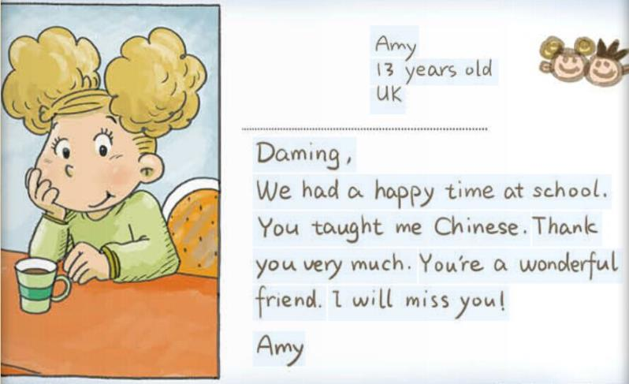
What did Daming teach Amy？

Slide 9
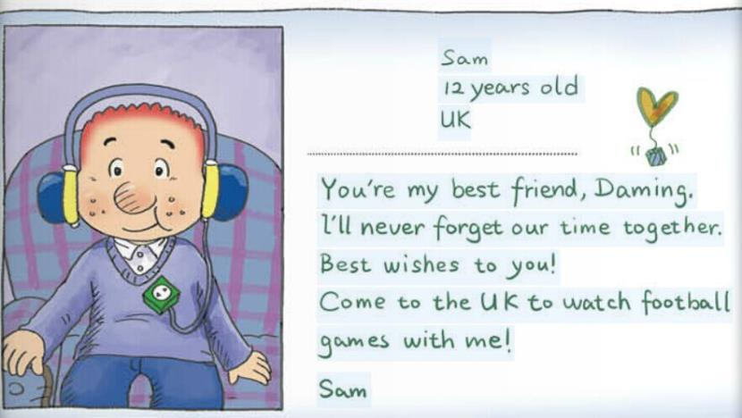
What does Sam ask Daming to do？

Slide 10
Choose.
（ ）Did Daming enjoy the time with his friend？
A. Yes, she did. B. Yes, he did.
C. No, he didn’t.
（ ）Does Lingling think Daming is naughty？
A. Yes, she did. B. Yes, she do.
C. Yes, she does.
（ ）What did Daming help Lingling in ?
A. Sport. B. English. C. Chinese.
（ ）What did Daming teach Amy？
A. English. B. Maths. C. Chinese.

Slide 11
New words
best wishes 最美好的祝愿
primary school 小学
message 留言 keep保留
forever 永远 joy 乐趣
future 未来 wonderful 出色的

Slide 12
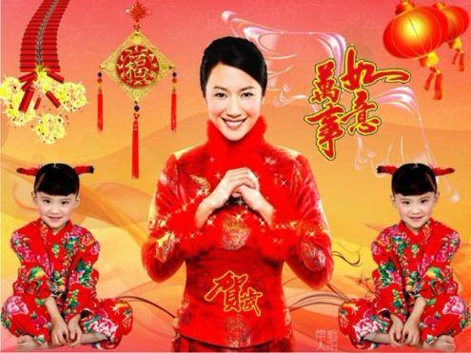
best wishes 最美好的祝愿

Slide 13
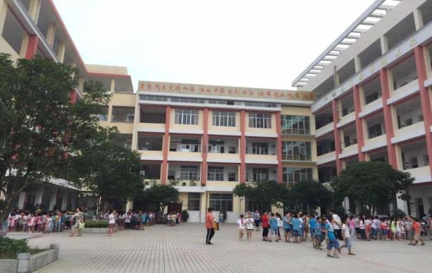
primary school 小学

Slide 14
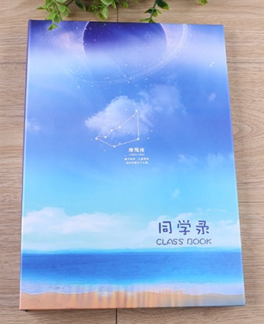
message 留言

Slide 15
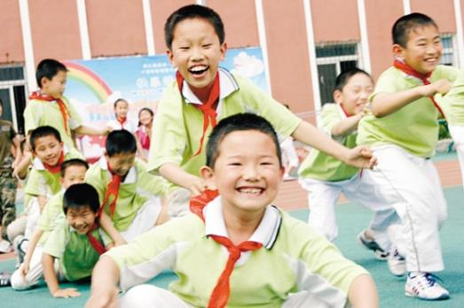
joy 乐事，乐趣

Slide 16
future
将来，未来

Slide 17
wonderful 了不起的，出色的

Slide 18
Summary
We ’re going to say goodbye to our primary school soon .
I’ll never forget our time together.
Best wishes to you!
Good luck for the future!
Please write a message in this book.
I will miss you!

Slide 19
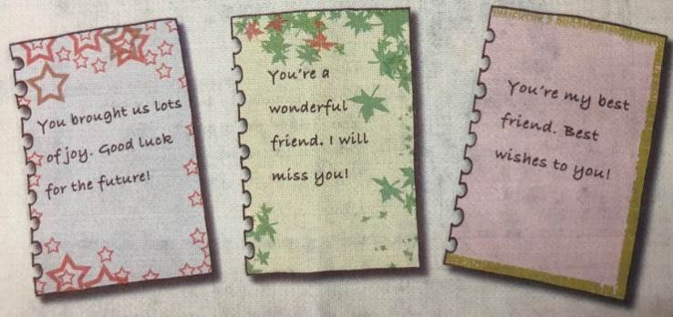
课文学习
3. Listen and say.

Slide 20
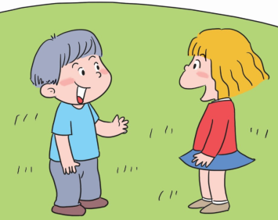
A: Good luck for the future. B: Thank you. A: And best wishes to you. B: Thank you.
课文学习
4. Practise.

Slide 21
Exercise
future wishes luck enjoyed are wonderful joy miss
1. Best _______ to you！
2. Good _______ to you！
3. You _______ a great friend.
4. I will _______ you.
5. You brought us lots of _______.
6. Good luck for the _______.
7. You’re a ________ friend.
8. I_______our time together.

Slide 22
Write a message to your friend.
Homework

