Slide 1
Unit 2 Topic 1
You should see a dentist.
Section C
WWW.PPT818.COM

Slide 2
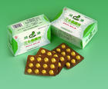

Learn the new words
pills
taxi

Slide 3
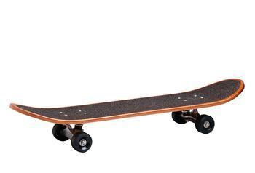
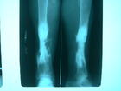
skateboard
X-ray

Slide 4
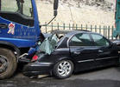
a serious traffic accident
严重的

Slide 5
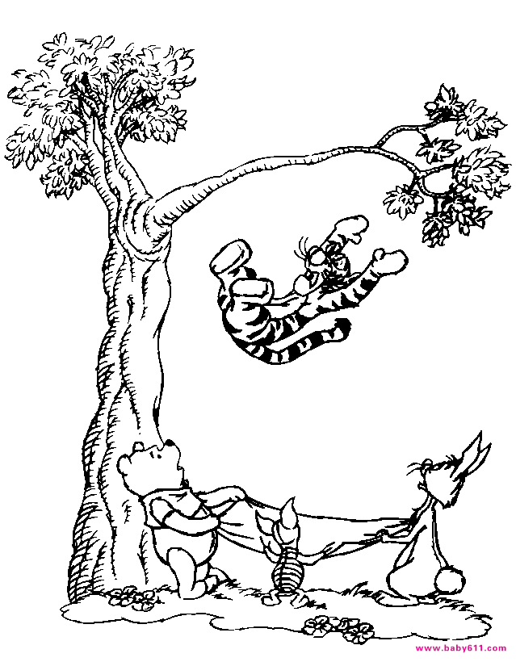
He fell down from the tree.
掉下来

Slide 6
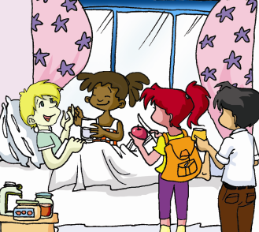
Michael is lying in bed. What happened to him?

Slide 7
Listen and find out the answer.
What happened to Michael?
Michael had an accident and fell off his skateboard.

Slide 8


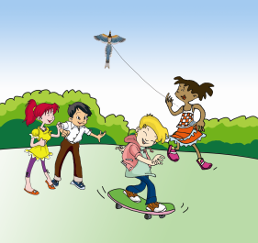
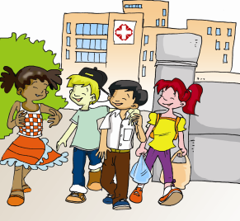
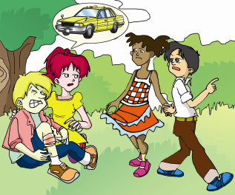
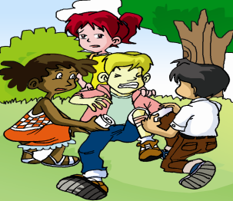
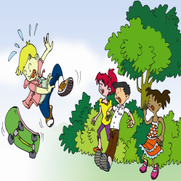
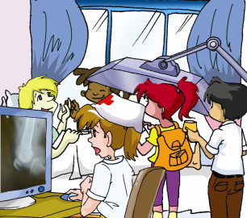
1a
Listen and put the pictures in the correct order.
1
6
4
3
5
2

Slide 9
It was a beautiful day and the children played in the park. Maria flew her kite while Michael played on his skateboard. “ Look! I’m going to try something new,” he aid. Michael did a difficult jump. Then the
skateboard went up and Michael fell down with a cry. The other children ran to him and asked, “ Are you all right? Are you hurt?”
“ oh, my leg, my arm! I feel terrible!” Michael cried.
I think you should see a doctor,” said KangKang, “ I’ll call a taxi”. Jane and Maria looked after poor Michael. “ My leg really hurts,” he said.

Slide 10
Soon the taxi came and take Michael and his friends to the hospital. The doctor told them, “ The X-rays show that it’s not serious. You can take
Hi home. Michael, you need to rest at home for a week. Here are some pills. Take two pills, three times a day.”
The children left the hospital. Kangkang helped Michael to walk. They were glad that the accident wasn't serious and Michael felt
much better.

Slide 11

1b
Watch the flash and choose the correct phrases to show what people did.
a. call a taxi b. have an accident c. hurt his leg
d. fall down e. rest at home f. feel terrible
g. give some pills h. look after Michael i. fly a kite
j. check the leg k. do a difficult jump l. ran to Michael
Michael | the other children | Doctor
b, d, c,
e, f, k
a, h,
i, l
g, j

Slide 12

Retell the story according to the pictures.
play on the skateboard / fall
The children played in the park. Michael played on his skateboard and fell down with a cry.

Slide 13
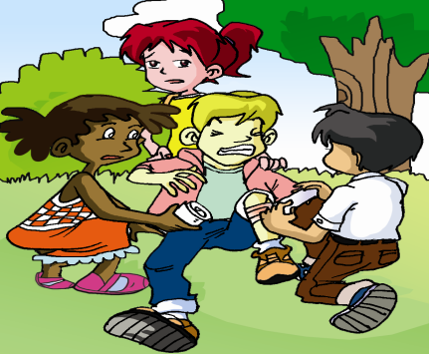
hurt / feel terrible
He hurt his leg and felt very terrible.

Slide 14

call a taxi / look after
Kangkang went to call a taxi while Jane and Maria stayed to look after him.

Slide 15

take … to the hospital /rest at home
The taxi took Michael and his friends to the hospital. He needed to rest at home and take some pills.

Slide 16

left / feel better
The children left the hospital. And they were glad that the accident wasn’t serious and Michael felt better.

Slide 17
Retell the story according to 1a.
It was a beautiful day and the children played in the park. Michael played on his __________. He did a _______ _____ and he _____ _____ with a cry. His _____ hurt. The children _____ a taxi. And the _______ took them to the hospital. The doctor told them that Michael needed to _____ at home and take some pills，_____ ______ a day. The children were glad that the accident wasn’t _______ and Michael felt better now.
skateboard
difficult jump
fell down
leg
called
taxi
rest
three
times
serious

Slide 18
Use the story in 1a to make up a conversation about Michael, his friends and the doctor.
2
You may begin like this:
Michael: Look, how fast! It’s cool!
Maria: Be careful, Michael! It’s dangerous!
Michael: Ouch!
Jane: Oh! How are you feeling, Michael?
Michael: Ouch, my leg! I’m feeling terrible.
… …

Slide 19
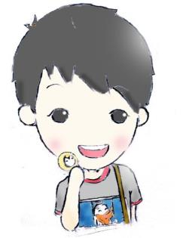
Act it out!

Slide 20
Practice
1d Rewrite the sentences with should (not)/ had better (not). Then give your own advice to Michael.
Go and see a doctor.
Take two pills, three times a day.
Be careful when you play.
You need to rest at home.
Take care of yourself.
Don’t go to school for a week.

Slide 21
Practice
Answers:
You’d better go and see a doctor.
You should take two pills, three times a day.
You should be careful when you play.
You had better rest at home.
You’d better take care of yourself.
You’d better not go to school for a week.

Slide 22

3 Help Michael to complete the note for leave.
Dear Miss Wang,
I’m sorry to tell you that I ______ an accident yesterday. I ______ my left leg. The doctor told me to ______ in bed for a week and take care of ______. So I’d like to ask ______ one weeks’ leave. I hope I’ll ______ well and return to school soon.
Thank you!
had
hurt
stay
myself
for
get
Yours sincerely,
Michael

Slide 23
Key phrases
1. 没什么严重的
2. 给某人做检查
3. 吃药丸
4. 因某事而感谢某人
5. 打的
6. 发生意外
7. 伤到腿
8. 请一个星期的假
9. 恢复健康
10. 请假条
nothing serious
check sb. over
take some pills
thank sb. for sth.
call a taxi
have an accident
hurt a leg
ask for a week’s leave
get well
a note for leave

Slide 24
Key points
一般用来询问、关心对方的身体状况。回答根据实际情况。
1. How are you feeling today?
2. But my left leg still hurts when I move it.
3. Your X-rays show it’s nothing serious.
不定代词 + adj.
痛；伤

Slide 25
4. Let me check it over again.
检查正误；检查身体
5. Stay in bed and don’t move your leg
too much.
“太多”
修饰动词放在句末

Slide 26
each & every
each “每一个”
指是两个或以上的每一个，强调个体概
念。可以作代词，单独使用或后接of 短
语。在句子中可以充当主语、宾语或同位
语。作主语时，谓语动词用单数。
e.g. Each of them has a dictionary.
他们每人都有一本字典。
We each work hard
我们每个人都努力工作。

Slide 27
every “每一个”
指三个或以上的每一个，强调整体感念。它只能作形容词，后接单数名词。every one 指每一个人或物，可以和of 连用。
e.g. Every student knows the exciting
news.
所有的同学都知道这令人振奋的消息。
Every one of the boys likes sports.
这些男生每个人都喜欢运动。

Slide 28
6. Oh, thank you for your flowers and fruit.
thank sb. for (doing) sth.
因某事而感谢某人
e.g. Thank you for helping me with my homework.

Slide 29
Exercises
Can you fill in these blanks?
1. — What’s wrong with Michael?
—He fell and ______ his left leg seriously yesterday.
hurt
nothing serious
2. His X-ray shows it’s ________ ________. (没什么严重的)
checking her over
3. Now the doctor is _________ ________ _____. (给她做检查)
three times a day
4. Please take these pills ____________________. (每日三次)
much better
5. I am feeling ________ _________ today. (好多了)
not eat
6. You’d better ________ ________ hot food. (不吃)

Slide 30
Translation:
1. 他今天感觉怎么样？
2. 我有一些重要的事情要说。
3. 你能检查一下我的家庭作业吗？
How is he feeling today?
I have something important to say.
Can you check over my homework?

Slide 31
4. 他们为她做了体检，结果她很健康。
5. 玩电脑游戏太多对你的健康有害。
6. 每次吃四粒药丸，每天三次。
7. 我的头痛。
They checked her over and she is fine.
Playing computer games too much is bad for your health.
Take four pills each time, three times a day.
My head hurts. = I have a headache.

Slide 32
Summary
We can tell a story.
We can give advice.

Slide 33
Homework
Retell the story after class.
Finish the exercises in the exercise book.

