Slide 1
Unit 9 Where will you go?
WWW.PPT818.COM

Slide 2
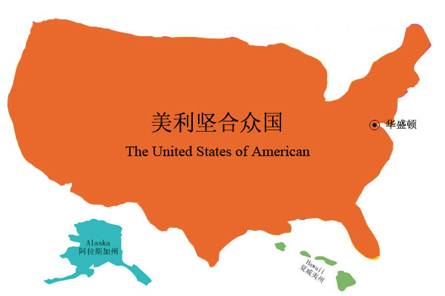
Washington .D.C.华盛顿哥伦比亚区
the capital of America

Slide 3
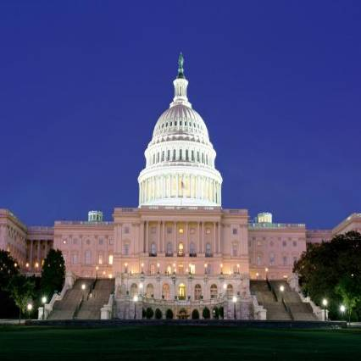
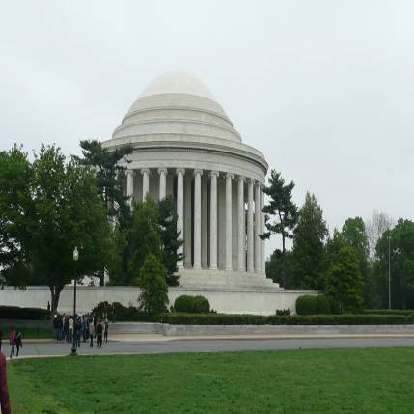
White House（白宫）
White House is famous for
WashingtonD.C.

Slide 4
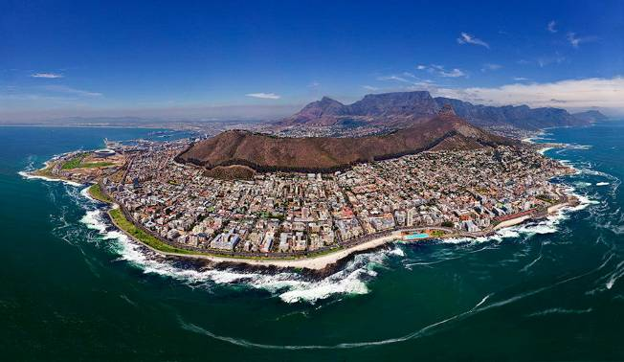
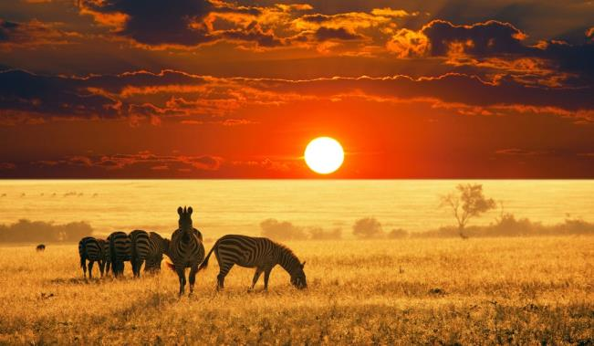
South Africa
I love nature in South Africa.
Natural beauty is famous for South Africa.

Slide 5
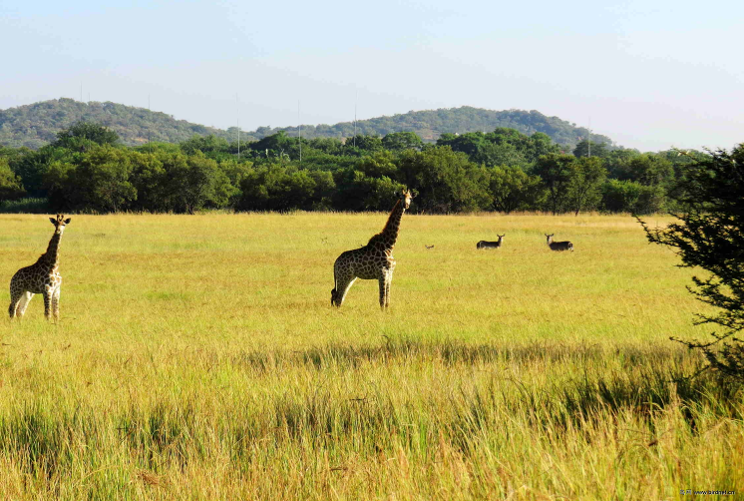
nature 大自然
natural 大自然的

Slide 6
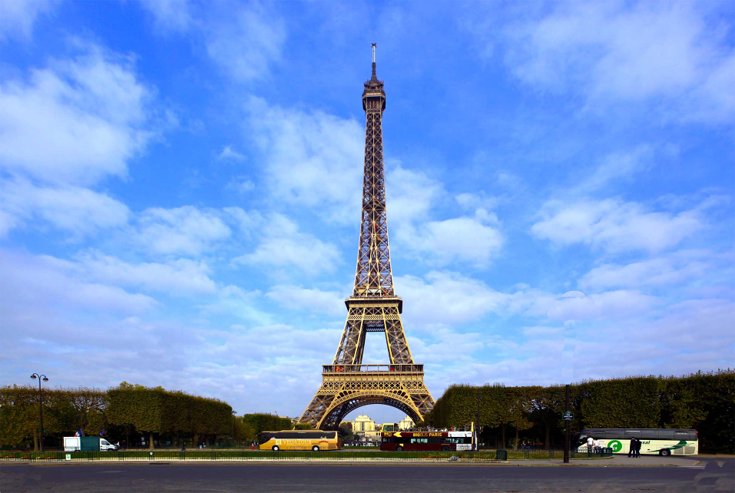
Paris 巴黎
Eiffel Tower
埃菲尔铁塔

Slide 7
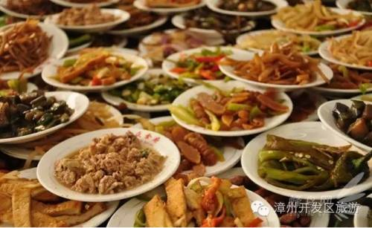
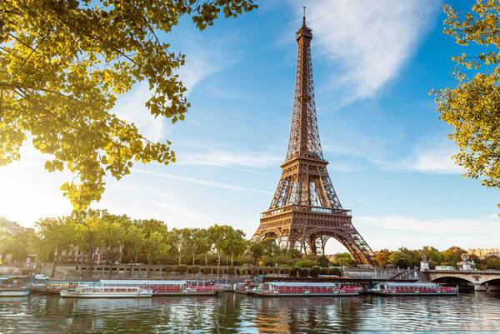
Paris is the capital of France.
Paris is the food capital of the world.

Slide 8
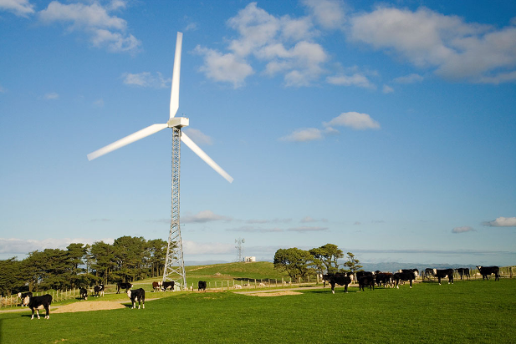
New Zealand
I love nature in New Zealand.
New Zealand is famous for natural beauty.

Slide 9
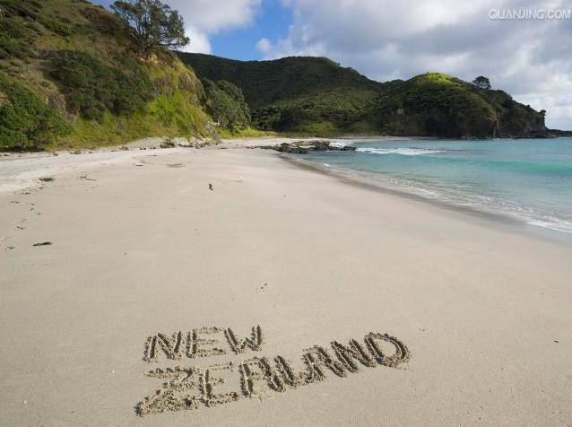
Wellington(惠灵顿)
Wellington is the capital of NewZealand.
I'd like to walk on the beach
in Wellington.

Slide 10
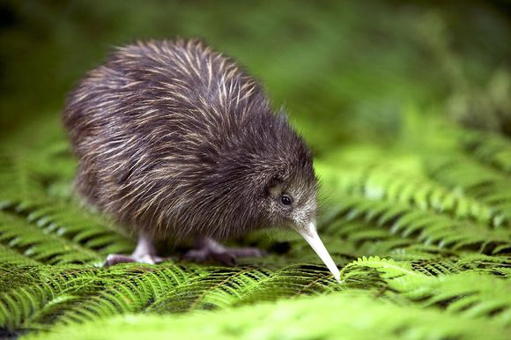
kiwi
几维鸟
New Zealand is famous for kiwi birds.

Slide 11
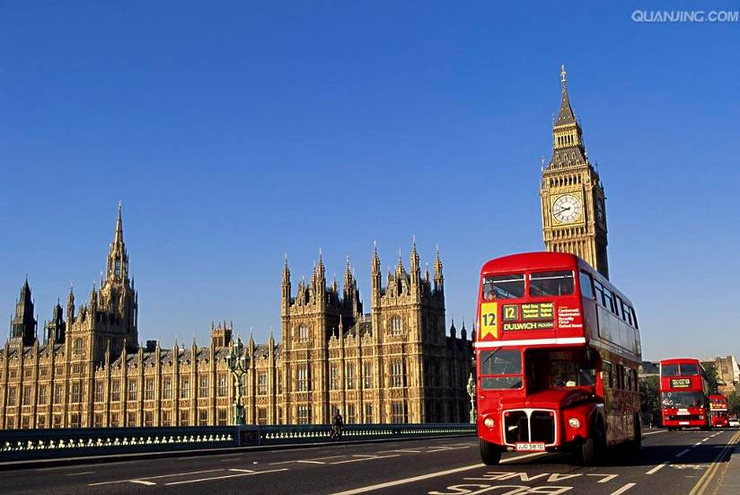
London
is the capital of the UK.

Slide 12
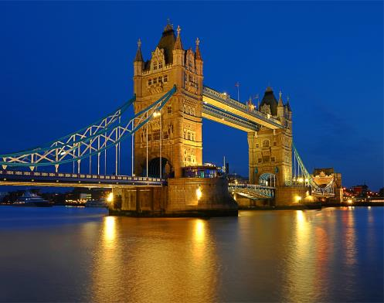
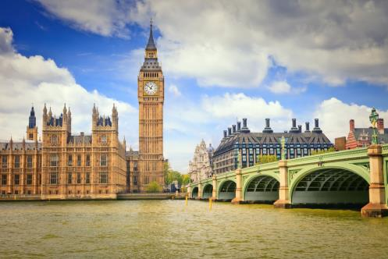
Tower Bridge
(伦敦塔桥)
Big Ben(大本钟)
London is famous for the Big Ben and
theTower Bridge.

Slide 13
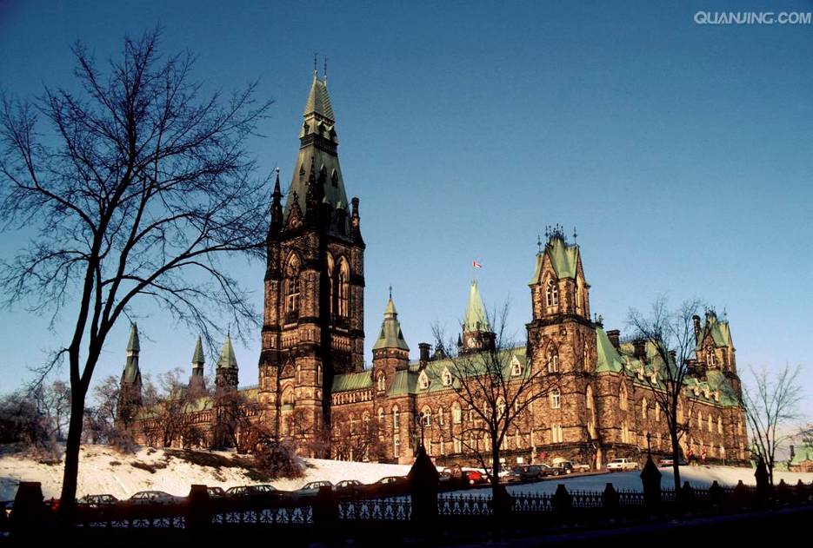
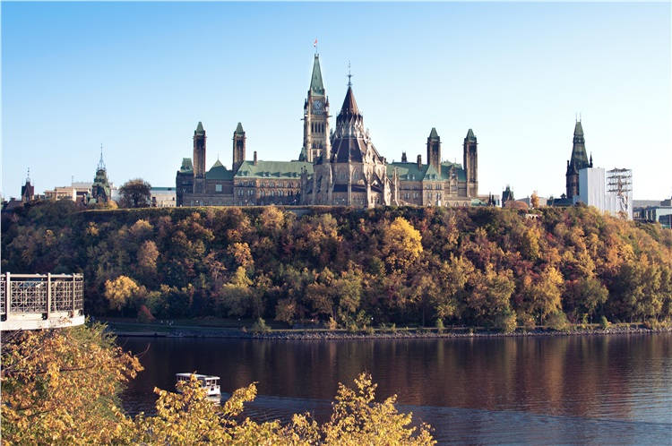
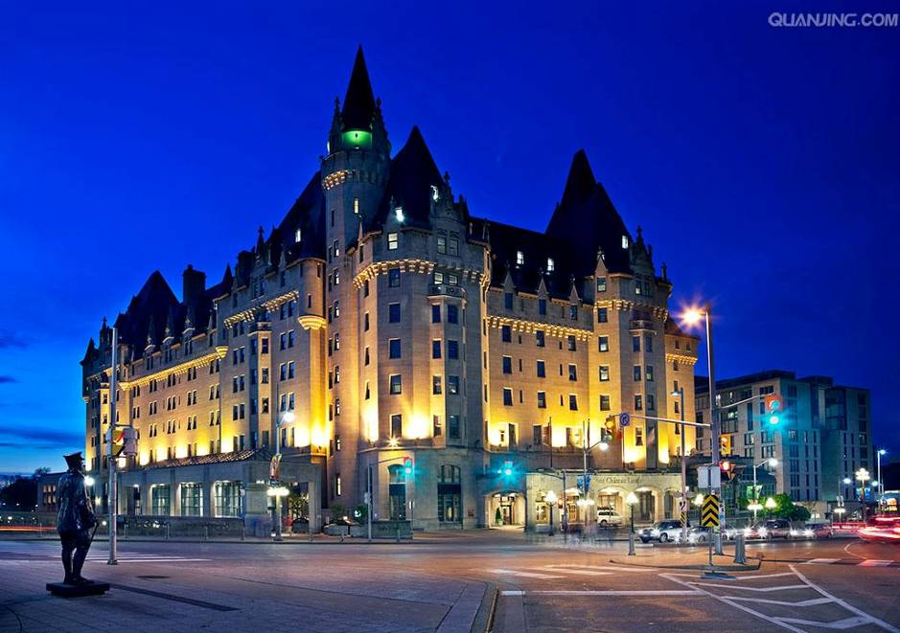
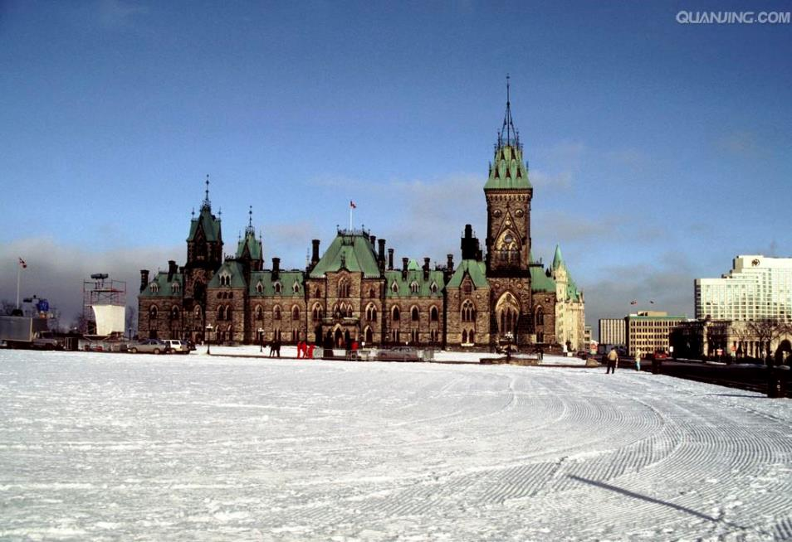
Ottawa (渥太华)
Ottawa is the capital of Canada.

Slide 14
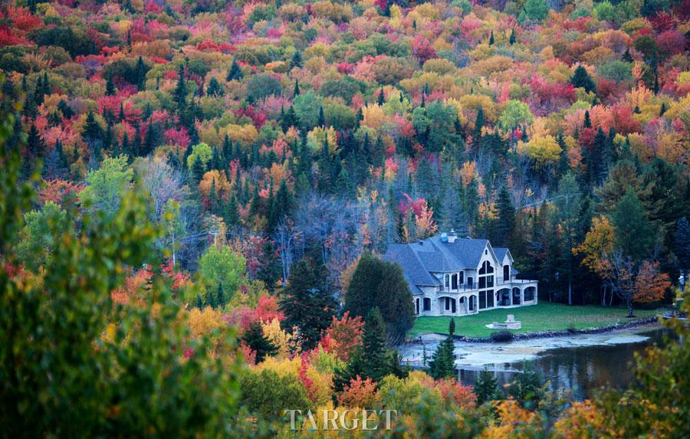
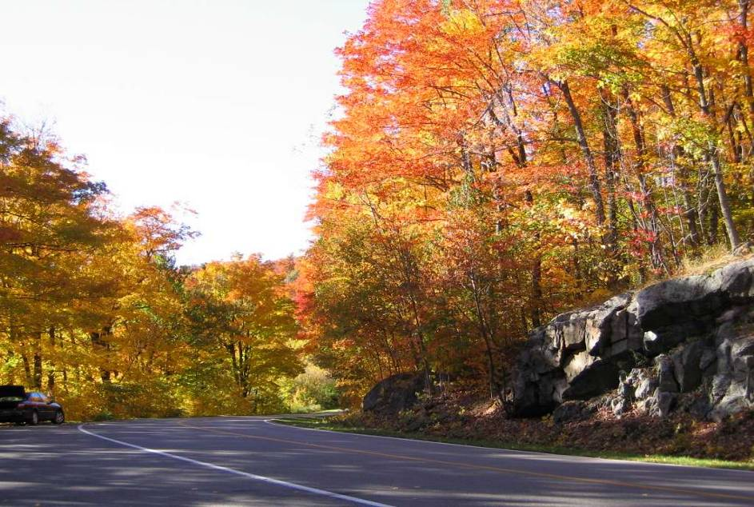
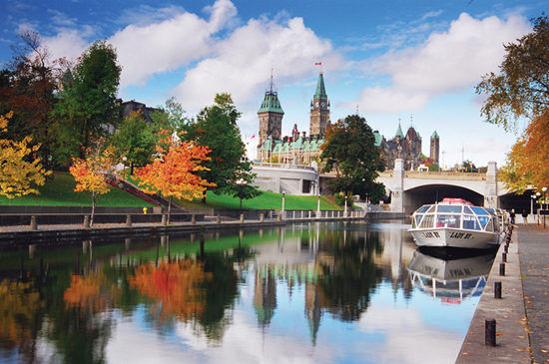
Maple trees(枫树)
Ottawa is famous for the Maple trees.

Slide 15
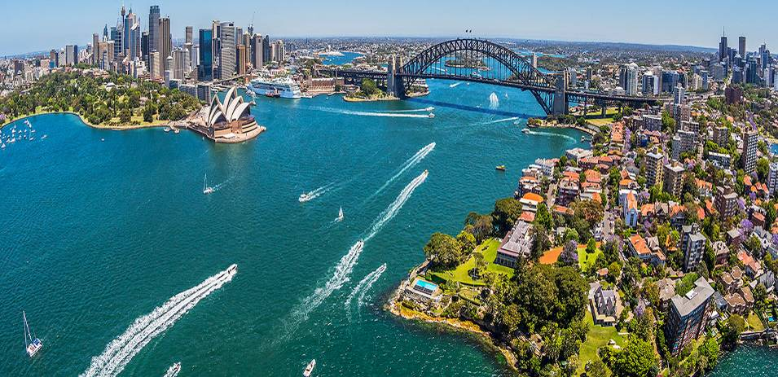
Sydney is the biggest city of Australia.

Slide 16
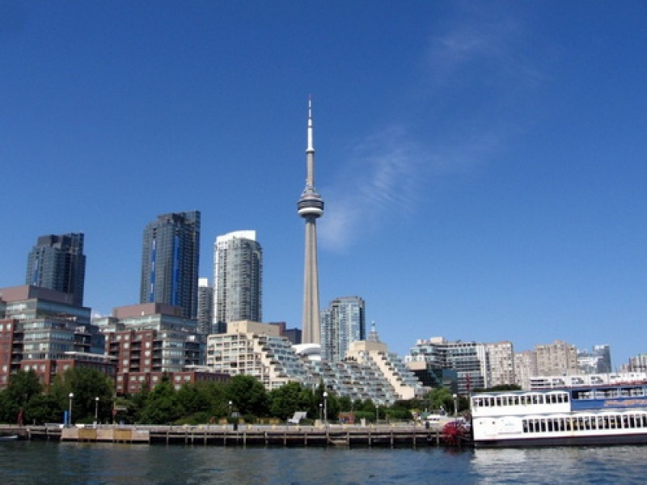
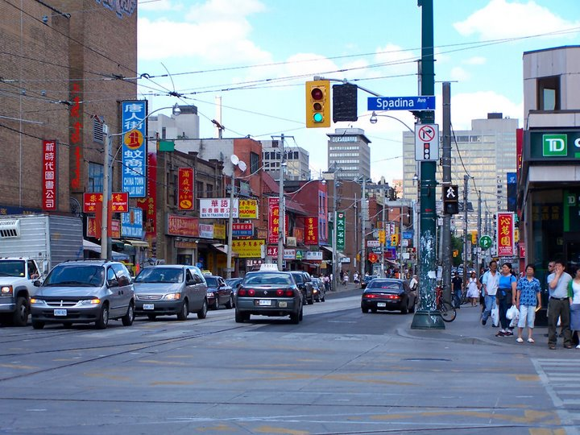
Toronto多伦多
Toronto多伦多
Toronto is the biggest city of Canada.
Toronto is famous for Chinatown.

Slide 17
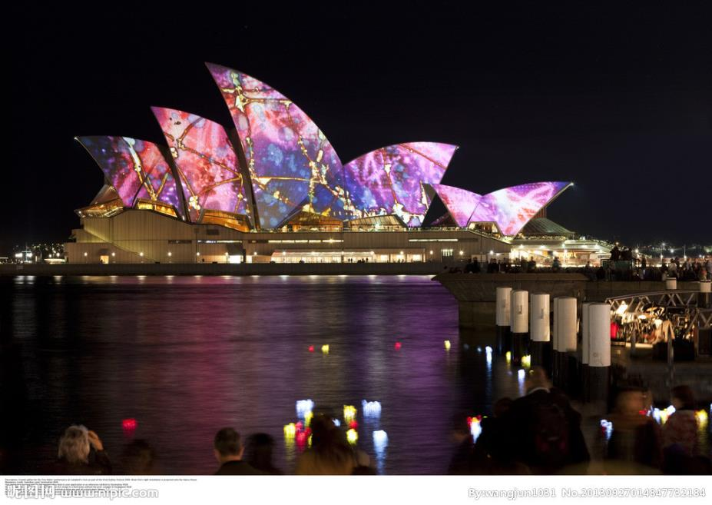
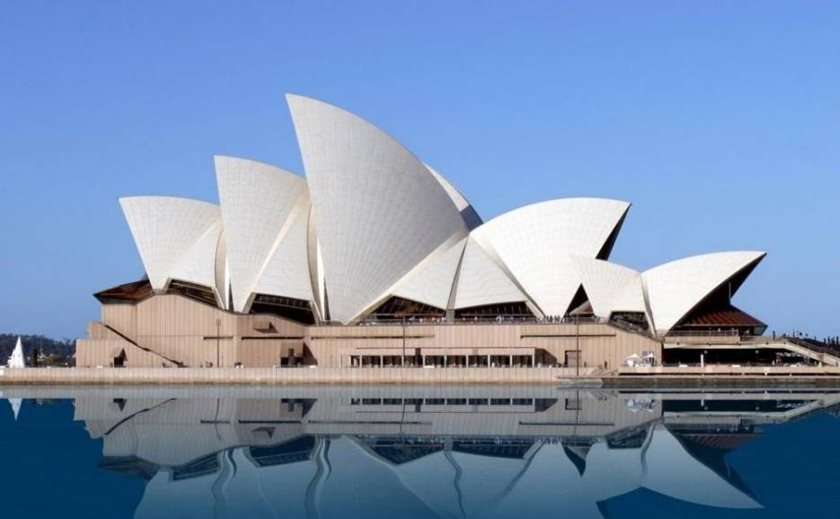
Sydney Opera House
Sydney (悉尼)
Sydney Opera House is famous for Sydney.

Slide 18
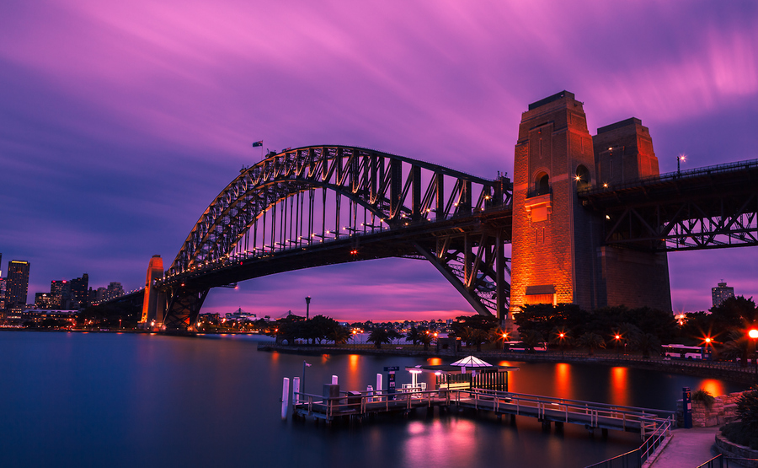
Sydney Harbour Bridge （悉尼海港大桥）
Sydney Harbour Bridge is famous for Sydney ,too.

Slide 19
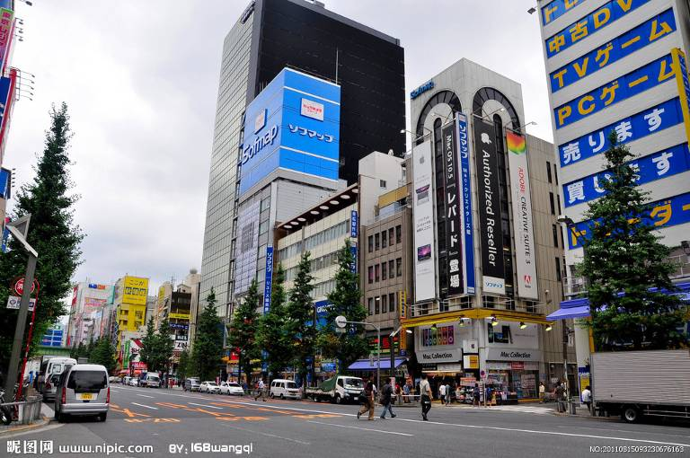
Tokyo 东京
Tokyo is the capital city of Japan.
Tokyo is a great place to go shopping.

Slide 20
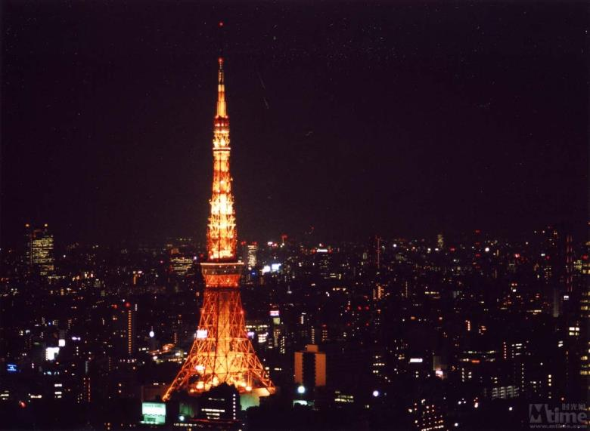
Tokyo Tower（东京塔）
Tokyo Tower is famous for Japan.

Slide 21
Canada
Toronto (多伦多)
Chinatown
Ottawa (渥太华)
Maple trees

Slide 22
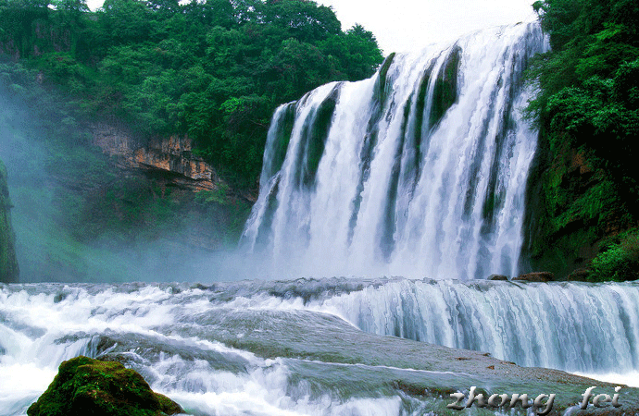
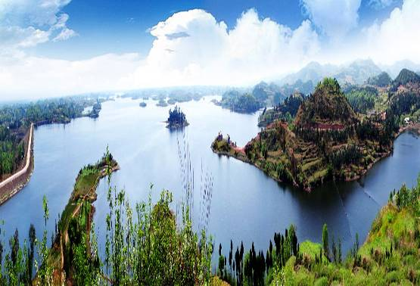
Canada
waterfall
瀑布
beautiful lakes

Slide 23
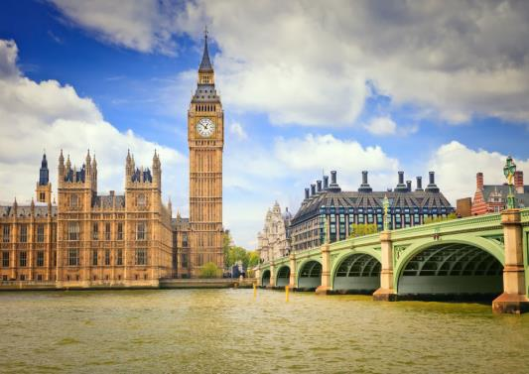
London the UK
Tower Bridge
(伦敦塔桥)
Big Ben(大本钟)

Slide 24
Sydney Australia
Sydney Opera
House悉尼歌剧院
Sydney Harbour
Bridge 悉尼海港大桥

Slide 25
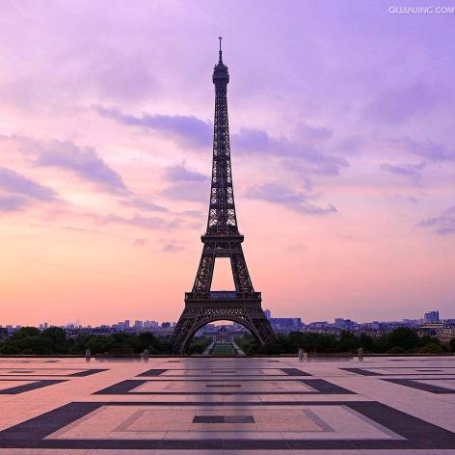
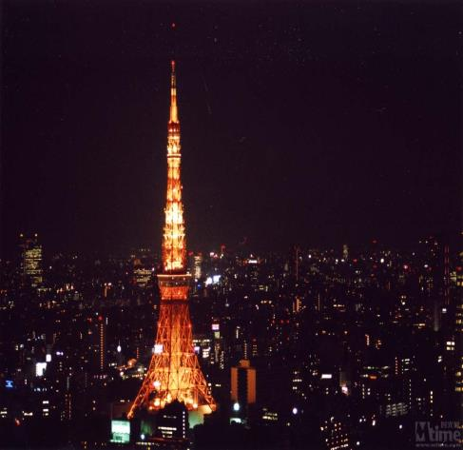
Paris France
Eiffel Tower
埃菲尔铁塔
Tokyo Japan
Tokyo Tower
东京塔

Slide 26
New Zealand
kiwi
South Africa
Natural beauty

Slide 27
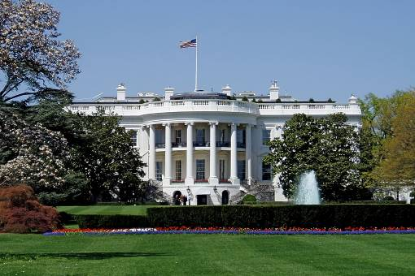
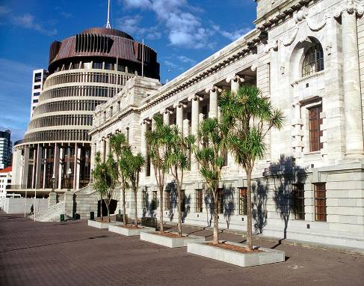
The USA
Washington D.C.
White House（白宫）
New Zealand
Wellington(惠灵顿)

