Slide 1
Module10 A holiday journey
Unit 2 This morning we took a walk.
WWW.PPT818.COM

Slide 2
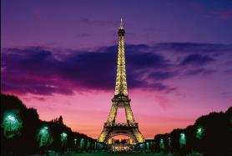
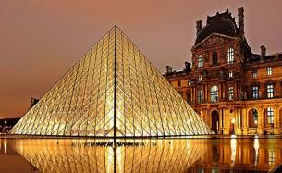
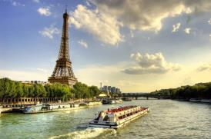
Warming-up
Look and say
Do you know these places?
Eiffel Tower
Louvre Museum
River Seine
埃菲尔铁塔
卢浮宫
塞纳河

Slide 3
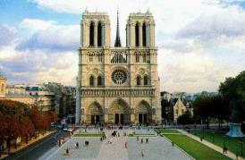
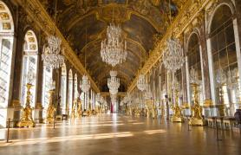
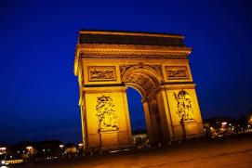
Warming-up
Look and say
Do you know these places?
Notre Dame de Pairs
Versailles
Triumphal Arch
巴黎圣母院
凡尔赛宫
凯旋门

Slide 4
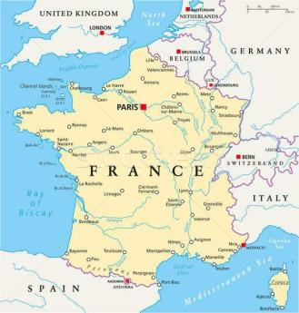
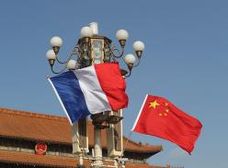
Warming-up
Look and learn
These beautiful places are in Pairs.
It’s the capital city of France.

Slide 5
Pre-reading
New words and expressions
arrive v. 到达
relax v. 放松
world-famous
adj. 举世闻名的
French
adj. 法国的；法语的
n. 法国人；法语
sell v. 卖；出售
top n. 顶端
till conj. 直到……为止
light n. 电灯
on adj. 在使用中，开着的
wonderful adj. 绝妙的；了不起的
palace n. 宫殿

Slide 6
Pre-reading
Listen and number the places.
1. a French restaurant
2. the Louvre Museum
3. the Eiffel Tower
4. the street markets
5. the Paris underground
6. the River Seine
2
1
5
3
4
6

Slide 7
While-reading
1 Read the email and check (√) the true sentences.
( ) (1) Betty arrived in Paris two days ago.
( ) (2) She took a tour in the city the day before yesterday.
( ) (3) They took the Paris underground today.
( ) (4) They waited for three hours to go to the top of the
Eiffel Tower.
( ) (5) Tomorrow they are going to take a boat tour on the
River Seine.
√
yesterday
√
one hour
√

Slide 8
While-reading
2 Complete the diary with notes.
The day before yesterday | arrived by plane was tired relaxed at home
Yesterday
This morning
went to the Louvre Museum
had dinner in a French restaurant
took a walk
did some shopping
bought a present

Slide 9
While-reading
2 Complete the diary with notes.
This afternoon and evening
Tomorrow | visit a famous palace take a boat tour on the River Seine
went to the Eiffel Tower

Slide 10
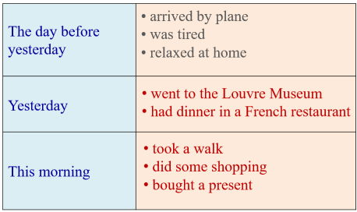
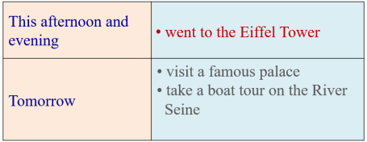
Post-reading
Retell the diary based on the notes.

Slide 11
Post-reading
3 Answer the questions.
(1) Who met Betty at the airport?
(2) What did she see in the Louvre Museum?
(3) Where did she go this morning?
Aunt Joan and Uncle Pete met her at the airport.
She saw many works of art, such as the Mona Lisa.
She went to the shops and street markets.

Slide 12
Post-reading
3 Answer the questions.
(4) When did they go to the Eiffel Tower?
(5) How did they get to the Eiffel Tower?
They went to the Eiffel Tower at about three o’clock.
They went there by underground.

Slide 13
Post-reading
Language points
1. Jenny and I arrived by plane the day before yesterday.
arrive vi.（不及物动词）到达，抵达
辨析：arrive, get与reach
三者作动词，都可以表示“到达”，但用法不同：arrive in+大地方（国家、城市等）
arrive at+小地方（村、镇、车站、机场等）
arrive+地点副词（here/there/home…）

Slide 14
Post-reading
Language points
e.g. We arrived in Pairs the day before yesterday.
我们前天到达了巴黎。
They arrived at the train station early.
他们早早地就到了火车站。
get to+地点名词
get+地点副词
e.g. Call me when you get to Beijing.
到北京了给我打电话。

Slide 15
Post-reading
Language points
We get home at six every evening.
我们每天晚上六点到家。
reach+地点名词/地点副词
e.g. He’ll reach Shanghai tomorrow morning.
他将在明天早晨到达上海。
e.g. I reached there early in the morning.
我一大早就到达了那里。

Slide 16
Post-reading
Language points
2. We were tired so we relaxed at home…
relax v. 休息；放松；使……放松
拓展：relaxing adj. 令人放松的（跟物有关）
e.g. I find swimming so relaxing.
我发现游泳会让人很放松。
relaxed adj. 放松的（跟人有关）
e.g. He is relaxed and confident before the match.
比赛之前他既轻松又自信。

Slide 17
Post-reading
Language points
3. It has many world-famous works of art, such as the Mona Lisa.
such as意为“例如”，表示列举。
辨析：such as与for example
such as一般列举同类人或事物中的几个例子。such as只能放在所列举的例子与前面的名词之间。
e.g. She can speak several languages, such as English,
Chinese and French.
她会说几种语言，如英语、汉语和法语。

Slide 18
Post-reading
Language points
for example一般用于列举同类人或事物中的一个例子。在句子中作插入语，可位于句首、句中、句末。
e.g. Ball games, for example, are popular around the world.
例如，球类运动在全世界受欢迎。

Slide 19
Post-reading
4 Complete the passage with the correct form of the
words from the box.
arrive date French relax till top
The (1) _________ today is 1st June. We (2) __________ in the (3) __________ capital, Paris, on 30th May, and we’re going to stay (4) ________ 3rd June. On 30th May we were tired so we (5) ________. But on 31st May we went to Louvre Museum and had dinner in a restaurant. And today we went to street markets. We also went to the (6) ______ of the Eiffel Tower.
date
arrived
French
till
relaxed
top

Slide 20
Post-reading
Writing
How do you talk about your holiday?
What
When
Where
holiday
Who
Why
How

Slide 21
Post-reading
Writing process
一、审图：确定基本要素：5W1H
when
who
where
why
how
what
Last summer
Daming and Lingling
went to Beijing
for the holiday
go… by train
认真看图, 然后在每幅图的下方写出所发生事情的相应词汇。

Slide 22
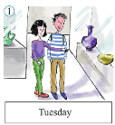
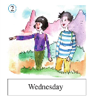
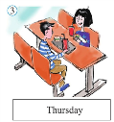
Post-reading
Writing
二、把要点变成完整的句子。
visit… museum
On Tuesday, they visited… museum.
go to… park
On Wednesday, they went to… park.
have lunch
On Thursday, they had lunch in a restaurant.

Slide 23
Post-reading
Writing
三、连句成文（发挥想象，开好头。注意5W1H）。
when
who
where
why
how
Last summer
Daming and Lingling
Last summer, Daming and Lingling went to Beijing for their holiday.
They went there by train.
went to Beijing
for the holiday
go… by train

Slide 24
Post-reading
Writing
三、连句成文（发挥想象，开好头。注意5W1H）。
On Tuesday, they visited… museum.
What
On Wednesday, they went to… park.
On Thursday, they had lunch in a restaurant.

Slide 25
Post-reading
Writing
四、 适当发挥加上结尾形成文章。
参考范文：
Last summer, Daming and Lingling went to Beijing for their holiday. They went by train. It took them nine hours to get there. They arrived on Monday. And took a taxi to their hotel.
On Tuesday, they visited the science museum. They learned a lot there and took photos with robots.

Slide 26
Post-reading
Writing
On Wednesday, they went to Beihai park. They went boating and saw a lot of fish in the water.
On Thursday, they had lunch in a restaurant. Next they did a lot of shopping. They bought presents for their family.
They went home by plane on Friday. It was a short holiday, but it was great. They had a great time.

Slide 27
Post-reading
Do the exercises
一、单项选择题。
1. —________ did you go last week?
—The school library.
A. Where B. What C. Which place
2. —________did you spend in Los Angeles?
—A week.
A. When B. How long C. How often

Slide 28
Post-reading
Do the exercises
3. He arrived in Tianjin ________.
A. by the plane B. take a plane C. by plane
4. It ________ me two hours to get there.
A. took B. spent C. needed
5. Ma Liang spent five minutes ________ that picture.
A. in B. on C. for

Slide 29
Post-reading
Do the exercises
二、按要求改写句子。
1. Lucy did her homework at home. (改否定句)
Lucy _____ _____ her homework at home.
2. He found some meat in the fridge. (变一般疑问句)
_____ he _____ any meat in the fridge?
3. They had a big dinner last Saturday. (就画线部分提问)
______ ______ they _____ last Saturday?
didn’t
do
Did
find
What
did
do

Slide 30
Post-reading
Do the exercises
4. They go to school by bus every day. (用yesterday改写)
They __________ to school by bus _________.
5. She stayed there for a week. (对画线部分提问)
_____ _____ _____ she _____ there?
went
yesterday
How
long
did
stay

Slide 31
Summary
Words and expressions | arrive, relax, sell, top, till, light, on, wonderful, the day before yesterday, such as
Sentence patterns | This morning we took a walk. In the evening we had dinner in a French restaurant.

Slide 32
Homework
Listen and read the passage fluently.
2. Write a passage about your unforgettable holiday.

Slide 33
Goodbye!

