Slide 1
Unit 4
I used to be afraid of the dark.
Section A (第2课时)
WWW.PPT818.COM

Slide 2
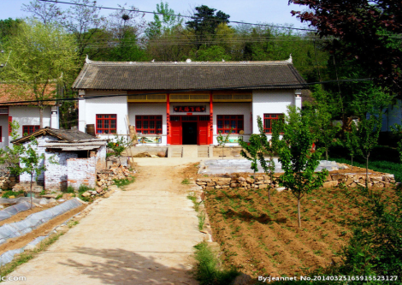
Warming up
1.What was your life like in the past? And now?
2.How did your life change?

Slide 4
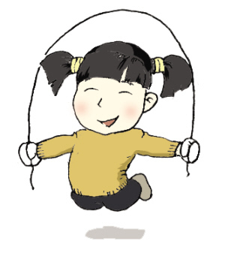
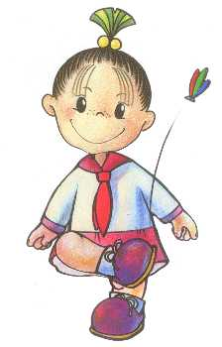

Slide 5
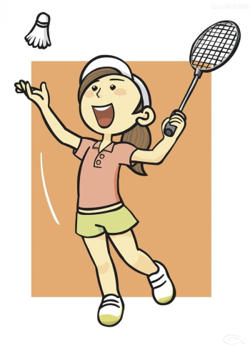
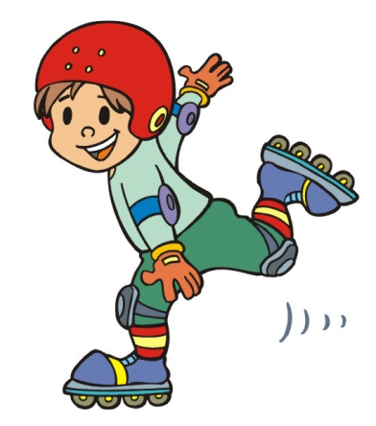

Slide 6
Read the article and identify the paragraphs [1-3] in which the following information appears.
3a
____how Candy's life has changed
____Candy's advice to young people
____Candy's background
2
3
1

Slide 7
From Shy Girl to Pop Star
1 For this month's Young World magazine, I interviewed
19-year-old Asian pop star Candy Wang. Candy told me that
she used to be really shy and took up singing to deal with
her shyness. As she got better, she dared to sing in front of
her class, and then for the whole school. Now she's not shy
anymore and loves singing in front of crowds.

Slide 8
2 I asked Candy how life was different after she
became famous. She explained that there are
many good things, like being able to travel and meet new
people all the time. "I didn't use to be popular in school, but
now I get tons of attention everywhere I go." However, too
much attention can also be a bad thing. "I always have to
worry about how I appear to others, and I have to be very
careful about what I say or do. And I don't have much private
time anymore. Hanging out with friends is almost impossible
for me now because there are always guards around me."

Slide 9
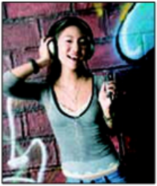
3 What does Candy have to say to all those
young people who want to become famous?
"Well," she begins slowly, "you have to be
prepared to give up your normal life. You can
never imagine how difficult the road to success
is. Many times I thought about giving up, but I fought on.
You really require a lot of talent and hard work to succeed.
Only a very small number of people make it to the top."

Slide 10
Read the article again and complete the
sentences about Candy.
3b
1. She used to be shy, but now she's not shy ________.
3. She didn't use to be ________ in school, but now she
gets lots of attention.
4. She used to _________ with friends, but it is almost
impossible now.
5. She didn't use to ___________ how she appears to
others, but now she does.
anymore
popular
hang out
worry about

Slide 11
Suppose you are the interviewer and your partner is Candy. Ask and answer questions.
3c
Interviewer: Candy, how has your life changed?
Candy: I used to be shy, but now I'm not shy anymore.
Interviewer: How was your life different after you
become famous?
Candy: ...

Slide 12
Language Points
1.Candy told me that she used to be really shy and took up singing to deal with her shyness. 坎迪告诉我她过去非常害羞，于是开始唱歌来对付她的羞怯。（教材第27页）
take up 意为“开始做”，通常指开始某项工作、某个爱好等。尤其指做以前从未做过的事或作为消遣的事。
take up doing sth.意为“开始做某事”。
e.g.:He is going to take up a hobby like painting.
My father took up learning English at the age of forty.
deal with 意为“对付；应付”。
e.g.:He has learned to deal with all kinds of difficulties.

Slide 13
辨析：deal with 与 do with
①deal with 与 do with二者都可以用来表示“处理”，
deal侧重于方式、方法，do侧重于对象。在特殊疑问句中，
deal with 与how 连用，do with则与what 连用。
e.g.:I don’t know how they deal with the problem.
=I don’t know what they do with the problem.
②deal with还有一个需要注意的地方：
在动词不定式短语 to deal with中，必须带宾语。
e.g.:I don’t know how to deal with it.

Slide 14
2. I always have to worry about how I appear to
others,and I have to be very careful about what
I say or do. 我总是不得不为怎样出现在别人面前而担忧，
并且我必须注意我说的话和所做的事。（教材第27页）
worry about 意为“为……担心，为……担忧，为……烦恼”。
e.g.:She always worries about some little things.
Don’t worry about your son and he is well.
【拓展】worry的过去分词可转化为形容词使用，构成
be worried about，相当于worry about。
e.g.:Mothers are always worried about their children.
=Mothers always worry about their children.

Slide 15
3. Hanging out with friends is almost impossible for me now because there are always guards around me.现在对于我来说和朋友们一起闲逛几乎是不可能的，因为在我的周围总是有警卫。（教材第27页）
① hang out意为“闲逛；闲荡”。
e.g.:Where does he hang out these days?
② guard此处用作可数名词，意为“守卫，警卫”。
e.g.:The camp guards changed every night.
【拓展】guard还可以用作动词，意为“防卫；警卫；看守”。
e.g.:The dog guarded the house.

Slide 16
4. . . .you have to be prepared to give up your
normal life. ……你必须准备好放弃你的正常生活。（教材第27页）
be prepared to do sth. 意为“准备好做某事，愿意做某事”。
e.g.:I am prepared to take the exam.
【拓展】be prepared for 意为“为……做好准备”。
give up意为“放弃”,其后可接名词、代词或动词-ing形式作宾语。give up是动副型短语，后接代词作宾语时，应将代词放在give 和 up之间。
e.g.:We should never give up hope.
English is very important. Don’t give it up.
I will never give up doing sports because I hope I will be healthier.

Slide 17
Exercise
一、根据首字母提示补全单词。
1. The boy d____ to talk back (顶嘴) in class.
The teacher is very angry.
2. The young man isn't a boss. He is only a g_____.
Look!He is standing at the gate.
3. Can you imagine how difficult the road to s______ is?
So you must work hard to succeed.
4. If you are p_______ to give up your good job,
you can go with me.
ares
uard
uccess
repared

Slide 18
二、选择方框中的短语，用其正确形式填空。
take up think about hang out deal with not ... anymore
1. Mo Yan ________ writing for many years.
He is very famous in the field.
2. Maybe nobody _________ in the city because the city is
polluted badly.
3. He will _________ the problem by himself.
4. The monkey _________appear to us ________.
5. I'm ____________ giving up my good life and will have
a hard life.
takes up
hangs out
deal with
didn't
anymore
thinking about

Slide 19
Homework
1.Learn the new words and expressions by heart.
2.Retell the story according to key words.

Slide 20
Thank you!

