Slide 1
Module
9
Population
Unit 3 Language in use
WWW.PPT818.COM

Slide 2
Language practice
Beijing is a huge city.
It takes an hour to get there by bus.
That’s almost one fifth of the world’s population.
That makes over 131.4 million births a year.

Slide 3
1. Work in pairs. Match the countries with their
populations.
1 China a) 4,437,000
2 the USA b) 22,956,000
3 Australia c) 314,791,000
4 New Zealand d) 1,370,537,000

Slide 4
Learning to learn
When you see a table or a chart, look carefully at the labels and graphs to make sure that you understand what they are showing. Look at the chart below. What is it comparing? What can you conclude?

Slide 5

2. Read your answers to Activity 1 to the whole
class.
China has a population of…
Now listen and check.

Slide 6
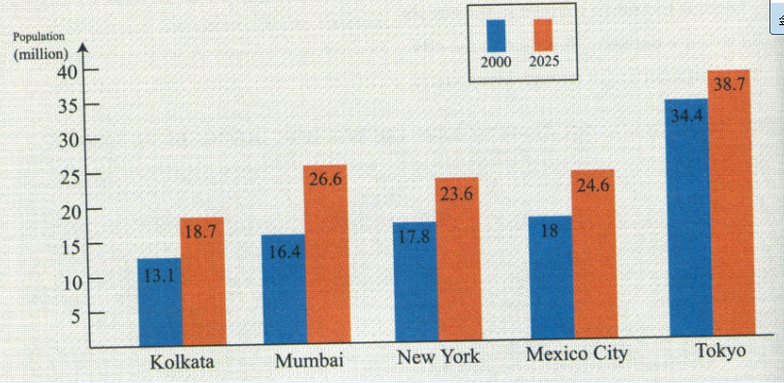
3. Read the chart and answer the questions.

Slide 7
1 Which city had the largest population in 2000?
2 Which city’s population will increase the most
from 2000 to 2025?
Tokyo had the largest population in 2000.
Mumbai's population will increase the most
from 2000 to 2025.

Slide 8
3 Which city will have a larger increase in its
population, New York or Mexico City?
4 Which city / cities do you think will have the biggest population problem? Why?
Mexico city.
I think Mumbai will have the biggest population
problem because its population will increase
the fastest.

Slide 9
4 Complete the passage with a, an or the
where necessary.
Mina is (1) ____eighteen-year-old girl. She has
got (2) ____brother and (3) _____sister. Mina is
(4) ___ oldest child in (5) ____ family. She lives
in (6)____very big city. She has (7) ______job in
(8) _____hotel. She hopes that one day she will
have (9)_____chance to go to (10) _____college.
an
a
a
the
the
a
a
a
a
/

Slide 10
5 Complete the sentences with the correct
form of the words in the box.
few good much small
1 We believe the schools in Arnwick are very
good, and we are working to make them
even_______ .
2 Their flat is too large for two people. They
want to find a _______one.
3 Anna always talks about her ideas. I think she
needs to listen _______.
4 There are a lot of parks in this city. I think
there are _______parks in a lot of other cities.
better
smaller
more
fewer

Slide 11
6 Complete the diagram showing population problems. Use the words in the box to help you.
air city country hospital increase public service traffic water
Problems of Arnwick
People move from_______
the countryside
People arrive in _________
the city
Problems: Population___________
increases

Slide 12
①
②
Environmental problems
Example:_____________
_____________
______________
______________
air pollution
water pollution
too much traffic
rubbish
Health problems
Example:
_______________
_______________
not enough
hospitals
③
Problems for the government
Examples:
_________________________________
_________________________________
_________________________________
need more schools and buses
need better public services
need more police to protect people

Slide 13
7 Complete the passage with the words in the box.
countryside pollution population
space traffic
Our world is facing many problems. Two of the biggest are increasing population and pollution.
The (1) _____________of the world is increasing quickly. Why is this happening? Because more babies are born every year and
population

Slide 14
people also live longer. Many people are leaving the(2) _________ to work in the cities, but there is not enough (3) __________for
so many people.
Another huge problem for the world is
(4)__________. There is so much (5) ________
on the roads that in some cities the air is heavily polluted. We must work harder to protect our world.
countryside
space
pollution
traffic

Slide 15
8 Complete the sentences with the expressions
in the box.
all over the world closed down in the future
it takes not… any more
1 Growing population is a problem___________
_____________.
2 The population of China may grow more
slowly .
3 The supermarket when a
bigger one opened in the town.
all over
the world
in the future
closed down

Slide 16
4 Usually an hour to get there by bus.
5 The town had a lot of population in the past
but it is a problem .
it takes
not any more

Slide 17
9 Listen and choose the best summary.
It is cheaper to share a car than to have a
personal car.
b) People in a car club do not often take buses, trains or the underground.
c) There are no car clubs in the US.
d) Joining car clubs is good for you and for the city.
√

Slide 18
10 Listen again and choose the correct answer.
1 Joining a car club is cheaper / more expensive
than having a personal car.
2 People in car clubs pay for / do not pay for a
car when they drive.
3 People in car clubs sometimes / never take a
bus or ride a bike.
4 People in car clubs probably are / are not
healthier.

Slide 19

11 Work in pairs and discuss this question.
Do you think car clubs would be popular in China? Why / Why not?
In my opinion, car clubs…

Slide 20

Around the world
World population and water
With more and more people in the world, more and more water is used. In fact, water use is growing more than twice as fast as the world’s population! As a result, getting good, clean water is becoming a problem in many places. A lot of water is polluted and in many areas people have to walk a long way

Slide 21
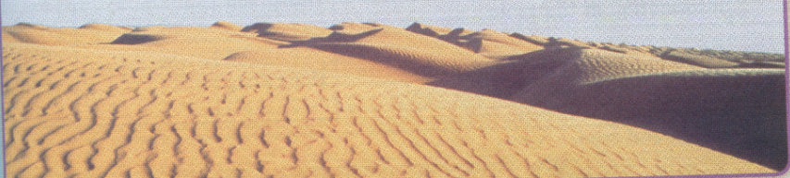
to get clean for daily use. More than 3.4 million people die each year from drinking and washing with polluted water. So let’s do everything we can to stop the pollution and save water.

Slide 22
Module task: making a graph
12 Work in groups. Prepare to make your graph.
Choose a country or town which interests you.
It could be your hometown.
Decide the time you want to look at— for
example, now, ten years ago and ten years
from now.
Research the population of your place in those
years. Write your notes carefully.

Slide 23
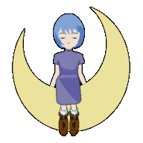
13 Make your graph.
Decide how you want to make your graph.
Draw it and colour it. You can also make it
on the computer.
Label it clearly.

Slide 24
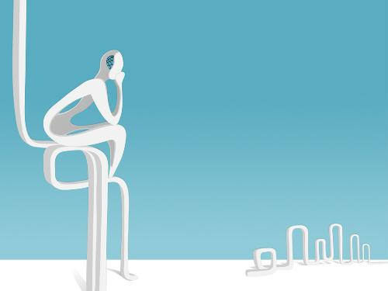
Pair work
14 Write a paragraph to describe your graph.
Then Present your graph to the class.

Slide 25
Language points
Beijing is a huge city.
北京是一个大都市。
huge 在这里表示“大，巨大”。另外表示“大”
的还有“ big, tall, vast, large, great” 等。
⑴说人、动物、树木等有生命的东西，主要
用tall不用high
例如 a tall woman 一个高个子妇女
a tall horse 一个高大的马

Slide 26
⑵说一个不与地面接触的人和物的高时，要用
high，而不用tall。比如人站在桌子上时，
飞机飞上天时。例如
He is high up in the tree.
他高高地爬在树上。
The plane is so high in the sky.
飞机在空中这么高。

Slide 27
⑶ 指建筑物、山时要tall或high都可以，不过
high的程度比tall高。
⑷ high可作副词，tall不能。
⑸ tall的反义词为short, high的反义词为low。

Slide 28
big 和large都可表示具体事物形体或面积的大小, 往往可以互换但big较口语化。
e.g. Our factory is a big/large one.
我们的工厂很大。
（1）在表示物体重量、人的身高大或长大了时，
只能用big。
e.g. The box is too big to carry.
这个盒子太大，拿不了。
（2）在表示数量时，用large, 不用big。
e.g. A large number of people came from all
parts of the country to see the exhibition.
从全国各地来了很多人观看展览。

Slide 29
great 的意思是“大、伟大的”多用于抽象意思。
在修饰具体事物时带有一定的感情色彩。
E.g. There have been many great presidents in American history.
美国历史上有很多伟大的总统。
在表示抽象意思时, 有也可用big, 但great更为正式。
e.g. Great/Big changes have taken place in our country in recent years.
近几年来我们国家发生了很大变化。

Slide 30
vast常用来指“广袤无垠的”、“面积广阔的”。
e.g. a vast forest, a vast sea, a vast desert,
vast darkness等。
huge指巨大的往往指体积。
e.g. a huge stone, a huge building等。

Slide 31

Exercises

Slide 32
用a, an, /, the 完成下列句子。
1. ____ Knowledge is power.
2. I earn 10 dollars _____ hour as _____ supermarket cashier on Saturdays.
3. The teacher asked us to write _____ 800-word-long composition.
4. I met _______ Jay, but not ____ one you know.
/
an a
an
a the

Slide 33
5. They are twins, so they are of _____ age.
6. He has _____ fine collection of paintings.
7. I don’t want to have words with you. I prefer to have ____ word with you.
a
a
a
Have words with sb. 与某人吵架
Have a word with sb. 与某人谈话

Slide 34
选择题
B
1. Beijing has got population of more than
13.8 million.
A. the B. a C. an D./
2. The _____ traffic stopped me from going to
school on time yesterday. I was late!
A. heavy B. crowded C. fast D. quick
A

Slide 35
3. Mrs. White isn’t feeling well these days. She
has made _____ with the doctor at three this
afternoon.
A. a movement B. an interview
C. a quarrel D. an appointment
4. I don’t like those big cities which have
got ____ people and ____ traffic.
A. too much; too many B. many too; too much
C. too many; too much D. too many; much too
D
C

Slide 36
5. ____ Tim’s help, I found my pet dog in the end. I should say thanks to him.
A. Along with B. Without
C. Thanks to D. Because
C

Slide 37
Homework
Make a graph and share with your classmates.
Recite all the words and phrases of this unit.

Slide 38
婴儿潮（baby boom），指的是在某一时期及特定地区，出生率大幅度提升的现象。历史上有记载的几次婴儿潮，通常是起因於有振奋人心的因素，像是农作物丰收、打赢战争及赢得体育竞赛等。但也有因为迷信的因素。在英文，形容婴儿潮时期出生的人为 baby boomer。 婴儿潮（baby boom）这个词的首次出现，主要是指美国第二次世界大战后的“4664”现象--从1946年至1964年，这18年间婴儿潮人口高达7800万人。在世界上大多数国家均有此现象。在日本，称呼此时期出生的人为“团块世代”団块の世代 。新中国成立后共出现过三次婴儿潮，值得注意的是：目前人口众多的“80后”一代也已长大，陆续成家立业。在21世纪的前15年，中国将迎来新一轮的“婴儿潮”。以此类推，每次“婴儿潮”平均都会有20-30年的周期。

Slide 39
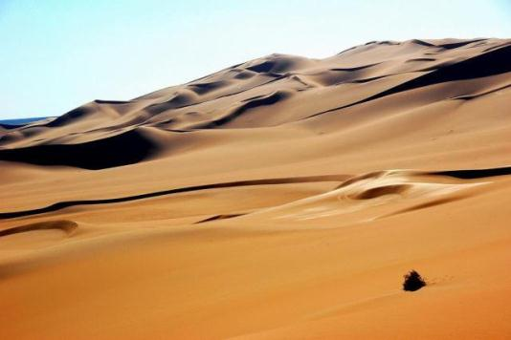
撒哈拉沙漠(英文名为：Sahara Desert)世界上阳光最多的地方，也是世界上最大和自然条件最为严酷的沙漠。
撒哈拉沙漠是世界最大的沙漠，几乎占满非洲北部全部。东西约长4,800公里(3,000哩)，南北在1,300～1,900公里(800～1,200哩)之间，总面积约8,600,000平方公里(3,320,000平方哩)。撒哈拉沙漠西濒大西洋，北临阿特拉斯山脉和地中海，东为红海，南为萨赫勒一个半沙漠乾草原的过渡区。
撒哈拉沙漠是世界上除南极洲之外最大的荒漠，位于非洲北部，气候条件极其恶劣，是地球上最不适合生物生长的地方之一。阿拉伯语撒哈拉意即“大荒漠”。

Slide 40
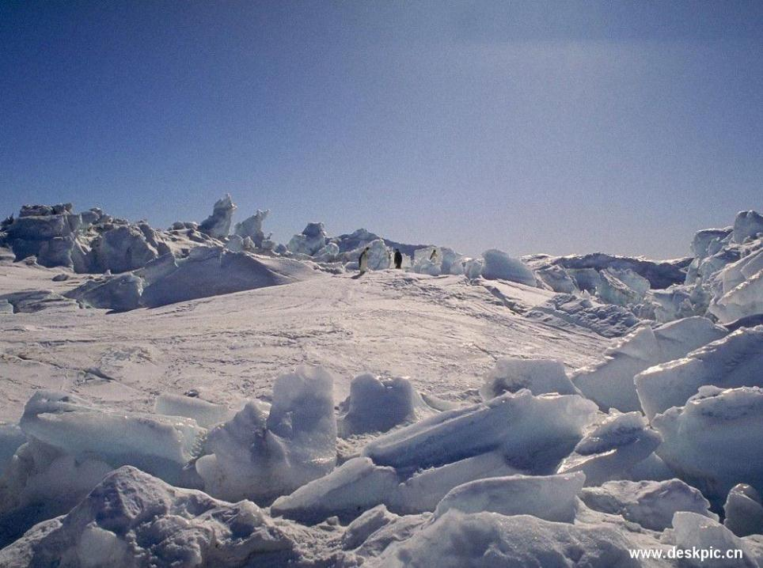

Slide 41
1.世界最寒冷之极
南极洲的年平均气温在－28℃，大陆内部的年平均气温在－40～－60℃，
最低气温达－89.6℃
2.暴风雪最强之地
南极沿海地区的年平均风速为17～18米/秒，阵风可达40～50米/秒。最大风
速达到100米/秒，被喻为“世界的风极”，“风暴杀手”。
3.最干旱的大陆
南极大陆的年平均降水量为55毫米，随着大陆纬度的增加降水量明显减少，大陆
中部地区的年降水量仅有5毫米。在南极点附近，年降水量近于零，比非洲撒哈
拉大沙漠的降水量还稀少。所以，南极是世界上最干旱的地区。其主要原因是固
态的冰雪降落在大陆后形成巨大的冰盖，加之极端寒冷的气候和极少的日照量，
冰盖的累积量还略大于消融量，形成干燥的“白色沙漠”。
4.最荒凉孤寂的大陆
南极大陆是世界上至今唯一没有常住居民的大陆。只有一些南极考察国家的科学考察人员短期的在南极工作，每年约2000人左右。

