Slide 1
Unit 4 Li Ming Comes Home
Lesson 24 Danny’s Surprise Cake
WWW.PPT818.COM

Slide 2
Warm-up
Greetings
Hello, my dear students.
Hello, Mr./Miss...
How are you today?
I’m fine.
How is the weather today?
It’s sunny.

Slide 3
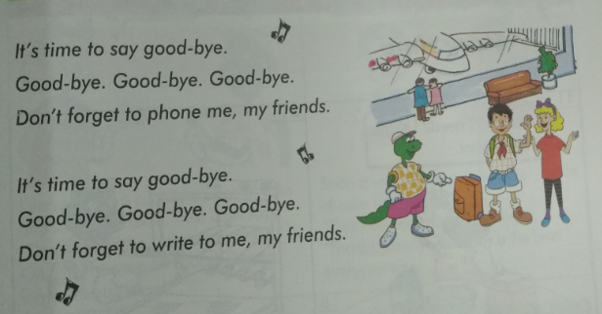
Warm-up
Let’s sing!

Slide 4
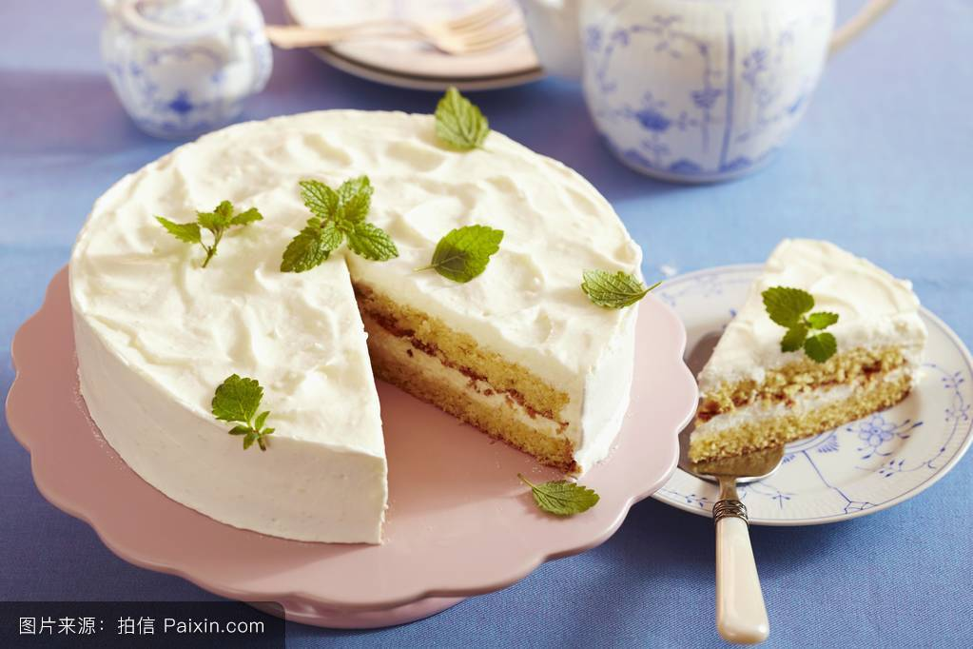
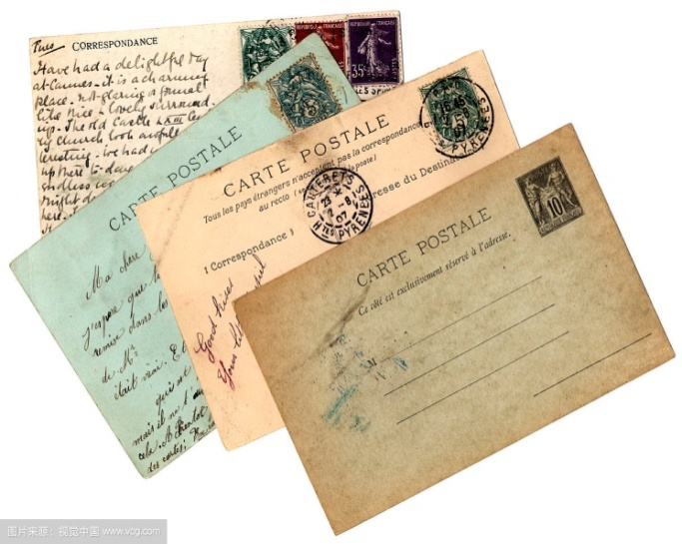
Review
Who can remember what Jenny, Danny and the others did before Li Ming went home?
What did Li Ming do ?

Slide 5
Presentation
Who is he?
He is Danny.

Slide 6
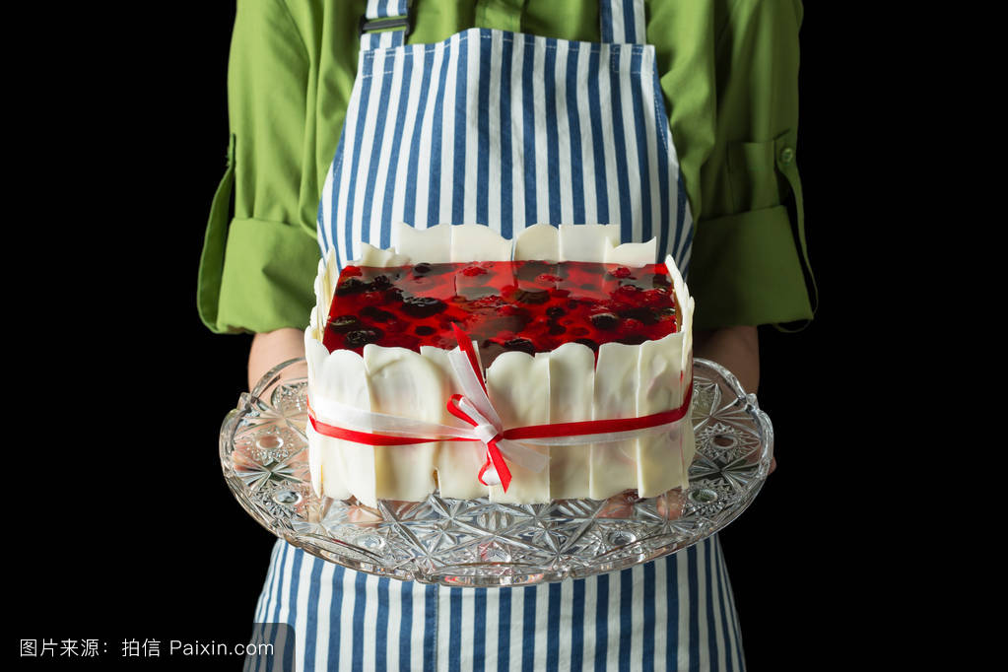
The cake is heavy,
so he walks slowly.

Slide 7
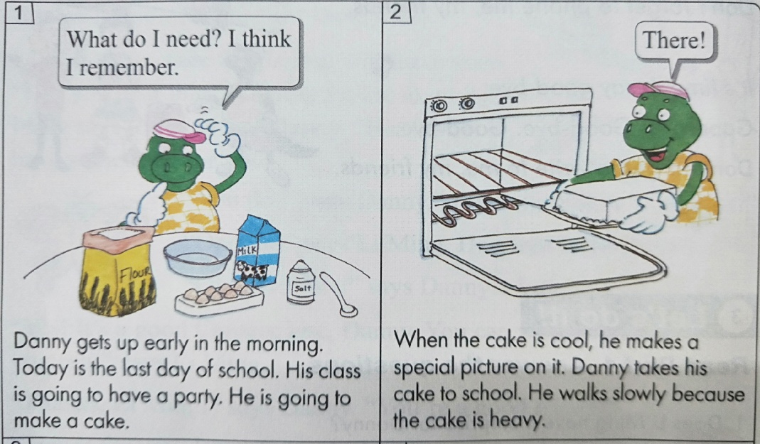
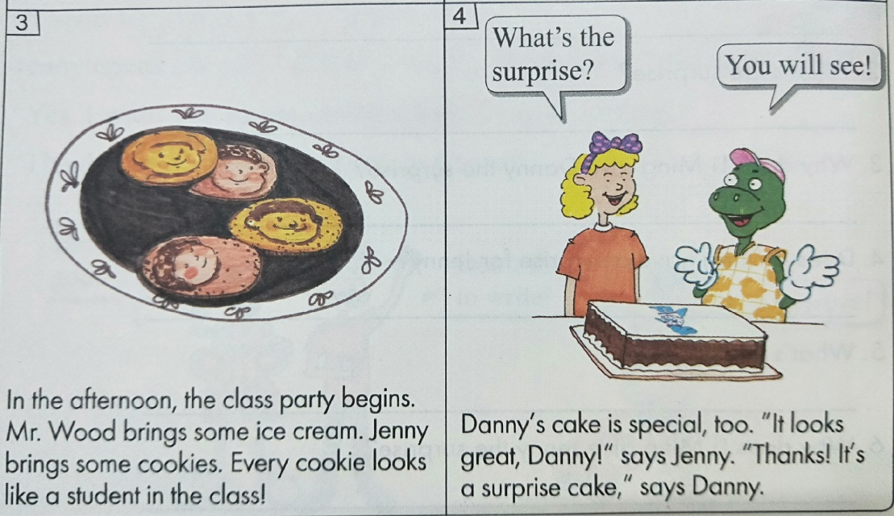
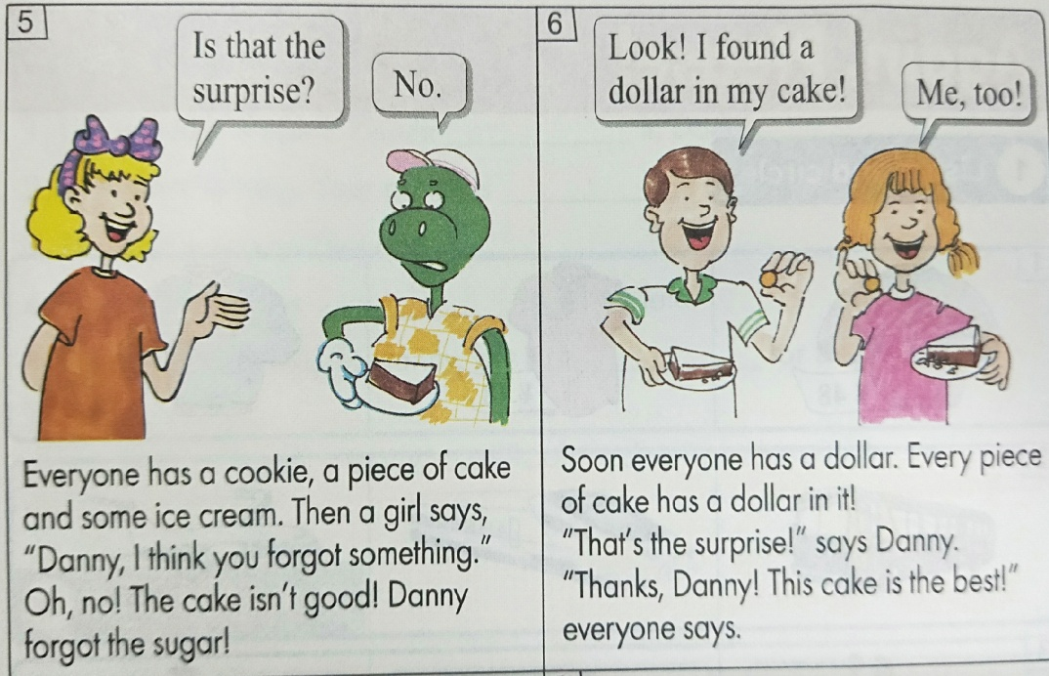
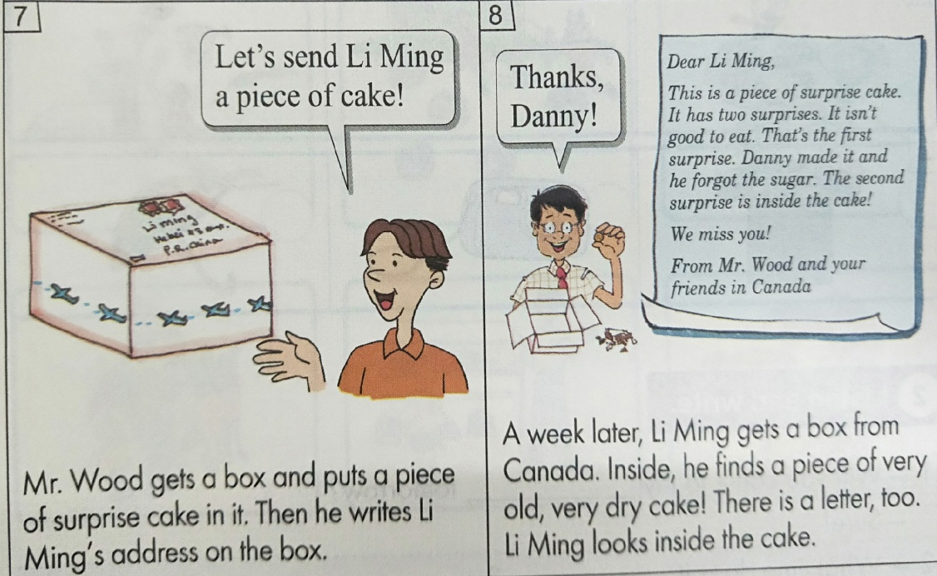
Story time
观看课文图片

Slide 8
Questions:
What do the cookies look like?
Every cookie looks like a student in the class.
What did Danny forget to put in his cake?
He forgot the sugar.
What did Danny put in his cake for a surprise?
Every piece of cake has a dollar in it.
What did Li Ming find in his cake?
He finds a letter and a piece of very old, very dry cake.

Slide 9
Knowledge Point
(1)be going to
(2)look like
(3)a piece of
(4)send sb. sth.

Slide 10
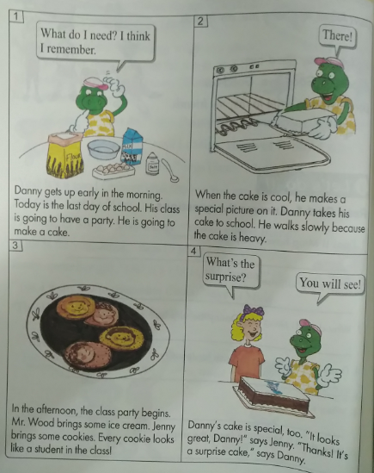
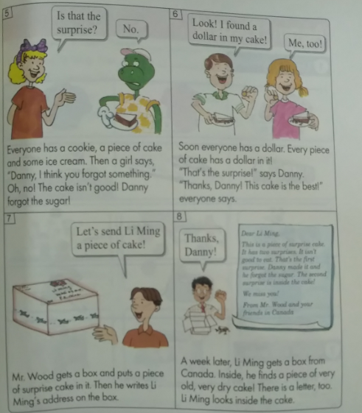
Practice
Story time
根据录音复述课文

Slide 11
Consolidation and Extension
根据课文内容填空。
early
Danny gets up ______ in the morning. His class is going to have a ______. Danny is going to make a ______. ______ do you make a cake? Does Danny ______? No, he _______! He puts flour, eggs, oil, milk and salt in the cake, but he forgets the _______. Danny carries his cake to school. He walks slowly and he is _______ for school. Mr. Wood brings some __________for the party. Jenny brings some_______. ________cookie looks like ______ ______ in the class.
party
cake
How
succeed
doesn’t
sugar
late
ice cream
cookies
Every
a
student

Slide 12
Homework
1.学生分组活动，要求根据自己不同的活动和动作，说出与本节相关的词语和句子 。
2.做完本课配套的课后练习题。

Slide 13
Thank You!

