Slide 1
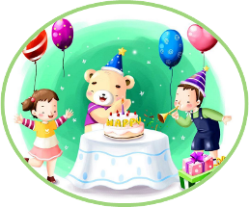
Unit3 Would you like to come to my birthday party?
人教精通版六年级上册
WWW.PPT818.COM

Slide 2
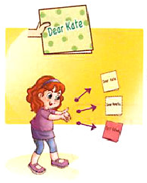
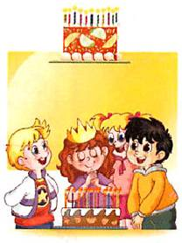
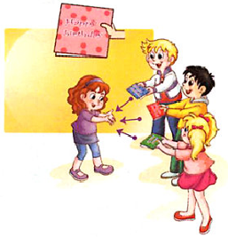
>>Review
Look and say
invite your friends
to your party
celebrate your birthday
with your friends
give a birthday card
to your friend

Slide 3
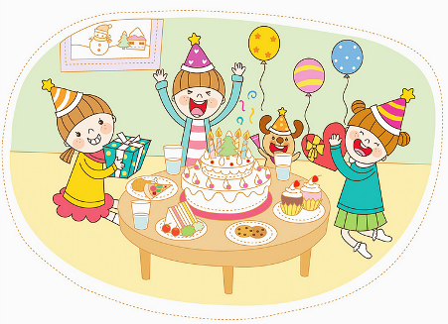
>>Lead-in
Look and say
Our good friend Lisa is going to have a birthday party. Would you like to come to her birthday party?

Slide 4
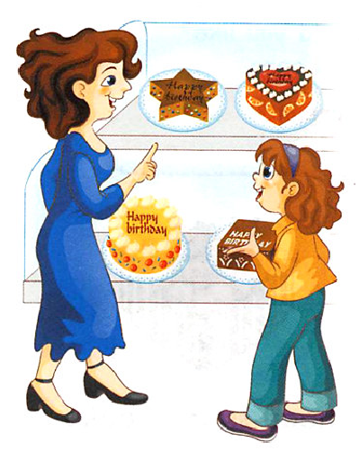
>>Presentation
Just read and talk
Look and say
Lisa is going shopping with her Mum. What do they want to buy?
They want to buy cakes.

Slide 5
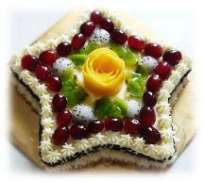
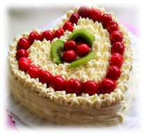
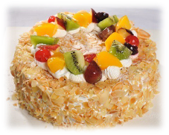
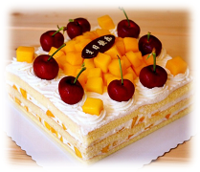
>>Presentation
Let’s learn
I have many cakes. Which one do you like?
star-shaped cake
heart-shaped cake
round cake
square cake

Slide 6
>>Presentation
Just read and talk
Listen and answer
What kind of cake would Lisa like?
She would like a chocolate heart-shaped cake.
chocolate
What kind of cake would you like?
I’d like ...

Slide 7
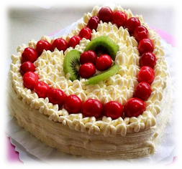
>>Presentation
Just read and talk
Read and answer
Why does she choose a heart-shaped cake?
A heart-shaped cake shows her love for Mum and Dad.

Slide 8
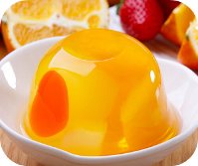
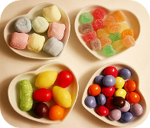
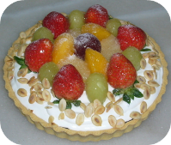
>>Presentation
Just read and talk
Read and circle
They also get some other things. What are they?
ice cream
jelly
candy
fruit pie

Slide 9
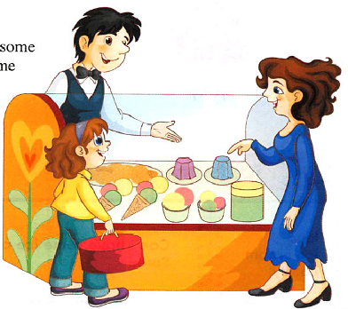
>>Presentation
Just read and talk
Look and say
sure
Sure. And I’ll get some candy and fruit pies for you.
Can I get some ice cream and some jelly?
Sure
Can I

Slide 10
>>Presentation
Just read and talk
Listen and imitate
Mum: What kind of cake would you like, Lisa?
Lisa: I’d like a chocolate cake.
Mum: What shape would you like? How about this
star-shaped cake?
Lisa: Well, Mum. I really like that heart-shaped
cake.
Mum: That’s wonderful! It can show our love for you.

Slide 11
>>Presentation
Just read and talk
Listen and imitate
Lisa: Thank you, Mum! It can also show my love
for you and Dad.
Mum: Good girl!
Lisa: Mum, can I have some ice cream and some
jelly, please?
Mum: Sure. And I’ll get some candy and fruit pies
for you, too.
Lisa: Thanks, Mum! I’ll have a great birthday party.

Slide 12
>>Practice
Read it by yourself for one minute .
自读对话一分钟。
一分钟倒计时
60
Learning tip :
10
10
50
自己读对话，比一比看谁能在一分钟内读完，并且读得准确、流利！
20
20
40
30
30

Slide 13
>>Practice
Show time
小组合作，练习对话并表演，其他同学评价。
Pronunciation (语音) |  | Fluency (流利) | Cooperation (合作)
OK!
Great!
Super!

Slide 14
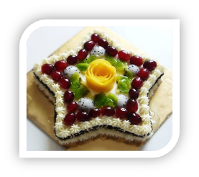
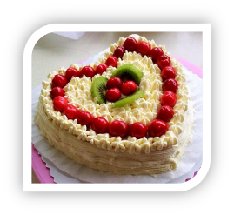
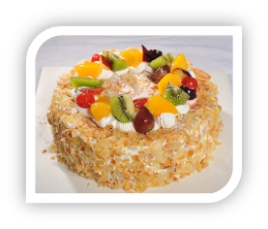
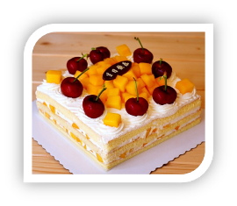
>>Practice
Pair work
A: What kind of cake would you like?
B: I’d like ...

Slide 15
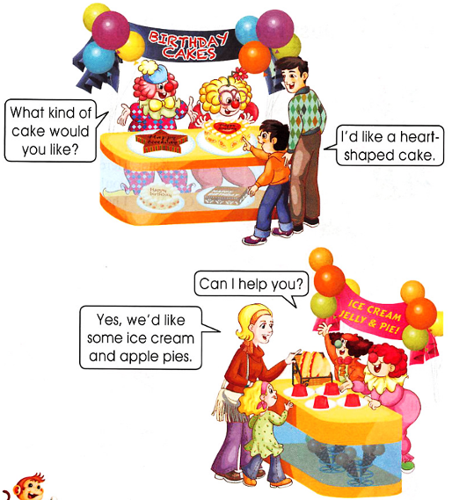
>>Practice
Group work
Let’s act!
What kind of cake
would you like?
I’d like a heart-shaped cake.
Can I help you?
Yes, we’d like some ice cream and apple pies.

Slide 16
>>Practice
活动
Do a survey
What kind of cake would you like?
Name
Shape
Flavour(口味)

Slide 17
>>Summary
如何询问某人想要什么种类的物品并做相关回答呢？
—What kind of … would you like?
—I’d like ...

Slide 18
>>Homework
1.跟读课文录音，按照正确的语音、语调朗读课文对话。 2.以小组为单位展开“What kind of cake would you like?”的调查，并制成一张调查表。
3.预习 Lesson17。

