Slide 1
Unit1 Be careful!
WWW.PPT818.COM

Slide 2
to our class

Slide 3
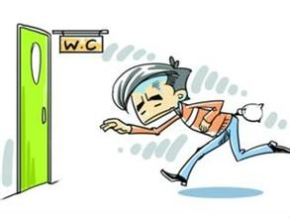
Guess
a
had
bad
Maybe he ate bad food.

Slide 4
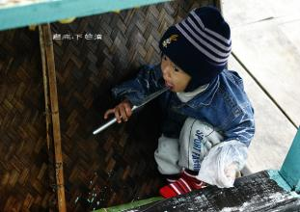
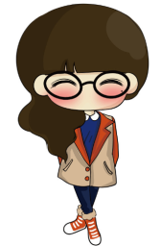
Kid,The knife is sharp.
Don't cut yourself.
ship
shar
sharp
garden
u
but
cut
e
bed
yourself

Slide 5
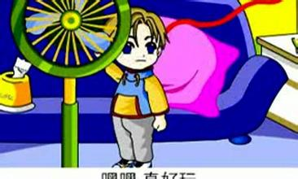
Don't touch the fan. You may get hurt.
an
hand
fan
hamburger
ur
hurt

Slide 6
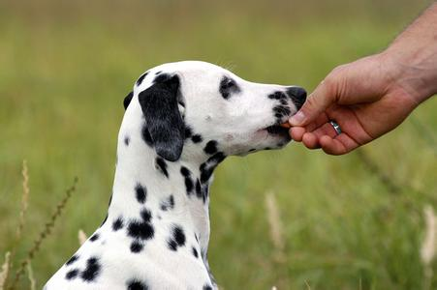
Don't feed the dog. It's so dangerous.
ee
feet
feed

Slide 7
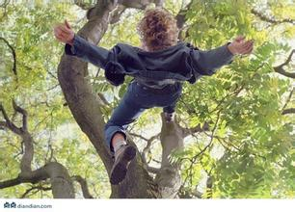
Don't climb a tree. You may fall down.
climb a tree
fall down

Slide 8
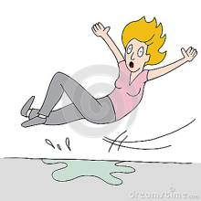
Watch out.The woman falls down. She must be careful.
all
ow
tall
fall
how
down
u
but
must

Slide 9
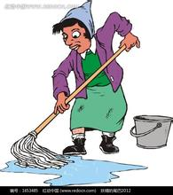
Be careful ! The floor is wet.

Slide 10
1. ---Don’t run near the hot water. --- OK.
2. ---Watch out, everyone. --- All right.
祈使句是用来表示命令、请求、指示等的句子，
肯定句常用动词原形开头，
否定句用Don’t+动词原形开头，如：
Get up, Sam!
Don’t watch TV for too long.

Slide 11
Don't eat ice-cream.
不要吃冰激凌！_____________________
不要跌倒！__________________________
做作业！___________________________-
不要忘记！_________________________
Don't fall down.
Do homework.
Don't forget.

Slide 12
dry the floor
跌倒
小心
great work
割伤你自己
cut yourself
做得好
get hurt
watch out
受伤
fall down
爬树
弄干地板
climb a tree

Slide 13
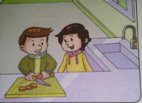
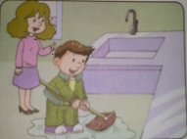
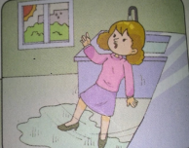
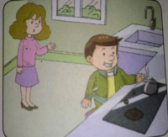
Mrs webb：_______,everyone. The floor is very wet.
Don't walk there. You may _________
Mrs webb：Don't cut the vegetable so
quickly,Ben.the knife is sharp. You
may_________________.
Ben：Here...Let me help you ____________
Mrs webb： _____________,Ben. Safety first.
Don't forget.
Mrs webb：Be careful,Ben.Don't run
near the hot water. You'll ________
Mrs webb: Cooking can be fun,but you
must __________.
dry the floor
Great work
cut yourself
Watch out
fall down
be careful
get hurt

Slide 14
homework
1、完成《活动手册》单词抄写。
2、读对话中词组和重点句型。

Slide 15
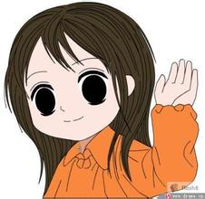
Thank you！

