Slide 1
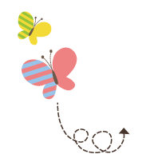
Unit 3 What Will You Do This Summer?
六年级下册
Lesson13 Summer Is Coming!
WWW.PPT818.COM

Slide 2
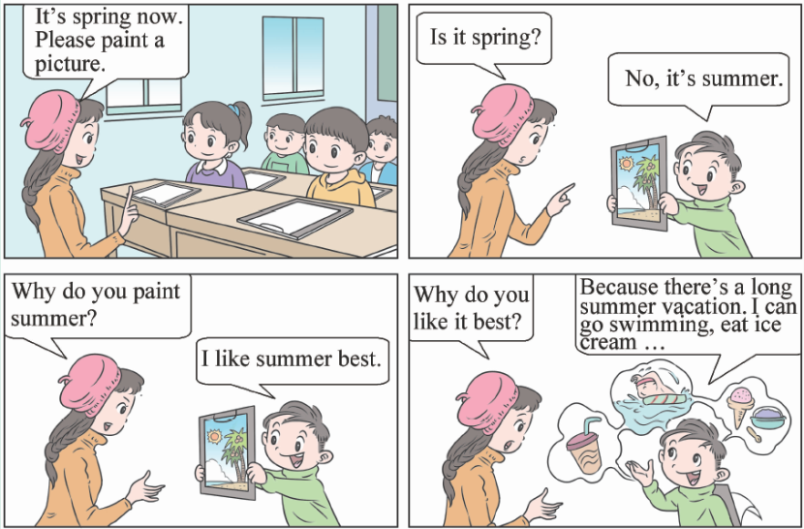

Slide 3
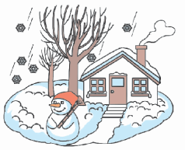
1. What season is it?
Hi, class! What happens to trees in different seasons?
In winter, it’s cold and snowy. Many trees don’t have any leaves.
In spring, the weather is warm. Trees have new leaves.
It’s hot in summer. Trees have green leaves.
In autumn, trees lose their leaves. What colour are the leaves?

Slide 4
知识点1
What happens to trees in different seasons? 树木在不同的季节里发生了什么(变化)?
what 引导的特殊疑问句
—What happens to trees in autumn?
在秋天树木发生了什么(变化)?
—They lose their leaves.
它们失去叶子。
例句：

Slide 5
易错点
提示
what在句中作主语时，谓语动词要用单数形式。其中happen to...意思是“对于……发生了”。
What happens ________ Danny?
A．in B．on C．to
典例
C

Slide 6
season /'siːz(ə)n/ n. 季节
There are four seasons in a year. 一年有四季。
例句：
seasons
复数：
out of season过时
短语：
sea（大海）+son（儿子）+season（季节）
加法记忆法：
魔法记忆：
大海（sea）的儿子（son）是季节。

Slide 7
知识点 2
snowy /'snəʊi/ adj. 多雪的
It is cold and snowy. 天气寒冷而且有雪。
例句：
字母组合ow的发音是 /əʊ/。
发音：
snowy(形容词)→snow (名词)
词性变化：

Slide 8
魔法记忆：
表示天气的部分形容词：
sunny，sunny阳光照，cloudy，cloudy云儿飘，
windy， windy风吹凉，rainy，rainy雨丝长，
snowy，snowy雪飞扬，
一年四个seasons里，天气变化真奇妙。
It’s ________ today. Let’s make a snowman.
A. sunny B. snowy C. rainy
典例
B

Slide 9
知识点 3
What colour are the leaves?树叶是什么颜色的？
what colour用来询问物品的颜色。
用法：
What colour + be动词+名词/代词？
句型结构：
—What colour are the flowers?花是什么颜色的？
—They are red. 它们是红色的。
— What colour is it？它是什么颜色的？
—It’s yellow. 它是黄色的。
例句：

Slide 10
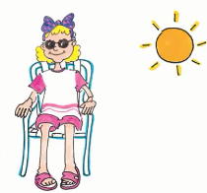
2. Summer fun
I love summer! In summer, I like to swim.
I like to sit in the sun.
Summer is hot. I like the fan. It’s cool.
Sometimes I play sports with my friends.
Sometimes I fly a kite.
Sometimes I like to look at the clouds.

Slide 11
I like to swim.我喜欢游泳。
知识点 4
like to do sth. 喜欢做某事
like doing sth.
同义短语：
I like to play basketball.
＝I like playing basketball.
我喜欢打篮球。
例句：

Slide 12
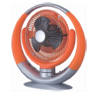
fan /fæn/ n. 风扇；扇子
知识点 5
Here is a fan. How cool!
这儿有一个风扇。好凉快啊！
例句：
fan n. 迷，爱好者
一词多义：
形近词：
fun n．有趣 can aux. v. 能；会
man n．男人 pan n．平底锅
ran v．跑(run的过去式)

Slide 13
3. Let’s do it!
Talk and write.
seasons | weather | trees | like to do
spring | warm | new leaves | ride a bike
summer
autumn
winter
It’s warm in spring. I can see new leaves. I like to ride my bike.

Slide 14
一、单项选择。
( )（1）________ autumn, the weather is cool.
A．In B．On C．At
( ) (2) There are four ________ in a year.
A．seasons B．months C. weeks
( ) (3) What happened ________ you last Monday?
A．to B. in C. of
A
A
A

Slide 15
( ) (4) Many trees _______have _______ leaves in winter.
A. doesn’t; any B. don’t; any
C. don’t; some
( ) (5) It’s hot now. Please turn on(打开) the ________．
A. TV B. computer C. fan
B
C

Slide 16
二、按要求完成下列各题。
（1）The leaves are yellow in autumn.(就画线部分提问)
________ ________ are the leaves in autumn?
（2）It is warm in spring.(改为一般疑问句)
________ ________ warm in spring?
（3）The trees have some apples in autumn.(改为否定句)
The trees ________ have ________ apples in autumn.
What colour
Is it
don’t any

Slide 17
本节课我们学习了以下知识，请同学们一定加强巩固，以便能和同学们进行灵活交流哦！
重点词汇：season, snow, fan➢
重点短语：like to do sth.
重点句式：What happens to trees in different seasons?
What colour are the leaves?

Slide 18
1 熟记本节课所学的句型、短语和单词，必须会听、说、读、写。
2 将What season is it的内容朗读流利。
3 完成配套的课后作业。

