Slide 1
Unit 6 Be a Champion!
The Dream Team
WWW.PPT818.COM

Slide 2
Learning Targets
Key words & phrases:
defeat, gold, medal, influence, Brazil, diving, badminton, coach, dream team, have an influence on, time after time, do one's best
Key sentences:
1. At the 1992 Olympics, the U.S. basketball team defeated all the other teams and won the gold medal.

Slide 3
2. They had a great influence on people everywhere—not just in the Olympic Games.
3. All of the players must work hard and do their best for the team.
4. But she didn’t want to miss the Olympics, so she practiced as soon as she got out of the hospital.

Slide 4
Lead in
What is the dream team of China?

Slide 5
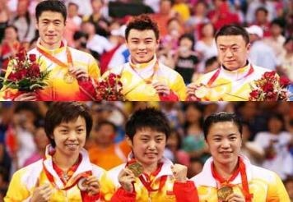
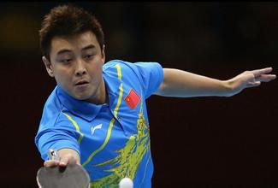
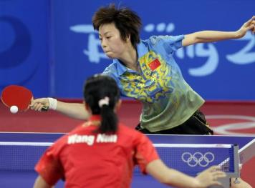
Ping-pong Team

Slide 6
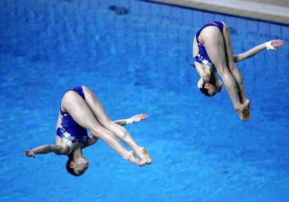
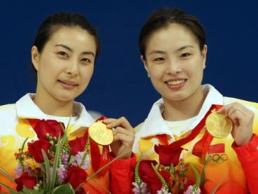
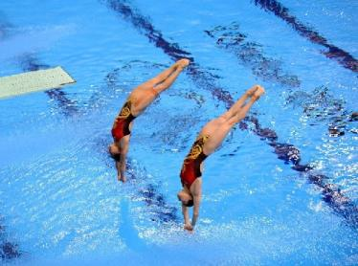
Diving Team

Slide 7
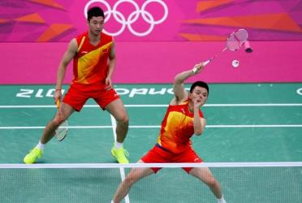
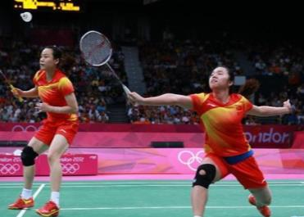
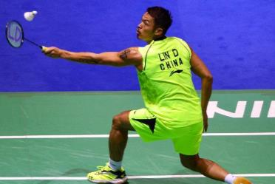
Badminton Team

Slide 8
Words and expression
defeat
gold
medal
influence
Brazil
diving
v. & n.战胜；打败
n. 金；黄金制品；金色 adj. 金色的
n. 奖牌；勋章
n. 影响；作用
巴西
n. 跳水

Slide 9
Words and expression
badminton
coach
dream team
have an influence on
time after time
n. 羽毛球
n. 教练；辅导教师
梦之队
对……有影响
多次；反复；不断地

Slide 10
Think about it
Which sports team do you like best? Why?
What is the most important part of a team?

Slide 11
Listen to the passage and tell True or False.
Presentation
1. The U.S. basketball team is considered to be the dream team.( )
2. The diving team is China’s only dream team.( )
3. There is more to a dream team than winning gold medals. ( )
T
F
T

Slide 12
Ⅰ .Read the lesson and answer the questions.
1. What is the dream team of the U.S.?
The basketball team.
Is the diving team China’s only dream team?
No. China also has dream teams in ping-
pong and badminton.

Slide 13
3. What does a dream team have?
A dream team has not only the best players
and the best coach, but also the best team
spirit.
4. How can the players perform better?
The players perform better by working
together.

Slide 14
Ⅱ. Complete the clues and do the crossword.
Across
The weather has a big _______ on agriculture.
Down
2. Lin Dan, a famous Chinese player, started playing ____________ at the age of nine.
3. Her hair is so blond that it almost looks like _____.
4. We have been practicing Snow White for over a month. We are going to _______ it tomorrow.
5. The_______ held a team meeting to discuss the reasons why they failed.
influence
badminton
gold
perform
coach

Slide 15
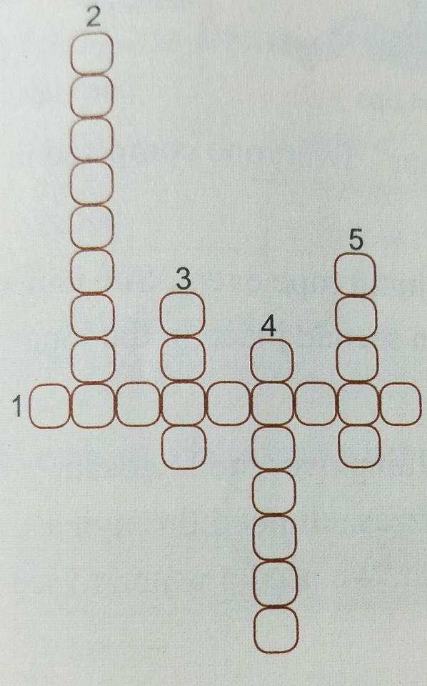

Slide 16
Ⅲ. Complete the passage with the correct forms of the given words.
Not every famous athlete is the one who goes the _________(fast) or the ________(high). Sometimes people win in other ways. In 1992, at the Barcelona Olympics, Canadian rower Silken Laumann came third in a race. But some people thought her bronze medal was as _______(good) as the gold medal.
fastest
highest
good

Slide 17
Just before the Olympic race, she was seriously injured. But she didn’t want to miss the Olympic, so she practiced as soon as she got out of the hospital. Taking part in the Olympics was _______________(important) than winning for her.
more important

Slide 18
Ⅳ. Work in groups. Take turns acting out a sport. While one group member acts, the others try to guess what sport it is.
You can ask the following questions:
Is it played inside or outside?
Is it on land or in water?
Is it a solo event or a team event?

Slide 19
Language points
1．At the 1992 Olympics, the U.S.basketball team defeated all the other teams and won the gold medal.
(1)gold n．黄金制品。
例：He wore a gold watch.
他戴着一块金表。
(2)medal n．奖牌；勋章。
例：The soldier was awarded a medal for his bravery.
那个士兵因勇敢而被授予一枚勋章。

Slide 20
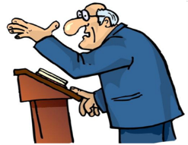
2.They had a great influence on people everywhere—not just in the Olympic Games.
have an influence on/upon＝ have an effect on/upon对……有影响。influence的前面可以加上great、big、no等词修饰。
例：Parents' reading habits have a great influence on their children.
父母的阅读习惯对他们的孩子有重大影响。

Slide 21
3.Many people would say that it's the diving team.
diving n．跳水。
例：I like swimming，but I prefer diving.
我喜欢游泳，但是更喜欢跳水。
4. Time after time，these teams have won gold medals for China.
time after time＝ again and again 多次，反复，不断地。
例：Bill spelt the word time after time.
比尔反复拼写那个单词。

Slide 22
5．All of the players must work hard and do their best for the team.
do one's best尽某人最大努力。它相当于try one's best。其后可接动词不定式，表示 “尽力做某事”。
例：You should do/try your best to learn English well.
你们应尽力把英语学好。

Slide 23
6.That's what makes a dream team！
句中that指代上文提到的 “By working together，they perform better，and they never give up”。what makes a dream team是what引导的表语从句，what在从句中作主语。
例：Thank you for coming. That's what I want to say.
谢谢你们的光临。那就是我想说的。

Slide 24
7.But she didn't want to miss the Olympics，so she practiced as soon as she got out of the hospital.
as soon as 一……就…… 该短语在句中引导时间状语从句。as soon as引导时间状语从句时，主从句的时态有以下两种情况：
①主句用过去时，从句用过去的某种时态；
②主句用将来时，从句用一般现在时表示将来。
例：As soon as I get there，I'll call you.
我一到那儿就给你打电话。

Slide 25
Ⅰ .Fill in the blanks with the correct forms of the words or phrases in the box.
Exercises
defeat gold medal dream team Brazil diving
time after time coach
1. An athlete needs to practice an event ____________ for many years to win a _______________ .
2. In the competition, our team ________ all the other teams and won first place.
3. Other than the best players, the best _______ is also very important to a ________________.
4. The 31st Olympic Games was held in _____ in 2016.
5. The Chinese _______ team has many excellent players, such as Guo Jingjing.
time after time
gold medal
defeated
coach
dream team
Brazil
diving

Slide 26
Ⅱ . Translate the following sentences.
1. 他在这次选举中击败了对手。
He defeated his opponents in this election.
2. 那将直接影响到全球的气候。
It would have an influence on global climate.
我们国家也有梦之队。
Our country also has dream team.
4. 一次又一次，我的心被伤害。
Time after time, my heart was hurt.
5. 她不但会说英语，而且会说法语。
She can speak not only English but also French.
6. 永远不要放弃，如果你仍然觉得还可以继续。
Never give up if you still feel you can go on.

Slide 27
Summary
Learn some new words and expressions.
Learn about the dream team.

Slide 28
Homework
Talk about the 2008 Olympics with a partner. Try using the following phrases or any others you can think of: dream team, catch up with, not…anymore, good luck, give up.

