Slide 1
Unit 3 Could you please tell me where the restrooms are? Section B (第1课时)
WWW.PPT818.COM

Slide 2
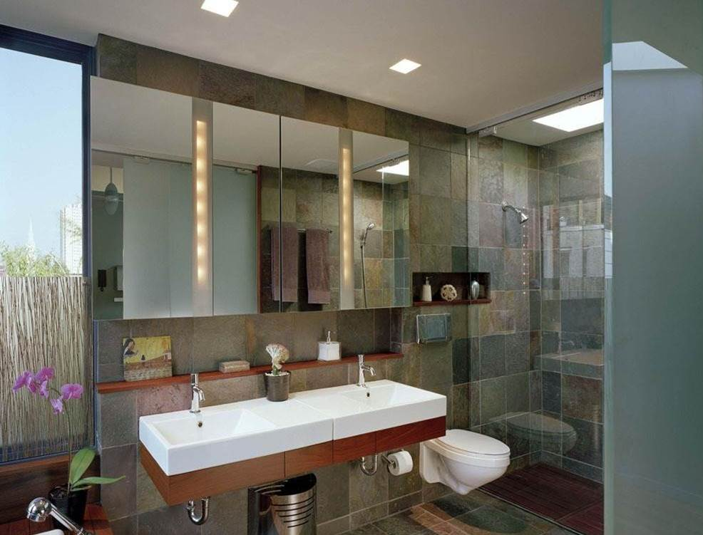

Slide 3
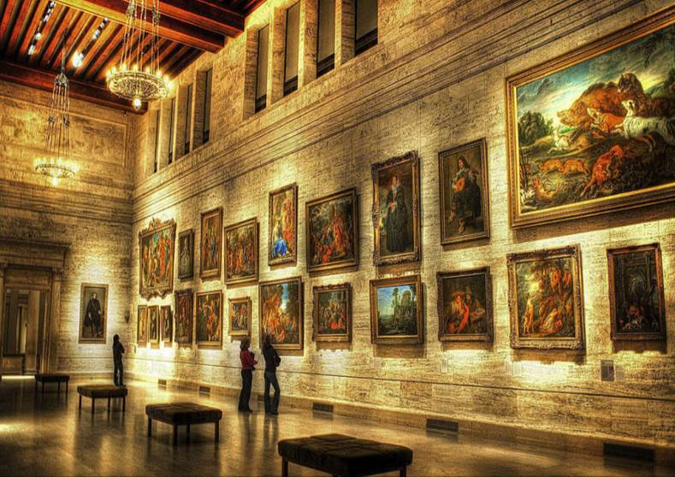

Slide 4
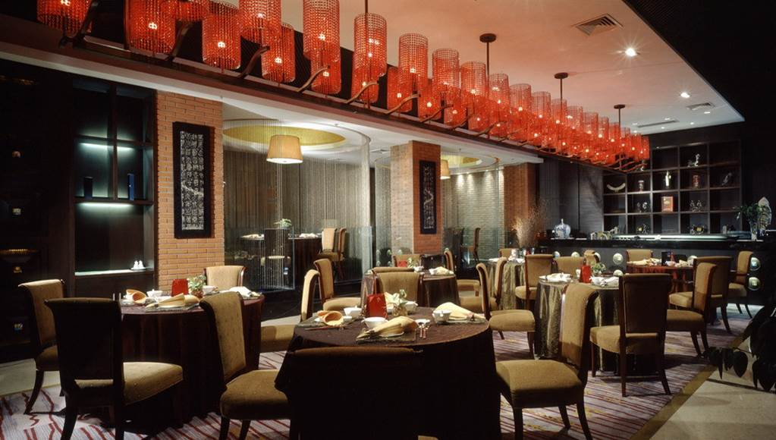

Slide 5
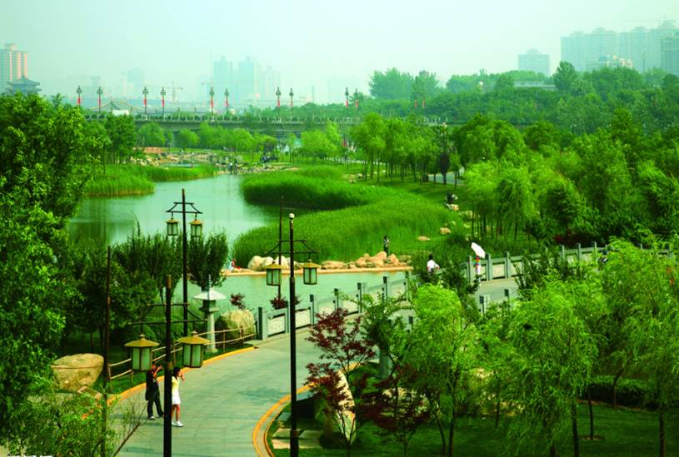

Slide 6
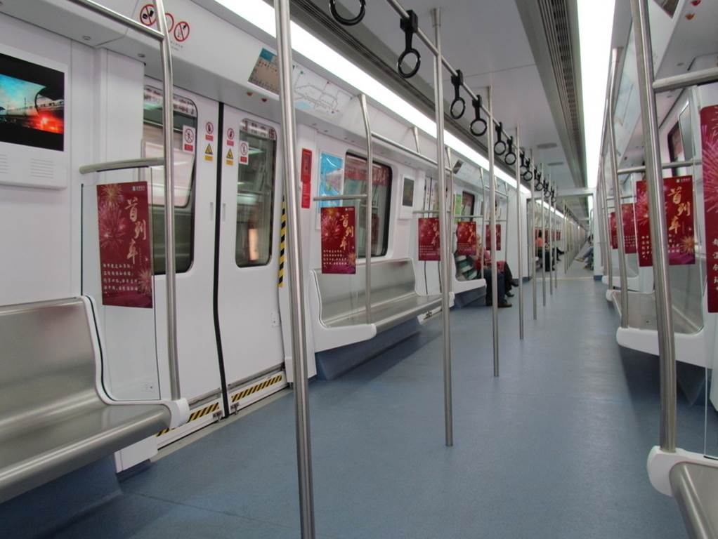

Slide 7
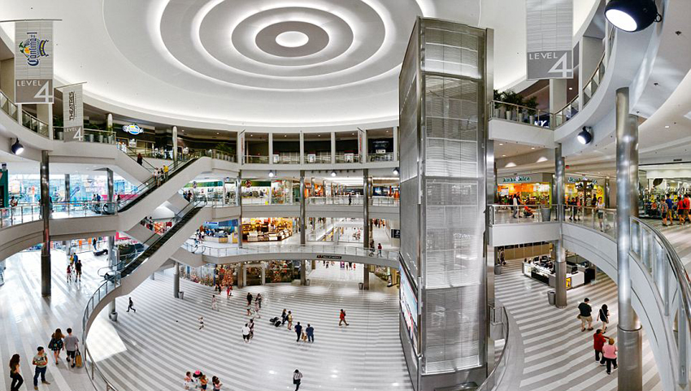

Slide 8
What qualities are important for each
place?Write the words from the box
next to each place below.Write the most
important words first.
1a
interesting fascinating
inexpensive quiet
uncrowded big
beautiful convenient
safe clean
Places | Qualities
1.restroom | clean,
2.museum
3.restaurant
4.park
5.subway
6.mall

Slide 9
1b
Talk about places in your city using
the word in 1a.
A:The Fine Arts Museum is
really interesting.
B:Yes,and it's beautiful,too.

Slide 10
1c
Listen to the conversations and complete the sentences.
Conversation 1
The boy asks about________________,and the clerk tells him to go to Green Land.
Conversation 2
The girl asks about_______________,and the clerk tells her to go to the corner of Market and Middle Streets.
Conversation 3
The mother asks about_____________.The father wants to go to a____________museum.The younger girl wants to go to a ____________museum.The boy wants to go to a____________museum.The older girl wants to go to an___________ museum. The clerk suggests they go to the____________museum.
a good place to eat
public restrooms
a good museum
history
science
children's
art
computer

Slide 11
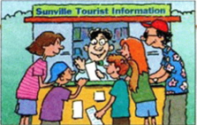
1d
Listen again. Check your answers in 1c.

Slide 12
1e
Role-play the conversations between the clerk and the tourists.
A:Can you tell me where there's a
good place to eat?
B:Of course.What kind of food do you
like?
A:...

Slide 13
2a
Where do you need to make polite requests? Think of some possible situations. Discuss them with your partner.

Slide 14
2b
Read the article and underline the
topic sentence for each paragraph.
Could You Please...?
When you visit a foreign country,it is important to know how to ask for help politely.For example, "Where are the restrooms?"or"Could you please tell me where the restrooms are?" There are similar requests for directions. Both are correct,but the first one sounds less polite.That is because it is a very direct question. It is not enough to just ask a question correctly. We also need to learn how to be polite when we ask for help.

Slide 15
Good speakers change the way they speak in different situations.The expressions they use might depend on whom they are speaking to or how well they know them well.However, if you say to your teacher,"When is the school trip?", this might sound impolite.But if you say,"Excuse me,Mr. West. Do you know when the school trip is?”, this will sound much more polite.
Usually polite questions are longer.They include expressions such as"Could you please...?"or "May

Slide 16
I ask...?"It sounds more polite to say,"Peter, could you please tell me your e-mail address?" than "Peter,tell me your e-mail address." Sometimes we even need to spend time leading into a request.For example,we might first say to a stranger,"Excuse me,I wonder if you can help me"or"I'm sorry to trouble you,but..."before asking for help.
It might seem more difficult to speak politely than directly.However,it is important to learn how

Slide 17
to use the right language in different situations.This will help you communicate better with other people.

Slide 18
2c
Find the direct questions and
polite requests from the passage.
Direct questions | Polite requests
1.Where are the restrooms? 2.When is the school trip? 3.Peter,tell me your e-mail address. | 1.Could you please tell me where the restrooms are? 2.Excuse me,Mr. West. Do you know when the school trip is? 3.Peter, could you please tell me your e-mail address?

Slide 19
2d
Read the requests below. In the second column,write A if you would say it to someone you know and B if you would say it to a stranger. In the last column,
write where you think these people are.
Request | Person | Place
1.Will you pass the salt?
2.Do you know where I can change some money,please?
3.Could you tell me what just happened?
4.Can you please tell me where the nearest station is?
5.Excuse me, do you know what time it begins, please?
6.Let me know when you're ready, OK?
7.Could you possibly tell me the way to the village school?

Slide 20
Language Points
1.fascinating 迷人的；极有吸引力的
fascinating 形容词，意为“迷人的；极有吸引力的”，
通常用来作表语和定语。作表语时，主语通常是物。
e.g.:Your ideas are fascinating.
【拓展】①fascinate 及物动词，意为“使……着迷，
使……极感兴趣”。
e.g.:The toys in the shop window fascinated the children.
②fascination 既可作可数名词，又可作不可数名词，
意为“魅力，极大的吸引力”。
e.g.:Chinese art has a great fascination for me.
③fascinated 形容词，意为“着迷的”，主语通常是人。
e.g.:I used to be fascinated with dinosaurs.

Slide 21
2.inexpensive 不昂贵的
inexpensive 形容词，意为“不昂贵的”，其同义词为
cheap，反义词为expensive/dear。
inexpensive是由词根expensive加上前缀in-构成的。
e.g.:The sweater is inexpensive.
【拓展】(1)在一个单词的前面或后面加上一个词缀构
成新词，这种构词法就做派生法。
加在单词前的词缀叫前缀，加在单词后面的词缀叫后
缀。前缀一般不引起词性的转变，而只是引起意思上
的变化。如：expert熟练的→inexpert不熟练的；
complete完善的→incomplete不完善的；possible可
能的→impossible不可能的。

Slide 22
3.convenient 方便的；便利的
convenient形容词，意为“方便的；便利的”，常用于
句型“It’s convenient for sb. to do sth.”中，意为“对于
某人来说做某事是方便的”。
e.g.:It’s convenient for us to do that.
【拓展】convenience 是convenient的名词形式，既可
作可数名词，又可作不可数名词，意为“方便，便利；
有益，有用的设施”等。
e.g.:I keep my books near my desk for convenience.
The house has all the modern conveniences.

Slide 23
4.safe 安全的
safe 形容词，意为“安全的”，常用作表语。be safe后
面一般接移动不定式，常构成句型：
It’s (not) safe to do sth.意为“做某事是（不）安全
的”；safe from后接表示“危险、危害”等的名词，意为
“不会受到……的伤害”。
e.g.:It’s not safe to swim alone in the river.
You will be safe from danger at home with your parents.
[助记]
safe(adj.安全的) safety(n.安全)
反义词 反义词
dangerous(adj.危险的) danger(n.危险)

Slide 24
Exercise
一、用所给词的正确形式填空。
1.It’s not __________(safely) to play on the
street.
2.I’m thirsty. I’m looking for something
__________(drink).
3.She is kind of __________(quiet).
4.The street in the morning is ___________(crowd).
But in the afternoon,it’s very crowded.
5.The space station is very__________(fascinate).
safe
to drink
quiet
uncrowded
fascinating

Slide 25
二、单项选择。
( )1.It’s _____ to take the subway to visit our
city.It can take you everywhere you want to
go.
A.fascinating B.inexpensive
C.uncrowded D.convenient
( )2.He was so______when he heard the
_____news that he got the frist prize in the
contest.
A.exciting;exciting B.exciting;excited
C.excited;excited D.excited;exciting
D
D

Slide 26
( )3.We must find a place______.
A.living B.to live C.lives D.lived
( )4.—Can you tell me_____?
—She is in the computer lab.
A.where Linda was B.where is Linda
C.where was Linda D.where Linda is
B
D

Slide 27
Homework
Read the article and recite key words.

Slide 28
Thank you!

