Slide 1
Unit 3
How do you get to school?
R 七年级下册
第3课时
WWW.PPT818.COM

Slide 2
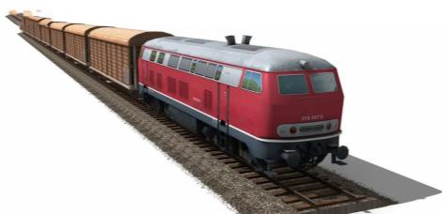
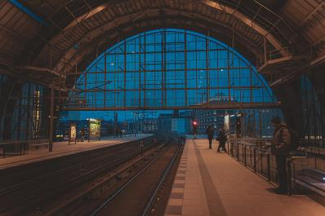
Lead-in
Where you can find these vehicles?
train station
train

Slide 3
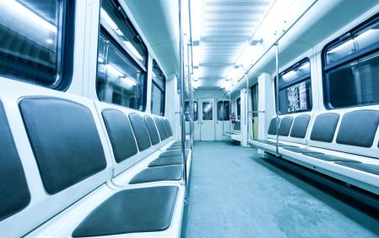
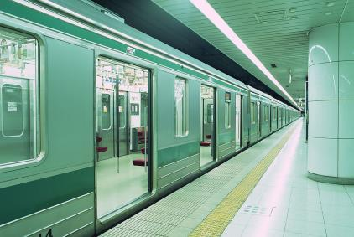
subway
subway station

Slide 4
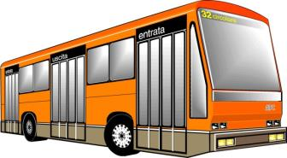
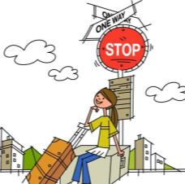
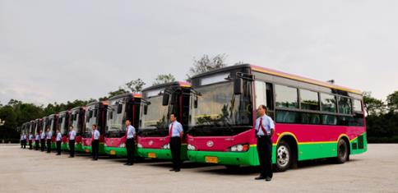
bus
bus stop
bus station

Slide 5
1a
Match the words with the pictures.
1. _____ bus stop 3. _____ bus station
2. _____ train station 4. _____ subway station
b
c
a
d

Slide 6
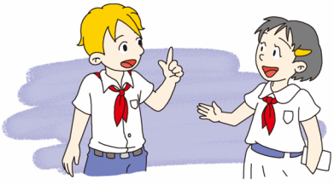
Tell your partner how you get to school. Imagine you use two types of transportation.
1b
I ride a bike to the bus stop. Then I take the bus to school.
How do you get to school?

Slide 7
I take a bus to the subway station. Then I take the subway. The subway station is crowded, and I spend five minutes to get out of there.
How do you get to school?

Slide 8
Listen and check (√) the things that Mary wants to know?
1c
Mary wants to know…
_____ where Bob lives.
_____ how far he lives from his grandparents’ home.
_____ how he gets to his grandparents’ home.
_____ how long it takes to get to his grandparents’ home
_____ what he thinks of the trip.
√
√
√

Slide 9
Listen again. How does Bob get to his
grandparents’ home? Check (√) 1 or 2.
1d
√

Slide 10
1e
Talk about how Bob gets to his grandparents’ home.
He walks to bus stop. Then he takes a bus to the train station. Finally, his grandfather takes the subway to pick him up.
How does Bob get to his
grandparents’ home?

Slide 11
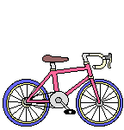
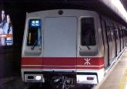
Make you own conversations with your partner according to the tips.
From the home to the park

Slide 12
How do you get to the park?
I …Then…

Slide 13
Language points
1. Mary wants to know what he thinks of the trip.
玛丽想知道他认为这段旅程怎么样。
think of意为“认为；考虑”。
of为介词，其后可接名词、代词或动名词作宾语
在表示“认为……怎么样”时，可与think about互换。

Slide 14
What do you think of…：你认为……怎么样？
= How do you like…
用来询问某人对某事或某人的看法。
例:你认为这次学校旅行怎么样？
What do you think of/about the school trip?
= How do you like the school trip?

Slide 15
Exercise
1. — Can you watch TV _____ dinner?
— No, but I can do it after dinner.
A. for B. after C. before D. on
2. — Why are you walking so fast?
— Because I ____ get home to do my work.
A. have B. go to C. have to D. has to
C
C

Slide 16
3. — Can you cook dinner?
— ______. It's easy.
A. No, I can't B. Yes, I can
C. No, I can D. Yes, I need
4. I can't watch TV _____ my school nights.
A. on B. at C. in D. to
B
A

