Slide 1
Unit 2
How do you come to school
第1课时
五年级
WWW.PPT818.COM

Slide 2
Quick respond 快速反应
Watch and say the transportations as quickly as possible!
看卡通快速说出交通工具！
Loudly! 大声！

Slide 3
A: How do you come to school?
B: I come to school____.
by plane
on foot
by train
by bike
TAXI
by bus
by taxi
by car

Slide 4
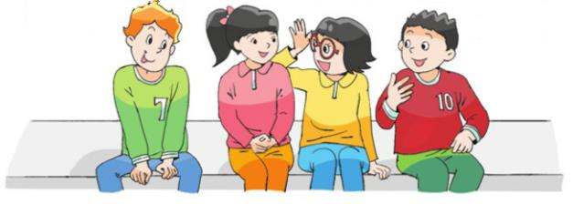
Watch the cartoon and answer questions.
看动画回答问题。
Where do they live?

Slide 5
Read and match
How do they come to school?

Slide 6
Listen and match
How do they come to school?

Slide 7
Read and circle
Su Hai lives near/ far from school. She lives on Moon Street
/Park Street, near City Library.
Yang Ling lives near/ far from school.
Mike lives in Sunshine Town/ near City Library.
Liu Tao lives on Moon Street/ Park Street.

Slide 8
Read in roles
Do you like your new home, Su Hai?
Yes! It’s very big. I like it very much, but it’s far from school.
Where do you live now?
I live on Moon Street, near City Library.
How do you come to school?
Su Yang and I come to school by bus.

Slide 9
Read in roles
Where do you live, Yang Ling? How do you come to school?
I live near school. I come to school on foot. Where do you live?
I live in Sunshine Town. I come to school by metro. What about you, Liu Tao?
I live on Park Street. I come to school by taxi. My father is a taxi driver.

Slide 10
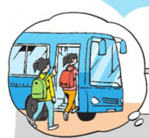
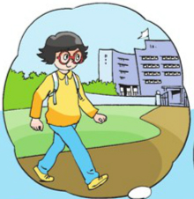
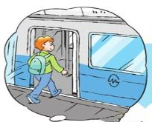
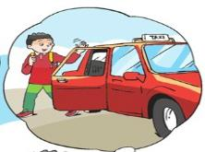
Moon Street, near City Library.
on foot
Sunshine Town by metro
by taxi

Slide 11
Homework
Read the story fluently, try to retell the whole story.
熟练朗读课文，试着复述整个故事。
Collect the names of more public transportation.
收集更多的公共交通方式的名称。(选做)

