Slide 1
Lesson 3
We sing here.
WWW.PPT818.COM

Slide 2
subjects
Chinese 语文
English 英语
science 科学
maths 数学
music 音乐
computer studies 电脑课
P.E. 体育
art 美术

Slide 3
let's talk
A: What subjects do we have today?
B: We have… and …
A: What’s your favourite subject?
B: It’s …

Slide 4
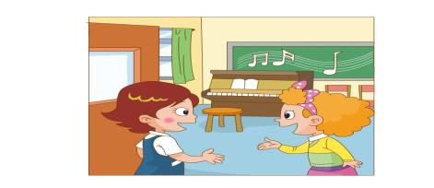
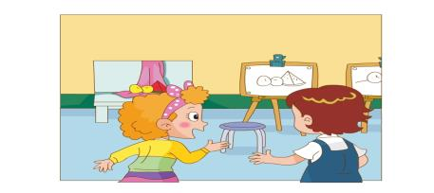
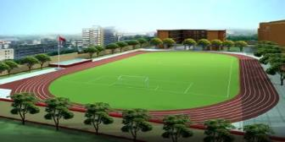
music room
playground
art room

Slide 5
listen and find the answers:
What do you do in the music room?
We _______ here. (这边)
sing

Slide 6
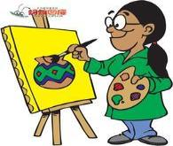
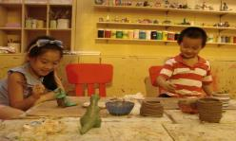
Watch and choose
We _______ in the art room.
A: sing
D: read
B: draw
C: making things

Slide 7
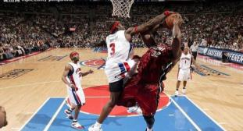
Read and choose:
What do you do on the playground?
We ______________ there. (那边)
play basketball
A:
B:
play basketball
making things

Slide 8
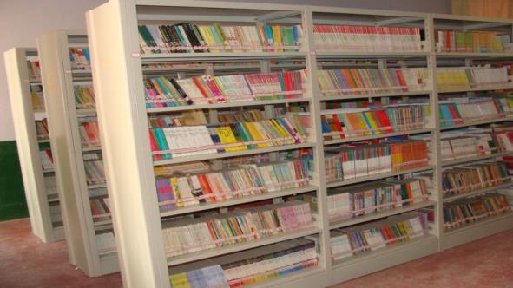
We read in the library.
library

Slide 9
Listen and point .
Listen and repeat .

Slide 10
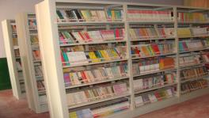
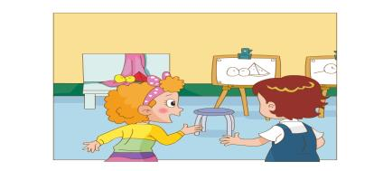
Pair work.
-- This is our … .
-- We … here/there .

Slide 11
Let's chant.
Sing, sing, sing
Sing in the music room;
Make, make, make things
Making things in the art room;
Play, play, play
Play baseball on the playground.

Slide 12
Let's copy .

Slide 13
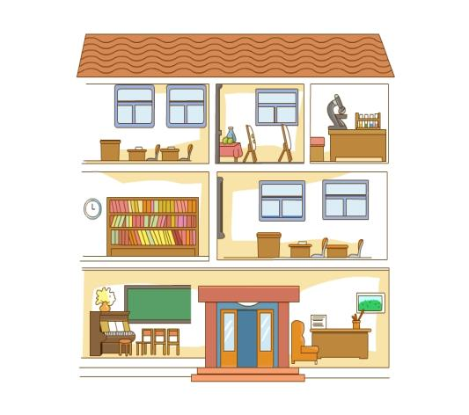
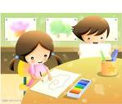
Match and say .
We … in the …

Slide 14
Read and choose.
1、We in the art room.
A. sing B. draw C.read
2、We read in the .
A.classroom B.music room C.library

Slide 15
Let's guess.
art room
music room
classroom
lab
playground
bedroom
living room
We … in the …

