Slide 1
Unit 6
An interesting country
WWW.PPT818.COM

Slide 2
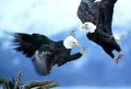
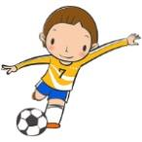
Let’s talk
Tower Bridge
Tower Bridge
Big Ben
Big Ben
I know something about …
We can see … in …
People like playing … in …

Slide 3
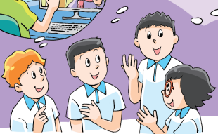
Let’s watch
The children will learn an interesting country next week.
will = be going to
What country is it?

Slide 4
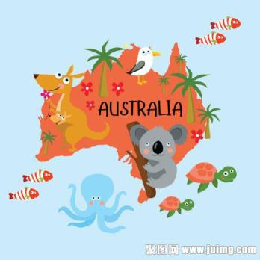
Let’s watch
The children will learn an interesting country next week.
will = be going to
What country is it?
Australia

Slide 5
The children will learn about Australia next week.
They want to find out about this country before the lessons.
发现/了解
What will they do before the lessons?
Let’s read

Slide 6
Let’s talk
What will they do before the lessons?
ask his e-friend in Australia and get some photos
will
will
ask Mr Green
will
read about Australia on the Internet
will
look for books and magazines about Australia
杂志

Slide 7
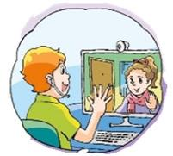
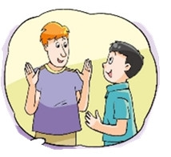
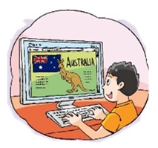
Before the lessons
Name |  | Do
 | will
Wang Bing
Liu Tao
ask his e-friend in Australia and get some photos
look for books and magazines about Australia

Slide 8
True or false
Mike wants to find some photos of Australia.
Wang Bing knows a woman from Australia.
Liu Tao has an e-friend in Australia.
Yang Ling will read books about Australia.
T
I’ ll = I will
I’ll ask my e-friend in Australia.
She can send me some photos.

Slide 9
True or false
Mike wants to find some photos of Australia.
Wang Bing knows a woman from Australia.
Liu Tao has an e-friend in Australia.
Yang Ling will read books about Australia.
T
F
I’ll ask Mr Green.
He comes from Australia.

Slide 10
True or false
I’ll go to the library and
look for books and magazines
about Australia.
Mike wants to find some photos of Australia.
Wang Bing knows a woman from Australia.
Yang Ling will read books about Australia.
Liu Tao has an e-friend in Australia.
T
F
T

Slide 11
True or false
Mike wants to find some photos of Australia.
Wang Bing knows a woman from Australia.
Yang Ling will read books about Australia.
Liu Tao has an e-friend in Australia.
T
I’ll read about Australia
on the Internet.
F
T
F

Slide 12
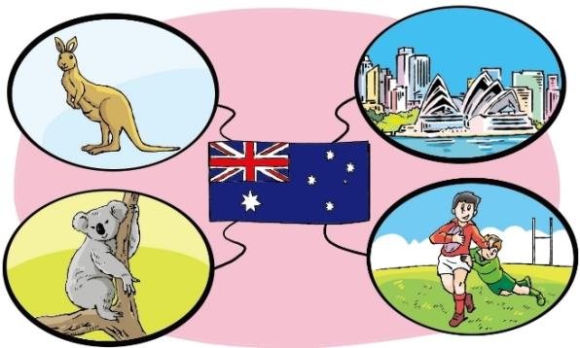
Let’s read
At home, Liu Tao is reading about Australia.
kangaroo 袋鼠
Sydney 悉尼
koala 考拉
Australian football
澳式橄榄球

Slide 13
Let’s read (P59)
What interesting things will we find
in Australia?
Australia
interesting animals
kangaroos & koalas
interesting sport
Australian football
interesting city
Sydney

Slide 14
Kangaroo
The kangaroo is a large animal.
It’s brown.
It has a small head and a big body.
It has a long tail.
Its front legs are short.
Its back legs are long and strong.
It can jump far（远）and high.
Let’s know
Does the kangaroo have four long legs

Slide 15
Where does the koala live and what does it eat
Koala
The koala is small.
It’s grey（灰色）.
It has large ears.
It has no tails.
It lives in trees and eats leaves（叶子）.
Let’s know

Slide 16
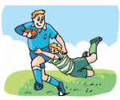
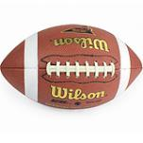
Australian football
It is different from English football or American football. There are 18 players in an Australian football team.
They use an oval（椭圆形）ball, not a round ball.
It’s a very exciting game.
Players can kick the ball or carry or hit the ball with the hand.
√
A
B
Let’s know

Slide 17
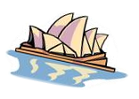
Sydney
Sydney is the biggest（最大的）city in Australia.
The Sydney Opera House is the most famous building
in Sydney.
Which city is the biggest one in Australia
Let’s know

Slide 18
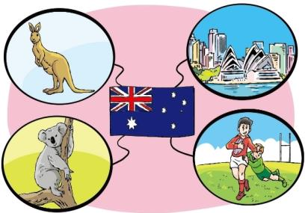
Introduce
Today, I’ll tell you about Australia.
You will find many interesting things in it.
You will love …
You will like …
You will like …

Slide 19
Let’s think
What else do you want to know about Australia?
animals
sport
city
place
seasons

Slide 20
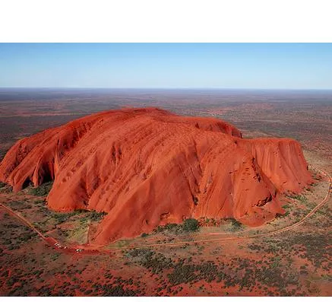
Interesting place：
Uluru is a big rock(岩石). It’s 863m high and 3000m long. Every year, a lot of visitors from all over the world come to visit it. Sport-lovers also like it. It’s a good place for climbing.
What’s Uluru?

Slide 21
Seasons：
The seasons in Australia are different from the ones in China. When we are in summer in July. People in Australia enjoy their winter days.
The summer comes to Australia in December. When we wear warm clothes, Australian people only wear T-shirt and eat the ice cream.
Is it hot in July in Australia?

Slide 22
Homework
1、搜集更多你感兴趣的国家的信息。
2、试着向同学介绍你的家乡。

