Slide 1
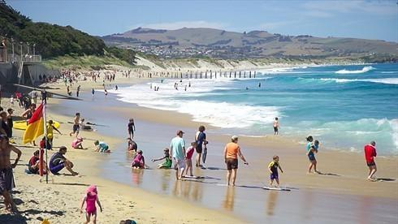
Module 9 People and places
Unit 1 We are enjoying the school trip a lot.
WWW.PPT818.COM

Slide 2
Teaching objectives
1. To learn new words and expressions in unit 1.
2. To listen and understand the dialogues.
3. To learn The Present Continuous Tense.

Slide 3
Words and expressions
/‘pəʊstkɑ:d/
/kɔ:l/
/laɪ/
/sʌn/
/laɪn/
/teɪk/
postcard
call
lie
sun
line
take
明信片 (给……)打电话 躺，平躺 太阳 行，排，列 拿，取

Slide 4
/teɪk ˈfəʊtəʊ/
/weɪt/
/weɪt fɔ: /
/wɔ:k/
/trɪp/
/fju:/
/ə fju: /
take photos
wait
wait for
walk
trip
few
a few
拍照 等待，等候 等待，等候
行走，步行 旅行 几个，很少 一些，几个

Slide 5
/seɪl/
/ɒn seɪl /
/ɪn'dʒɔɪ/
/'enɪweɪ/
/bæk/
/ɡəu bæk/
sale
on sale
enjoy
anyway
back
go back
卖，出售 正在出售 享受……的乐趣 尽管如此 向后，回到 回去

Slide 6
3
Listen, read and learn
B: Hi, Mum!
M: Hello, Betty. Where are you now?
B: I'm standing on the Great Wall of
China and talking to you.
M: Really? That's great.
B: We're on a school trip.
B=Betty M=Mum

Slide 7
M: What about the others? Are they with you?
B: Well, right now Tony is eating a delicious
ice cream. Wang Hui is taking lots of
photos. Lingling is buying a few presents
and postcards. They're on sale at the
shop. Daming is having lunch and lying
in the sun.

Slide 8
M: I'd like a postcard too, but please take
some photos of the Great Wall and send
them to me by email.
B: OK. We're enjoying the school trip a lot.
Anyway, it's time to go back to school
now. Bye, Mum! Bye, Betty!

Slide 9
Recite
长城
与朋友们交谈 拍照
许多, 大量 躺在阳光下
给我发送贺卡
the Great Wall
talk to friends
take photos
a lot of / lots of
lying in the sun
send me postcards

Slide 10
等公共汽车
正在出售 回到学校
正在出售的贺卡 在郊游
通过电子邮件
wait for the bus
on sale
go back to school
postcards on sale
on a school trip
by email

Slide 11
开车
喜欢学校郊游
写明信片
玩得高兴
买些礼物
drive a car
enjoy the school trip
write a postcard
have a good time
buy some presents

Slide 12
巩固
训练
Betty: Hi, Mum!
Mum: Hello, Betty. Where are you now?
Betty: I __________ on the Great Wall of
China and ______ to you.
Mum: Really? That’s great.
Betty: We’re __ a school trip.
Mum: What _____ the others?
’m standing
talking
on
about

Slide 13
Betty: Well, Tony _ _______ an ice cream,
Wang Hui _ _______ lots of photos
and Lingling _ ______a few presents
and postcards. And Daming ______
______ lunch and ____ in the sun.
is eating
is taking
is buying
is
having
lying

Slide 14
Mum: I’d like a postcard too, but please
___ some photos of the Great Wall
and send them to me __ _____.
Betty: OK. We _ ________ the school trip
_ ___. ______ , It’s time to __ ____
to school now. Bye, Mum!
Mum: Bye, Betty!
take
by email
’re enjoying
a lot
Anyway
go back

Slide 15
home me mum
money now sun
eating standing talking
China
enjoy
boy enjoy toy

Slide 16
Chant
Talking, talking, talking, I am talking.
Writing, writing, writing, he is writing.
Singing, singing, singing, she is singing.
Sitting, sitting, sitting, we are sitting.
Doing, doing, doing, what are you doing?

Slide 17
现在进行时句式
1. 肯定句：主语 + be + 动词-ing …
They are waiting for buses.
now, look, listen是标志词
2. 否定句：主语 + be + not + 动词-ing …
They are not (aren’t) waiting for buses.
3. 一般疑问句: Are we waiting for buses?
Yes, we are. /No, we aren’t.
4. 特殊疑问句：
特殊疑问词＋一般疑问句？
What are they waiting for?

Slide 18
Guessing Games
What is she doing?
She is shopping.

Slide 19
What are they doing?
They are lying on the grass.

Slide 20
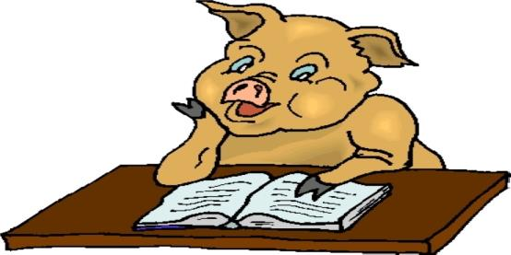
What is Mr Pig doing?
He is reading a book.

Slide 21
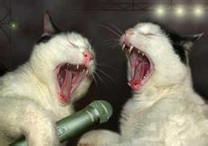
What are they doing?
They are singing.

Slide 22
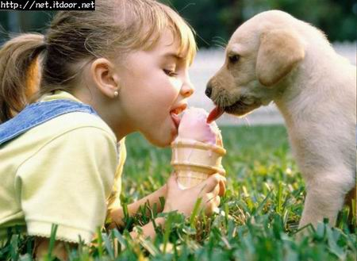
What are they doing?
eats
ice cream
They are eating ice cream.
Notes:
22

Slide 23
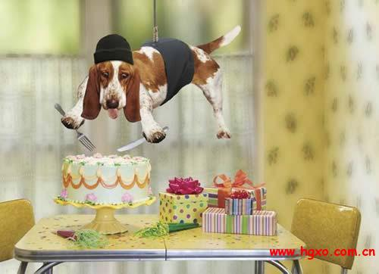
What is Mr Dog doing?
He is cutting a cake.

Slide 24
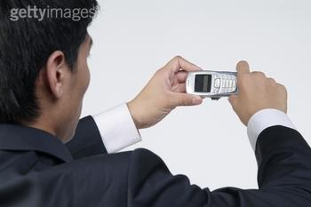
What is the man doing?
He is taking photos.

Slide 25
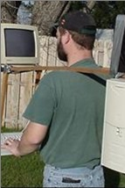
What is he doing?
He is playing the computer.

Slide 26
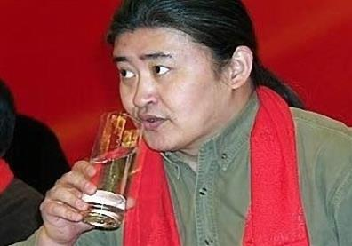
What is Liu Huan doing?
He is drinking .
Notes:
26

Slide 27
Underline the correct words.
The children are on a school (1) trip / holiday to the Great Wall. They’re walking on it, taking photos and buying (2) a few / a lot of
presents, ice creams and postcards on (3)
sale / line at the shop. They (4) are enjoying / aren’t enjoying the trip a lot.

Slide 28
Read and complete the passage.
Betty and her friends are __ a school trip. Betty ___ _____ on the Great Wall of China and ______ to her mum. Tony _ ______ a delicious ice cream. Wang Hui _ _____ lots of photos and Lingling is buying ___ ____ presents and postcards. And Daming ____
______ lunch and ____ in the sun.
on
is standing
talking
is eating
is taking
a few
is
having
lying

Slide 29
Betty’s mum would like a _________ and some ______ of the Great Wall and she wants Betty to send them to her __ _____. They ___ _______ the school trip _ ___. _______ , It’s time to __ ____ to school now.
postcard
photos
by email
are
enjoying
a lot
Anyway
go back

Slide 30
写出下列单词的现在分词形式
enjoy
wait
drink
buy
have
take
write
enjoying
waiting
drinking
buying
having
taking
writing
drive
run
swim
shop
lie
die
driving
running
swimming
shopping
lying
dying

Slide 31
buy
lie
stand
read
talk
walk
sing
dance
have
take
buying
lying
standing
reading
talking
walking
singing
dancing
having
taking
write
shop
eat
drive
call
enjoy
tell
swim
wait
drink
writing
shopping
eating
driving
calling
enjoying
telling
swimming
waiting
drinking

Slide 32
1. Li Lei ______ doing his homework.
A. am B. is C. are
2. Are you _______ photos?
A. take B. taking C. takes
3. Is Ms Li ________ on the bed?
A. lie B. lies C. lying
4. Lingling and Daming ____ writing.
A. are B. am C. is
5. What are you ____?
A. do B. does C. doing

Slide 33
enjoy doing sth. “喜欢做某事”
She enjoys playing tennis.
她喜欢打网球。
enjoy oneself “玩得开心；过得愉快”
I enjoyed myself in the party.
在晚会上我玩得很开心。

Slide 34
完成句子
1. 他们一边躺着晒太阳一边吃东西。
They are____ _ __ __ .
and eating something.
2. 我们非常喜欢学校的这次郊游。
We’re________ the school trip _ ___ .
3. 他们正在照相！
They are_____ _____ !
lying in the sun
enjoying a lot
taking photos

Slide 35
4. 你能给我寄一张明信片吗？
Can you____ __ __ _____ ?
5. 玲玲正在同她妈妈说话。
Lingling’s______ __ her mother.
6. 我们正在进行一次学校旅行/郊游。
We __ __ a school trip.
send me a postcard
talking to
are on

Slide 36
2. 其他人呢?
What about the ______ ? =
What about the ____ ________ ?
3. 请你拍一些长城的照片, 用邮件发给我。
Please ____ some photos __ the Great
Wall, send them __ me ___ email.
4. 他们和你在一起吗？
___ they _____ you?
others
other students
take of
to by
Are with

Slide 37
5. 公园里有许多人。
There are _ __ __ people in the park.
6. 现在该回学校了。
It’s time _ ___ ____ __school now.
7. 该起床了。________________
8. 该回家了。________________
a lot of
to go back to
It’s time to get up.
It’s time to go home.

Slide 38
9. 大明在等谁?
Who __ Daming _____ ____ ?
0. 看! 珍妮正躺在床上看书.
Look! Jenny __ _____in bed and
______ a book.
1. 他们在商店买一些特价明信片。
They ___ ______ __ ____ _____
on sale at the shop.
is waiting for
is lying
reading
are buying a few postcards

Slide 39
单词拼写
1. Can you ___ /kɔ:l/ me tonight?
2. Betty is _______ /ɪn'dʒɔɪɪŋ/ herself at
her birthday party now.
3. Tony is _____ /'laɪŋ/ in the sun and
eating an apple.
4. _______ /ˈeniweɪ/ , what time is it now?
5. The boy is _____ /'teɪkɪŋ/ photos on the
Great Wall.
call
enjoying
lying
Anyway
taking

Slide 40
Read and fill the blanks
Hello! I’m Betty. Now I 1___________ (stand) on the Great Wall of China and 2. ______ ( talk) to you. We’re on a school trip and we 3.___________ ( have) a good time.
Tony 4.__________ (eat) an ice cream.
am standing
talking
are having
is eating

Slide 41
Wang Hui 5.________ ( take) lots of pictures and Lingling 6._________ ( buy) some presents and postcards. And Daming 7. ________ ( eat ) lunch and 8._____ ( lie) in the sun. We 9._____ _______ ( enjoy) the school trip a lot.
is taking
is buying
is eating
lying
are
enjoying

Slide 42
本课时主要词组
talk to you
on a school trip
take lots of photo
eat lunch
lie in the sun
enjoy the school trip
send a postcard to me by email

Slide 43
Homework
1. Recite the dialogue on page 54.
2. Write about a trip.

Slide 44
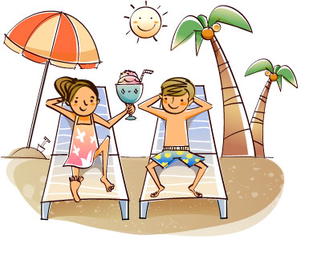
Goodbye

