Slide 1
Module 7 Great Books
Unit 1 We’re still influenced by Confucius's ideas.
WWW.PPT818.COM

Slide 2
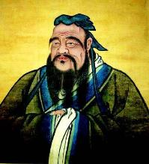
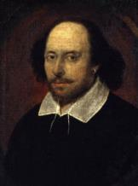
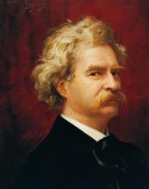
新课导入
Lead in
思 考
Free Talk
Do you know about them?

Slide 3
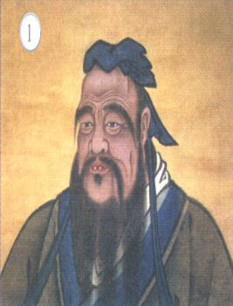
新课讲解
Before Reading
思 考
Confucius
Confucius (circa 551－479 B.C.) He sometimes went by the name Kong Zi, though he was born—Kong Qiu—styled Zhong Ni. He was born in the village of Zou in the country of Lu.

Slide 4
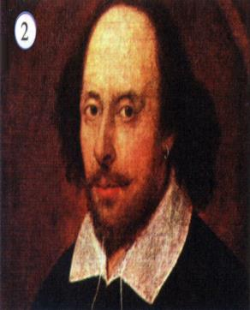
新课讲解
思 考
Shakespeare
(1564－1616) He was considered the greatest playwright（剧作家） in the world and the finest poet who has written in the English language.

Slide 5
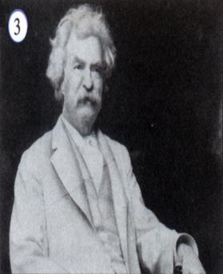
新课讲解
思 考
Mark Twain
( l835—1910 ) He was the U.S. critical realism literature founder, world renowned short story master.

Slide 6
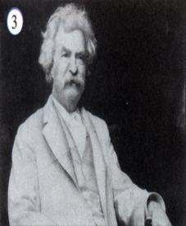
新课讲解
1
思 考
Work in pairs. Look at the pictures. Say who the
people are and why they are famous.
Now listen and check your answers.

Slide 7
新课讲解
2
Listen again and complete the sentences.
1. Confucius is well-known in ______________．
2. Shakespeare wrote _________________.
3. Mark Twain's stories are set ___________of the US.
思 考
many countries
plays and poems
in the south

Slide 8
新课讲解
3
思 考
Listen and read.
Mr Jackson: Hello, Betty. What's up?
Betty: I want to join an Internet group to discuss great books
by great writers.
Mr Jackson: So, who are your great writers?
Betty: Well, maybe Confucius and Shakespeare.
Mr Jackson: Really? I accept that they're great because their
works are still read by many people today. But I
think I'd describe Confucius more as a teacher and
thinker than a writer. He was a very wise man.
What do you have to do for the discussion?

Slide 9
新课讲解
Betty: Well, each of us reads a favourite book and writes a
review for the discussion.
Mr Jackson: I see. We're still influenced by Confucius's ideas, and
Shakespeare's plays also make a lot of sense to us
today. People have always read, and will always read
great books. By the way, what do you think of Mark
Twain, the great American writer in the nineteenth
century?
Betty: He was important, but I suppose he isn't as well-known as
Confucius or Shakespeare.
Mr Jackson: No, but his books are still popular, and one of his
books is my favourite, The Adventures of Tom
Sawyer.
思 考

Slide 10
新课讲解
Betty: Great! Why don't you join in the discussion and
tell us about it?
Now match the people with the descriptions.
1. Confucius
2. Shakespeare
3. Mark Twain
思 考
a) He was a very wise man.
b)He is not as well­ known as the other two
people, but his works are still popular.
c) His plays are read by millions of people.
d) He was more a teacher and thinker than a writer.
e) People are still influenced by his ideas.

Slide 11
新课讲解
4
Complete the passage with the correct form of the words in the box.
accept discuss influence review sense thinker wise
Mr. Jackson and Betty are (1)__________ great writers. Betty explains that in her Internet group, each person reads a favorite book and then writes a(n) (2)_______ of it. Mr. Jackson (3)________ that Confucius and Shakespeare are great because their works are still read by people today, but he thinks Confucius was more a teacher and (4)________ than a writer. He says that Confucius was a very (5)_______ man. Mr. Jackson thinks that we are still (6)____________ by Confucius’s ideas and that Shakespeare’s plays still make (7)_______ to people today.
discussing
review
accepts
thinker
wise
influenced
sense

Slide 12
新课讲解
5
Listen and underline the words the speaker
stresses.
1. We're still influenced by Confucius's ideas.
2. Shakespeare's plays also make a lot of sense to us today.
3. He was important, but I suppose he isn't as well-known as Confucius or Shakespeare.
Now listen again and repeat.

Slide 13
新课讲解
6
Work in groups. Do you agree with the following opinions? Give your reasons.
1. Teahouse is one of the greatest plays in China.
2. Everyone should learn some Tang poems.
3. We should only read books by great writers.
I accept...
I agree/don't agree with...
I suppose...
I think...
Now report the ideas of your group to the whole class.
Most of us think... We think we learn...

Slide 14
新课讲解
Language points 1
Point
discuss /dɪ'skʌs/ v.讨论
discuss sth. with sb.和某人讨论某事。
discuss sb./sth. 意为“讨论某人或某事”。
其名词形式为discussion，
常用结构为 have a discussion with sb. about sth.，意为“与某人讨论某事”。
eg: She will not discuss her goals.
她不愿讨论她的目标。

Slide 15
新课讲解
Language points 2
Point
review /rɪ'vjuː/ n.评论
vt.复查；重新考虑；复习； 回顾；评论 | review the situation 对形势重新加以研究 review last week's lessons 复习上周的功课
n. 回顾；复习课；评论 | a careful review of political events 有关政治事件的谨慎的回顾

Slide 16
新课讲解
Language points 3
Point
sense /sens/ n. 道理
make sense 合情理，有意义，一般不用于被动语态。
与sense相关的短语
make no sense无意义
make sense of 理解；明白
make sense to sb.对某人有意

Slide 17
新课讲解
Language points 4
Point
suppose /sə'pəʊz/ v.猜想；相信；认为；推测
suppose ＋that 表推测， 假定，假如，认为。 | eg：I suppose that you are right. 我想你是对的。
suppose用于祈使句中， 表示“要不……”。 | eg：Suppose we go for a swim.要不我们去游泳吧。
suppose ＋名词 ＋to be 表示“认为……是……”。 | eg：Many people suppose him to be over 50. 许多人认为他50多岁了。
be supposed to do sth.应该做某事，相当于should。 | eg：You are supposed to do exercise every day to keep in good health. 你应该每天锻炼保持身体健康。

Slide 18
当堂小练
一、根据句意及首字母或汉语提示完成单词
1.The radio says it's going to rain this afternoon，so it's____（ 明智的） of you to take your umbrella.
2.What will （影响）your decision about what to do when you grow up？
3.（嘉兴改编）We d the differences between Britain and the US in the English class yesterday.
4.It makes s to take care of your health.
5.He writes r for The New Yorker.
wise
influence
iscussed
ense
eviews

Slide 19
当堂小练
二、单项选择
6.（山西）—A lot of old people feel lonely. We should
try our best to care for them.
— I mean， we're all going to be old one day， too.
A. Take it easy B. Not at all C. You're right
7.This story happened in century.
A. nineteen B. nineteenth
C. the nineteenth D. the nineteen
8.（中考·成都）Yesterday people came to the town
to watch the car race.
A. hundreds B. hundred
C. hundreds of D. hundred of
C
C
C

Slide 20
当堂小练
9.（中考·湘潭）You're supposed something
happy and lucky to others on New Year's Day.
A.to say B. saying C. say
10.（中考·漳州）—Do you know Lin Shuhao？
—Yes. He is one of basketball players in the NBA.
A. popular B. more popular C. the most popular
A
C

