Slide 1
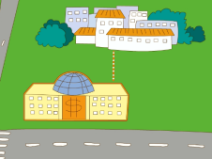
Unit2 There is a park near my home.
人教精通版六年级下册
WWW.PPT818.COM

Slide 2
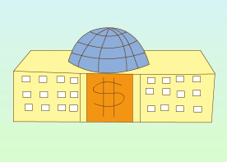
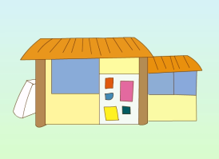
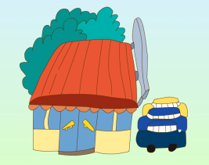
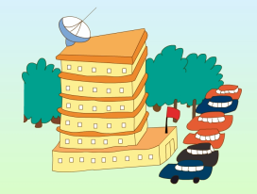
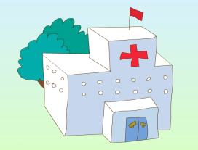
>>Review
Look and say
What’s missing?

Slide 3
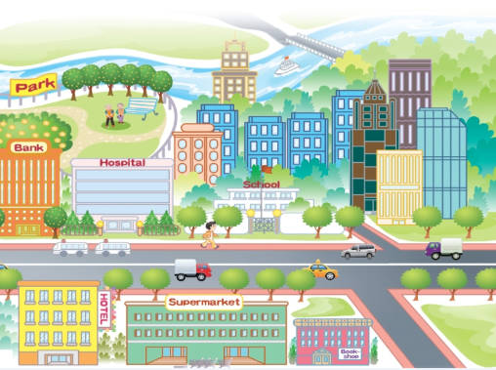
>>Review
Look and say
What’s in Susan’s community, do you
remember?
There is/are …

Slide 4
>>Lead-in
Free talk
What’s in your community?
There is/are …

Slide 5
>>Presentation
Look and say
My home
Bank
There is a bank ________ my home.
in front of

Slide 6
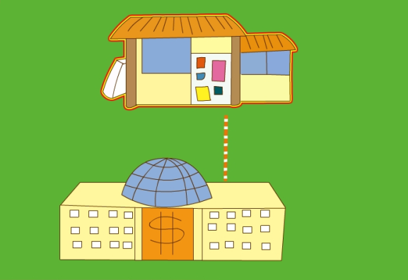
>>Presentation
Look and say
Bookshop
Bank
There is a bookshop ______ my bank.
behind

Slide 7
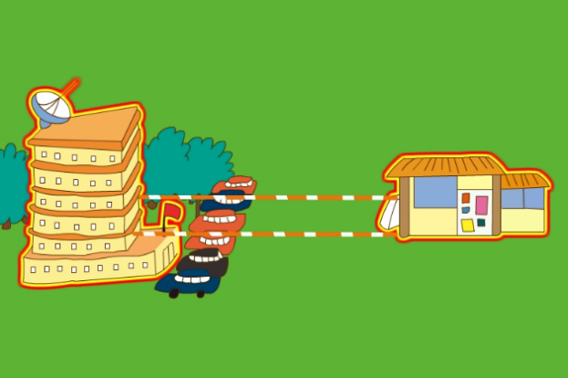
>>Presentation
Look and say
hotel
Bookshop
There is a hotel ________ the bookshop.
beside

Slide 8
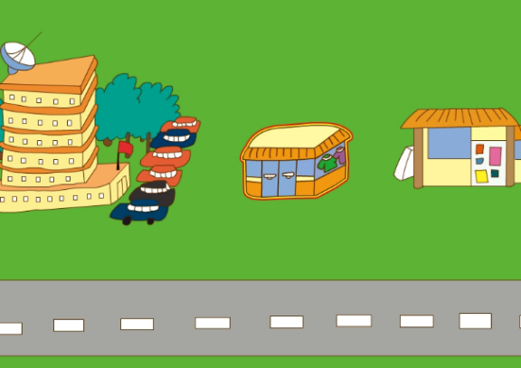
>>Presentation
Look and say
hotel
Bookshop
Clothes shop
There is a clothes shop _______ the
bookshop and hotel.
between

Slide 9
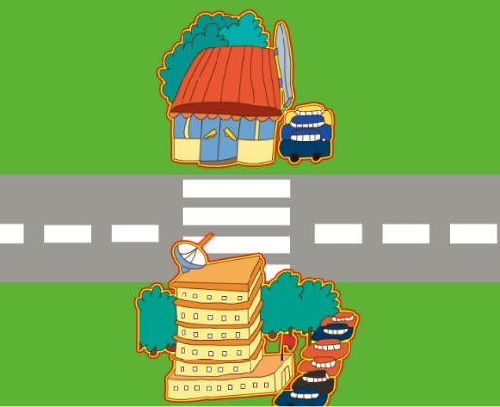
>>Presentation
Look and say
Supermarket
hotel
There is a supermarket ______ the road.
across

Slide 10
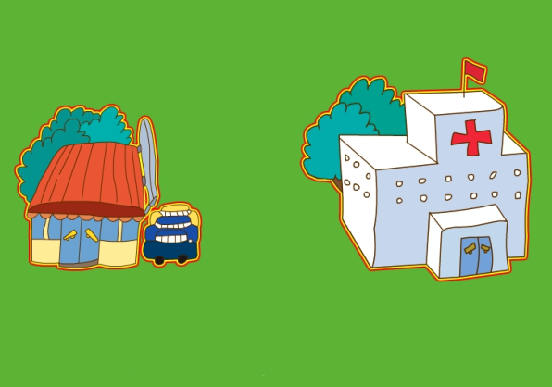
>>Presentation
Look and say
Supermarket
hospital
There is a hospital ____ the supermarket.
near

Slide 11
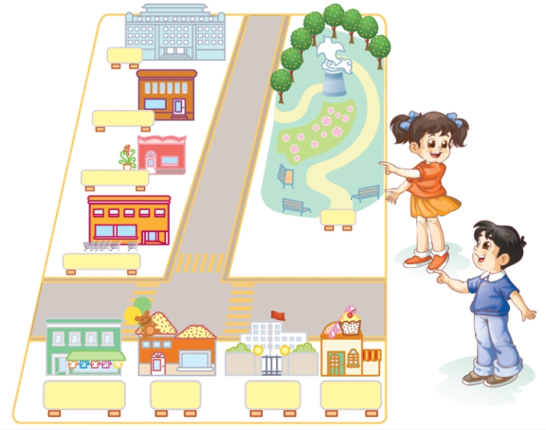
>>Practice
Let’s talk
There is a bookshop between the hotel and the flower shop.
Hotel
Bookshop
Flower shop
Yes, and there
is a supermarket
in front of the
flower shop.
Supermarket
Clothes shop
Toy shop
School
Cake shop
beside between in front of
near across behind

Slide 12
>>Practice
活动1
司机找乘客
Hotel
Bookshop
Flower shop
Supermarket
Clothes shop
Toy shop
School
Cake shop

Slide 13
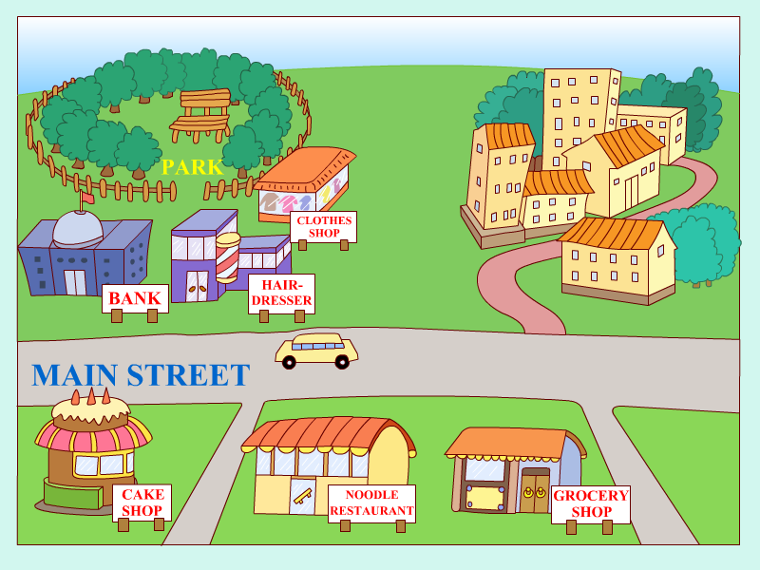
>>Practice
活动2
我是“路路通”

Slide 14
>>Practice
Let’s chant

Slide 15
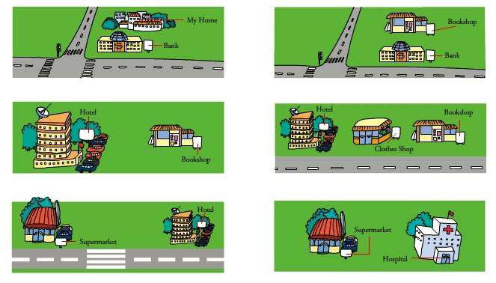
>>Summary
There is ... in front of/behind/beside/between/
across/near …

Slide 16
>>Homework
1.跟读本课音频，按照正确的语音、语调大声朗读三遍。 2.在四线三格中正确抄写本课的新单词，不少于5遍。
3.预习 Lesson 9。

